Slide 1
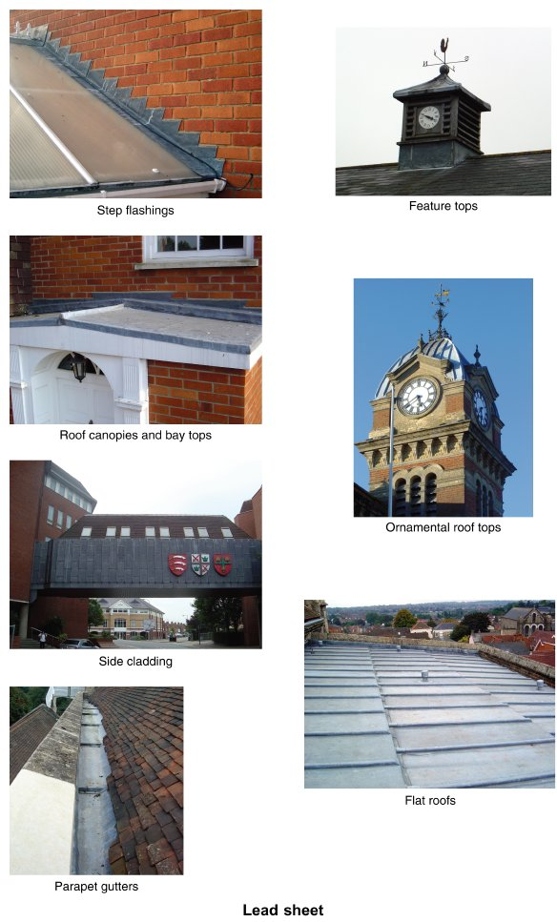
Form Plumbing, 4th Edition. R. D. Treloar. Page 349
© 2012 Blackwell Publishing Ltd. Published 2012 by Blackwell Publishing Ltd.

Slide 2
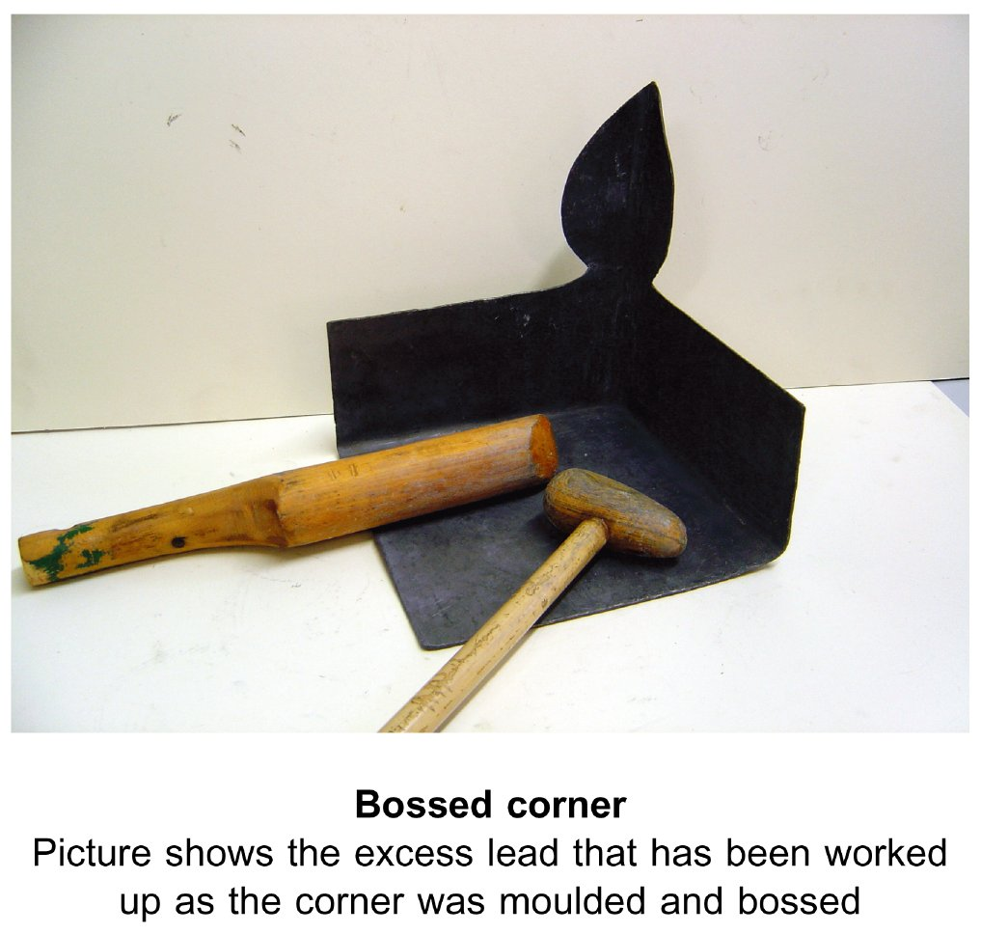
Form Plumbing, 4th Edition. R. D. Treloar. Page 350
© 2012 Blackwell Publishing Ltd. Published 2012 by Blackwell Publishing Ltd.

Slide 3
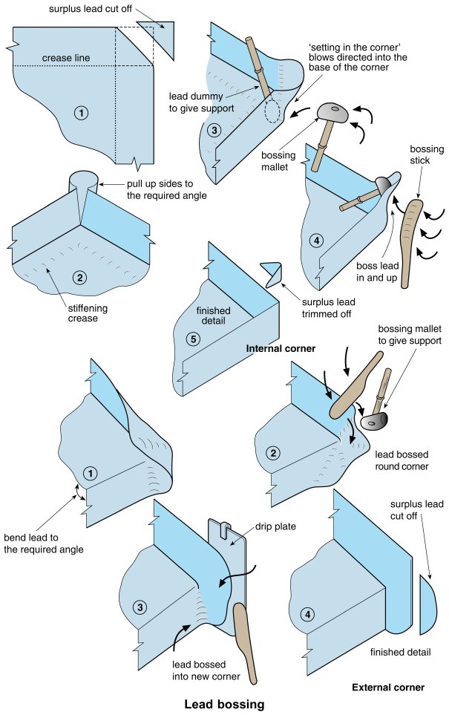
Form Plumbing, 4th Edition. R. D. Treloar. Page 351
© 2012 Blackwell Publishing Ltd. Published 2012 by Blackwell Publishing Ltd.

Slide 4
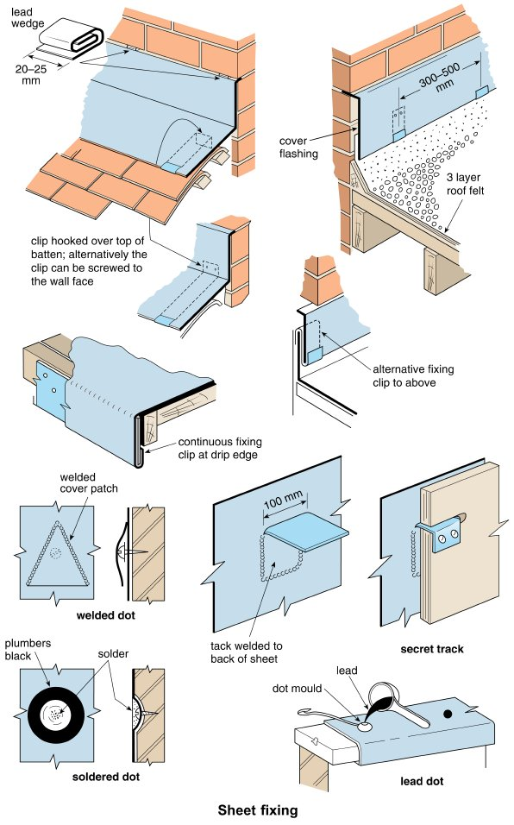
Form Plumbing, 4th Edition. R. D. Treloar. Page 353
© 2012 Blackwell Publishing Ltd. Published 2012 by Blackwell Publishing Ltd.

Slide 5
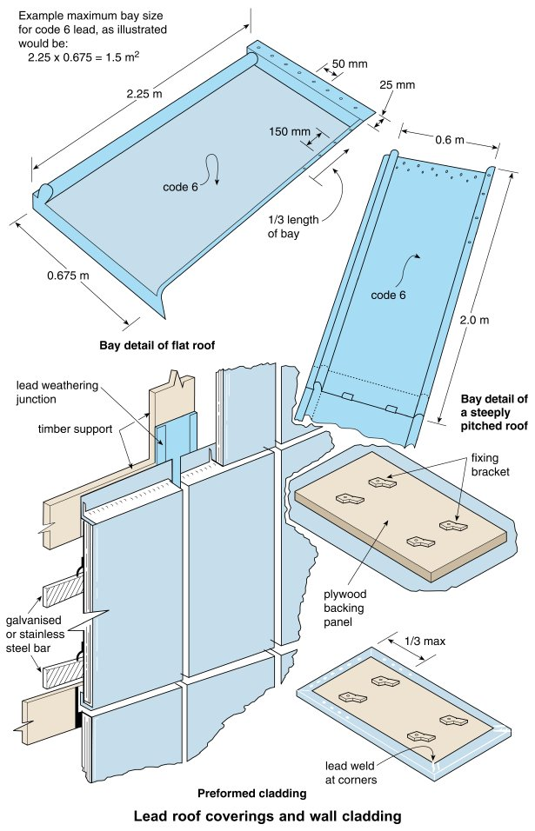
Form Plumbing, 4th Edition. R. D. Treloar. Page 355
© 2012 Blackwell Publishing Ltd. Published 2012 by Blackwell Publishing Ltd.

Slide 6
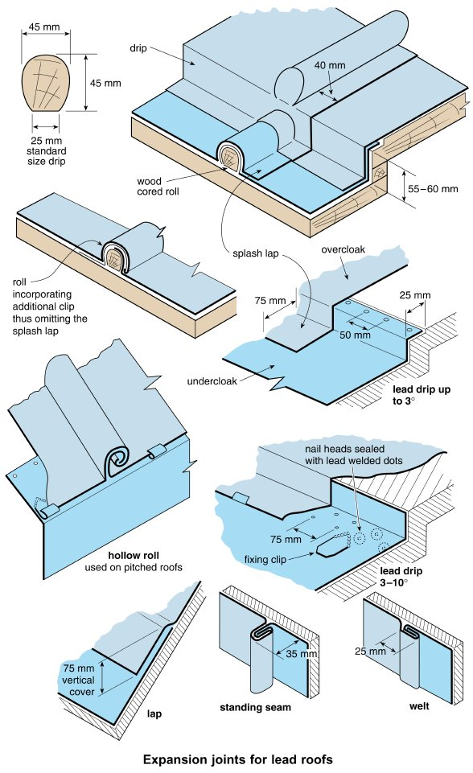
Form Plumbing, 4th Edition. R. D. Treloar. Page 357
© 2012 Blackwell Publishing Ltd. Published 2012 by Blackwell Publishing Ltd.

Slide 7
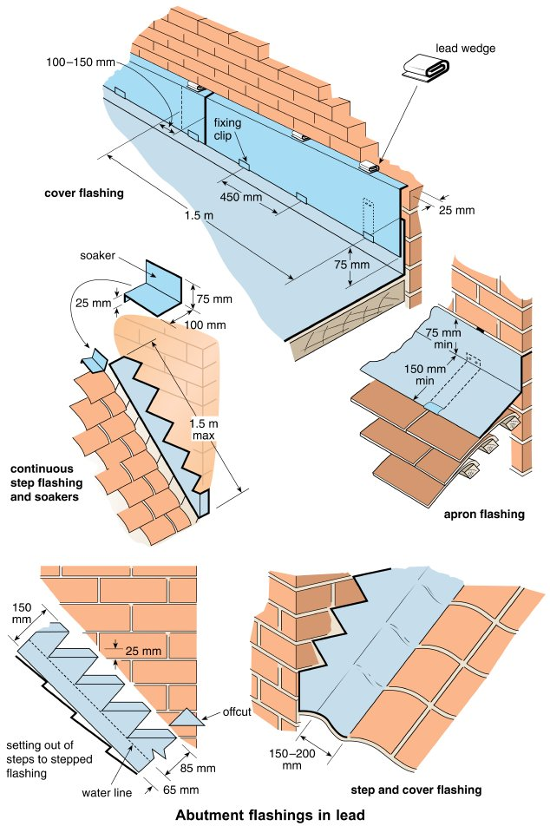
Form Plumbing, 4th Edition. R. D. Treloar. Page 359
© 2012 Blackwell Publishing Ltd. Published 2012 by Blackwell Publishing Ltd.

Slide 8
Form Plumbing, 4th Edition. R. D. Treloar. Page 360
© 2012 Blackwell Publishing Ltd. Published 2012 by Blackwell Publishing Ltd.

Slide 9
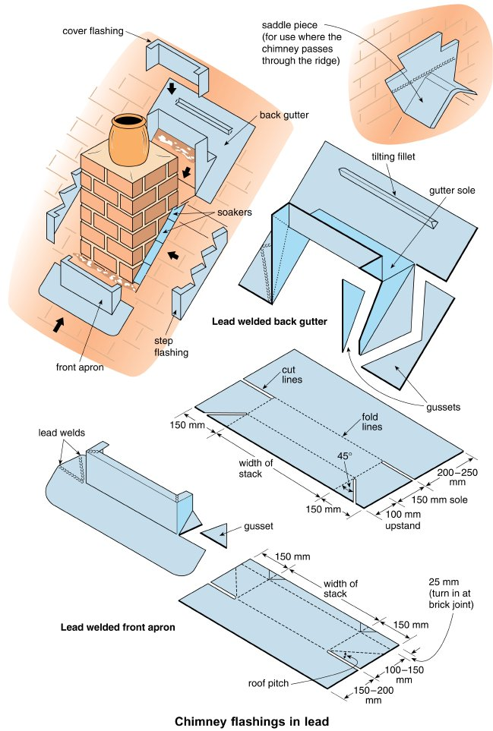
Form Plumbing, 4th Edition. R. D. Treloar. Page 361
© 2012 Blackwell Publishing Ltd. Published 2012 by Blackwell Publishing Ltd.

Slide 10
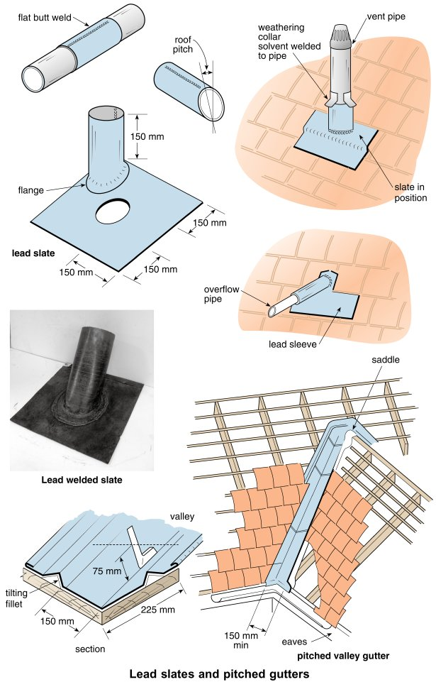
Form Plumbing, 4th Edition. R. D. Treloar. Page 363
© 2012 Blackwell Publishing Ltd. Published 2012 by Blackwell Publishing Ltd.

Slide 11
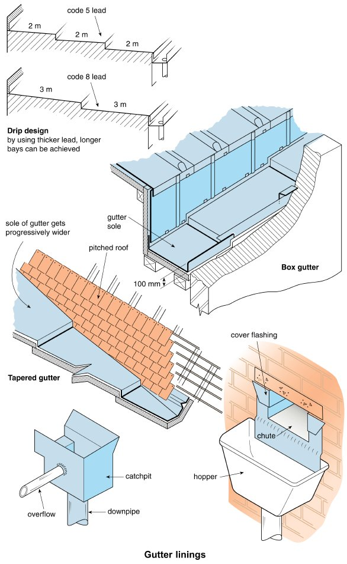
Form Plumbing, 4th Edition. R. D. Treloar. Page 365
© 2012 Blackwell Publishing Ltd. Published 2012 by Blackwell Publishing Ltd.

Slide 12
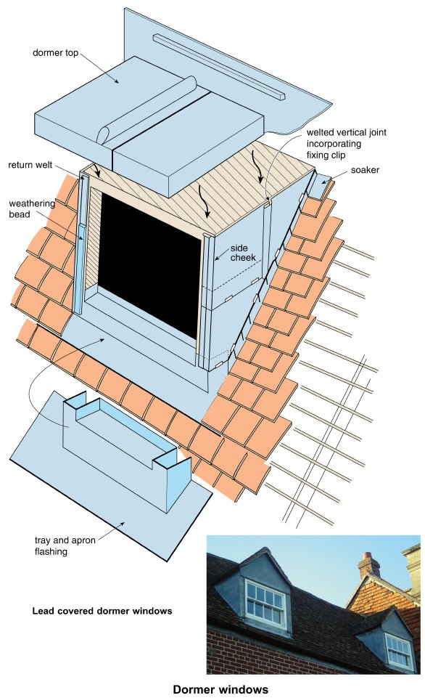
Form Plumbing, 4th Edition. R. D. Treloar. Page 367
© 2012 Blackwell Publishing Ltd. Published 2012 by Blackwell Publishing Ltd.

