Slide 1
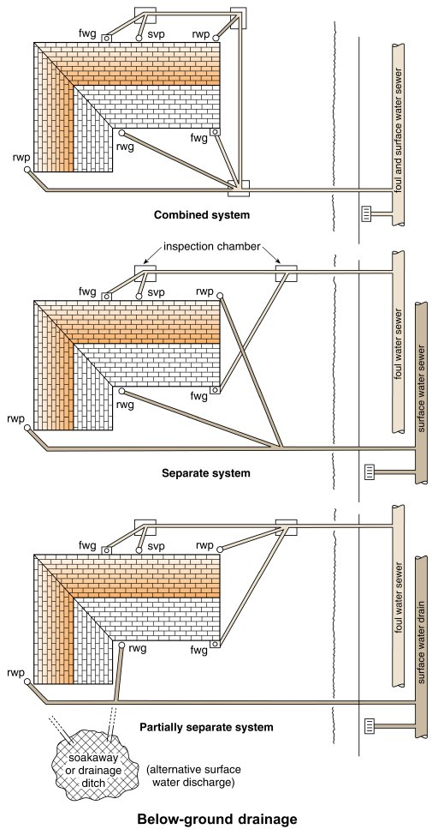
Form Plumbing, 4th Edition. R. D. Treloar. Page 325
© 2012 Blackwell Publishing Ltd. Published 2012 by Blackwell Publishing Ltd.

Slide 2
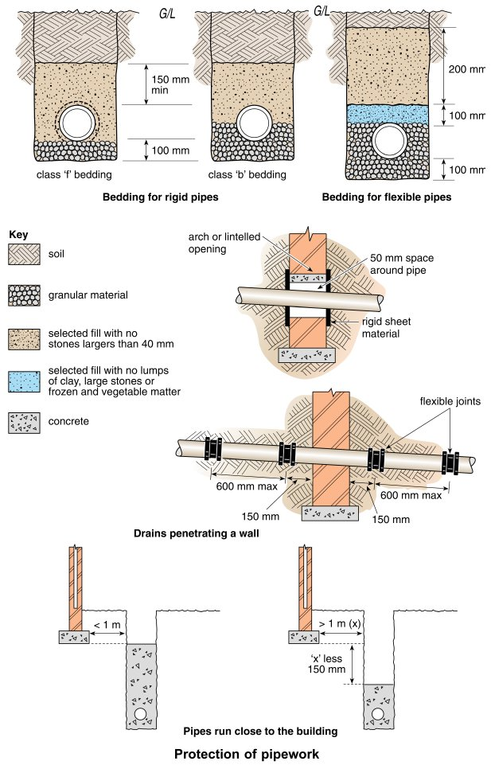
Form Plumbing, 4th Edition. R. D. Treloar. Page 327
© 2012 Blackwell Publishing Ltd. Published 2012 by Blackwell Publishing Ltd.

Slide 3
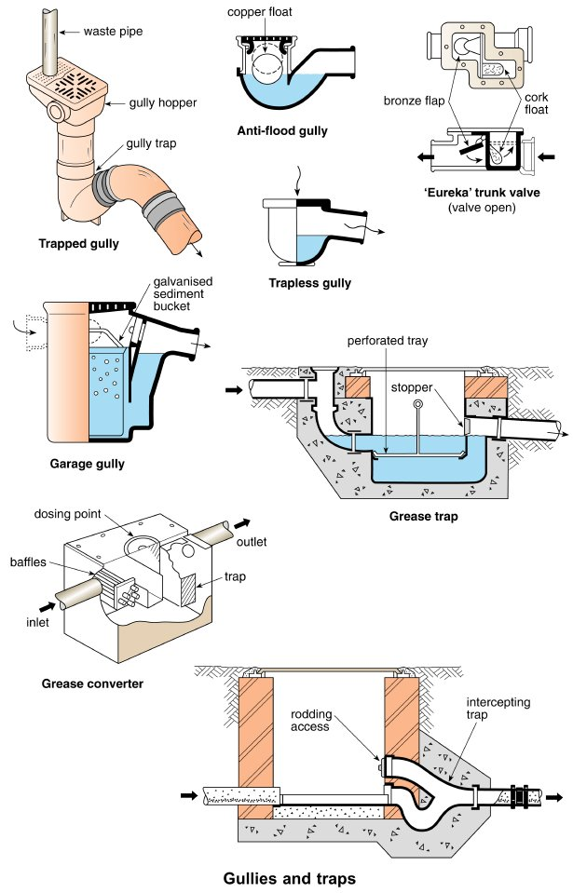
Form Plumbing, 4th Edition. R. D. Treloar. Page 329
© 2012 Blackwell Publishing Ltd. Published 2012 by Blackwell Publishing Ltd.

Slide 4
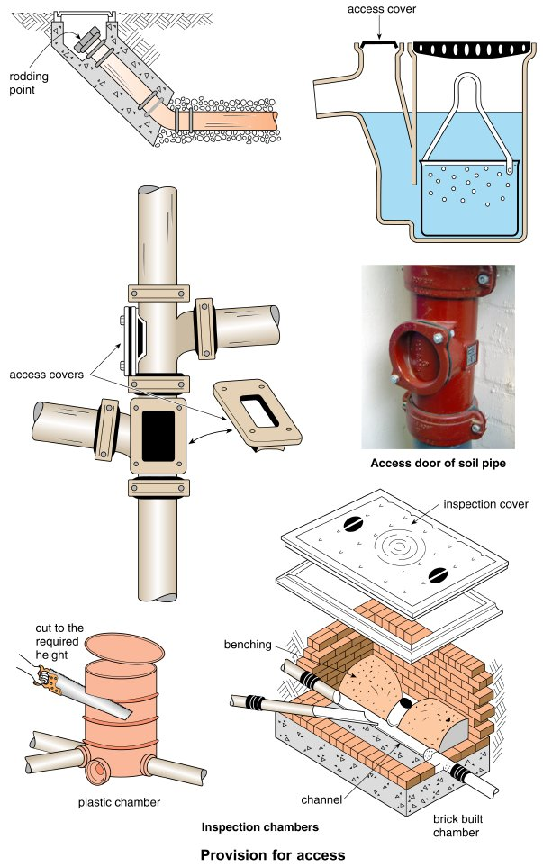
Form Plumbing, 4th Edition. R. D. Treloar. Page 331
© 2012 Blackwell Publishing Ltd. Published 2012 by Blackwell Publishing Ltd.

Slide 5
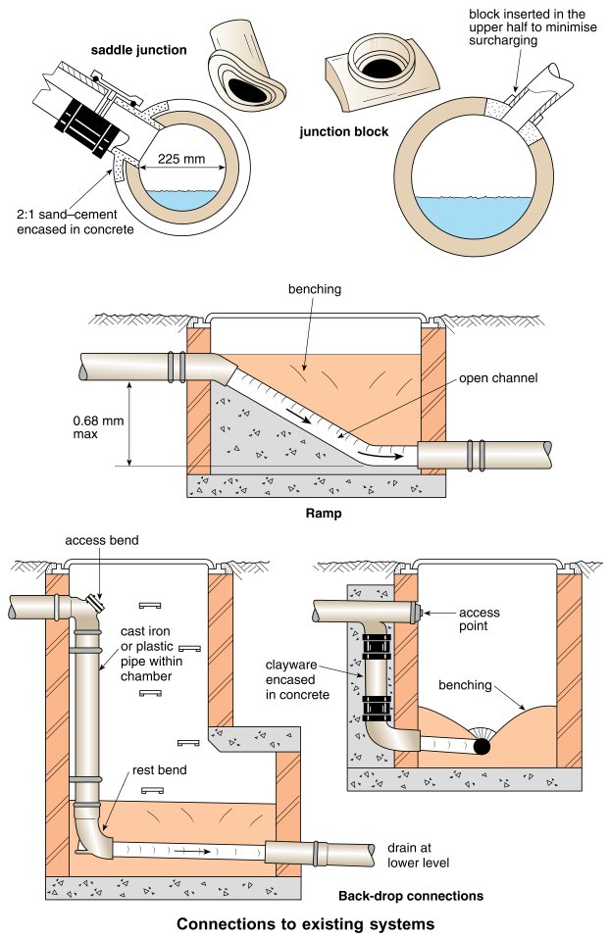
Form Plumbing, 4th Edition. R. D. Treloar. Page 333
© 2012 Blackwell Publishing Ltd. Published 2012 by Blackwell Publishing Ltd.

Slide 6
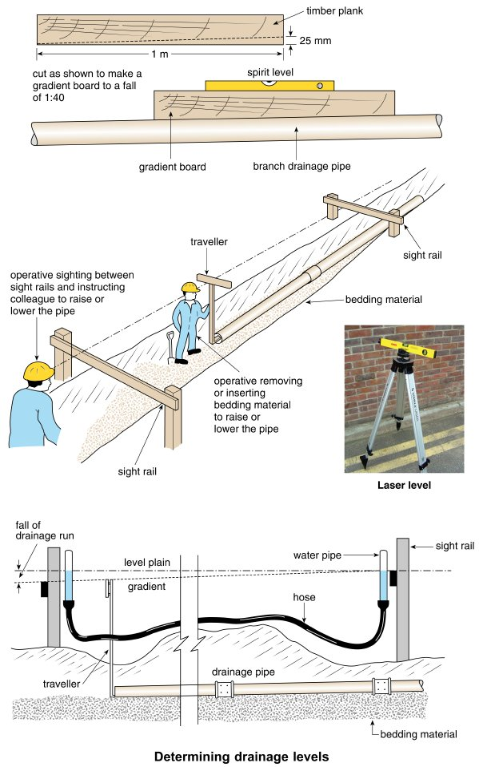
Form Plumbing, 4th Edition. R. D. Treloar. Page 335
© 2012 Blackwell Publishing Ltd. Published 2012 by Blackwell Publishing Ltd.

Slide 7
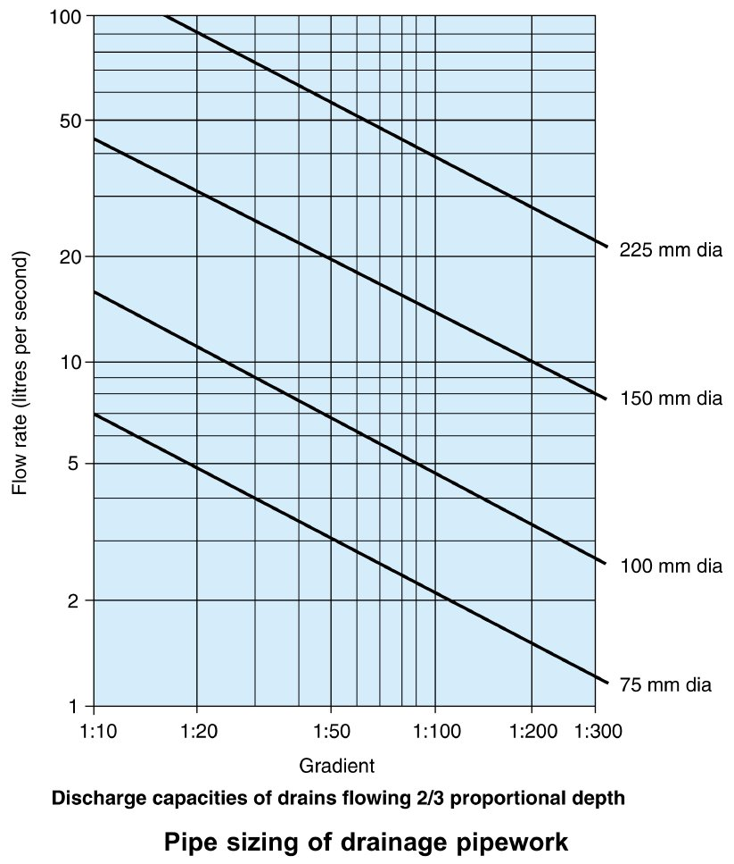
Form Plumbing, 4th Edition. R. D. Treloar. Page 337
© 2012 Blackwell Publishing Ltd. Published 2012 by Blackwell Publishing Ltd.

Slide 8
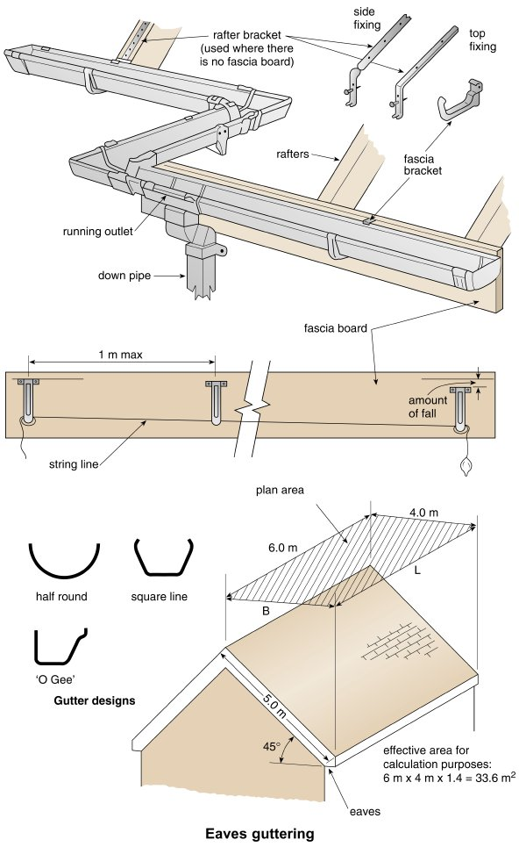
Form Plumbing, 4th Edition. R. D. Treloar. Page 339
© 2012 Blackwell Publishing Ltd. Published 2012 by Blackwell Publishing Ltd.

Slide 9
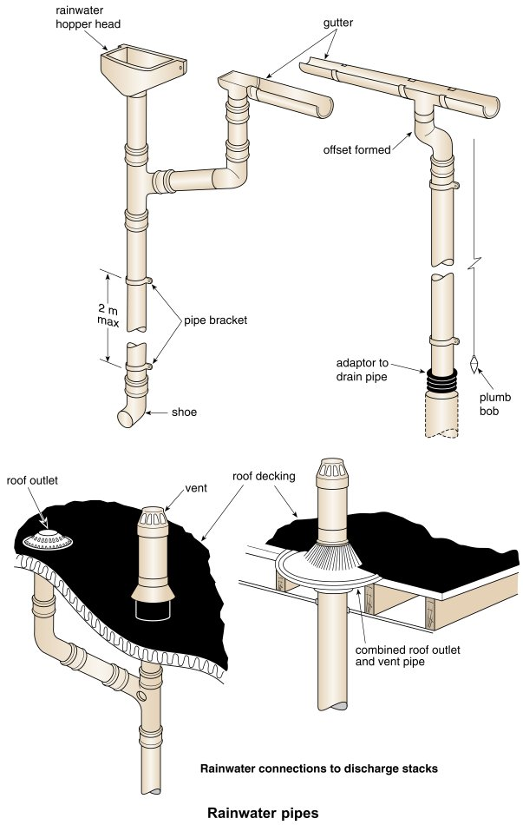
Form Plumbing, 4th Edition. R. D. Treloar. Page 341
© 2012 Blackwell Publishing Ltd. Published 2012 by Blackwell Publishing Ltd.

Slide 10
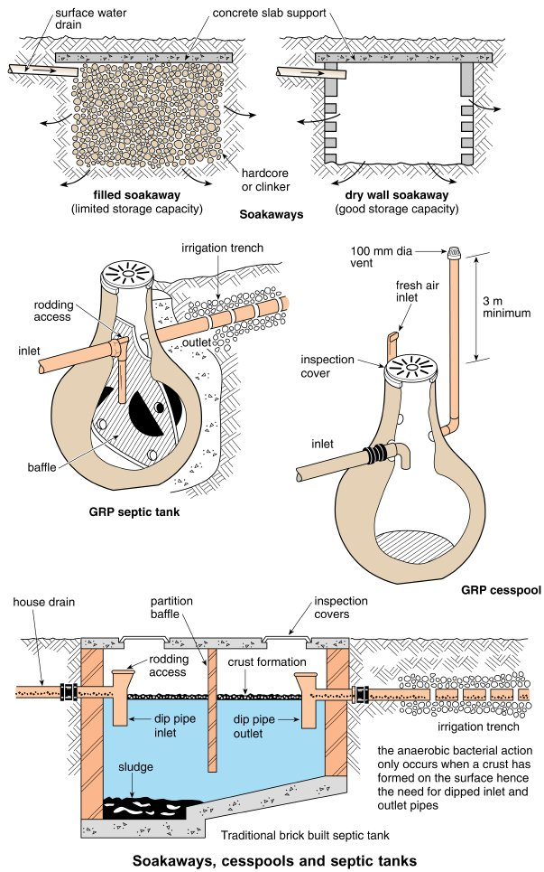
Form Plumbing, 4th Edition. R. D. Treloar. Page 343
© 2012 Blackwell Publishing Ltd. Published 2012 by Blackwell Publishing Ltd.

Slide 11
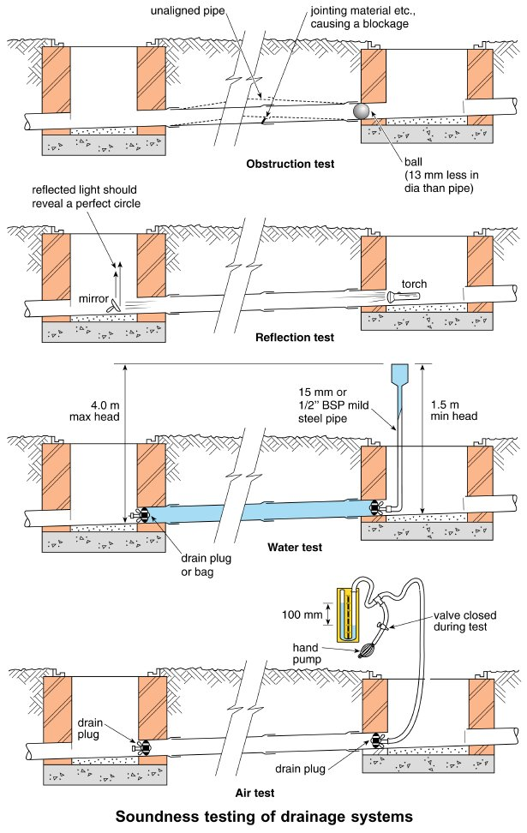
Form Plumbing, 4th Edition. R. D. Treloar. Page 345
© 2012 Blackwell Publishing Ltd. Published 2012 by Blackwell Publishing Ltd.

