Slide 1

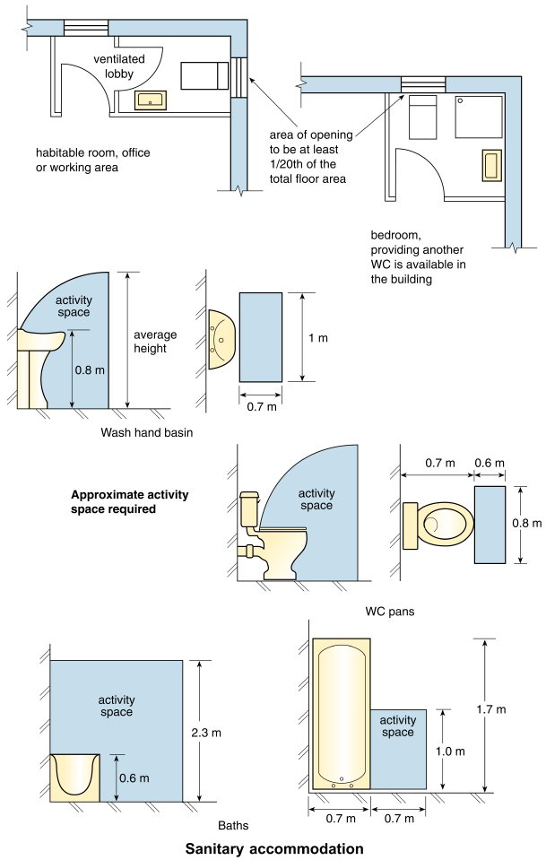
Form Plumbing, 4th Edition. R. D. Treloar. Page 295
© 2012 Blackwell Publishing Ltd. Published 2012 by Blackwell Publishing Ltd.

Slide 2
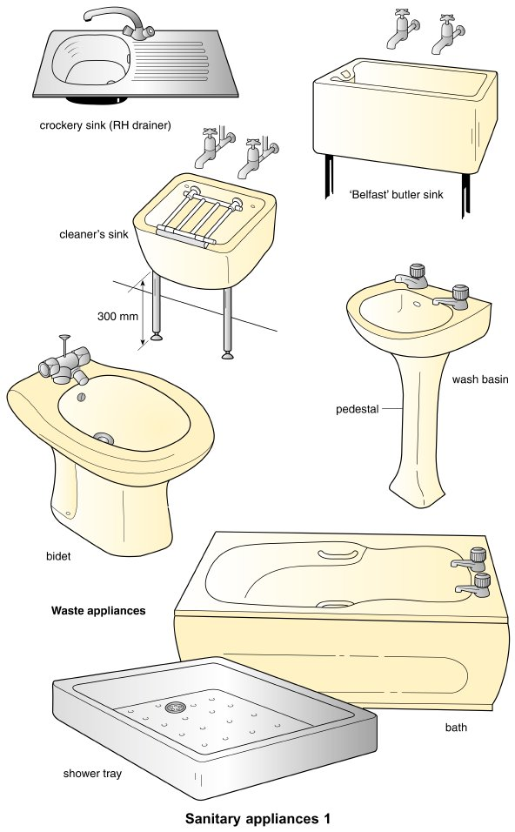
Form Plumbing, 4th Edition. R. D. Treloar. Page 297
© 2012 Blackwell Publishing Ltd. Published 2012 by Blackwell Publishing Ltd.

Slide 3
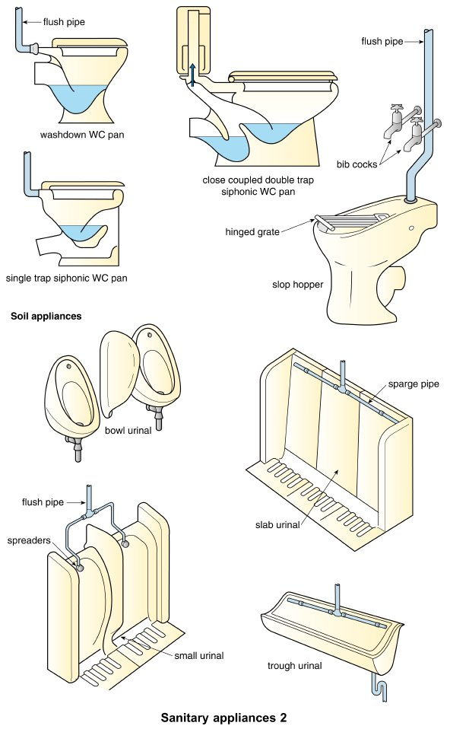
Form Plumbing, 4th Edition. R. D. Treloar. Page 299
© 2012 Blackwell Publishing Ltd. Published 2012 by Blackwell Publishing Ltd.

Slide 4
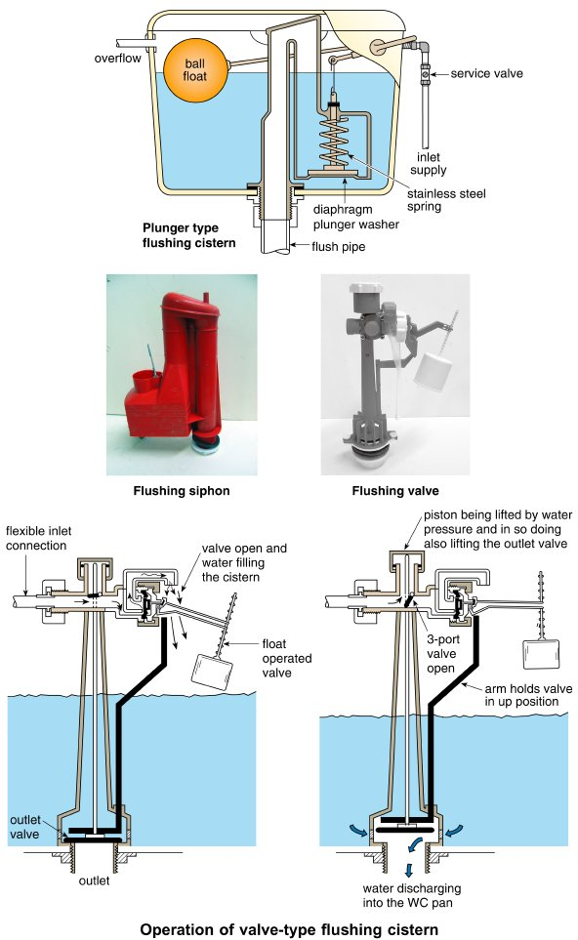
Form Plumbing, 4th Edition. R. D. Treloar. Page 301
© 2012 Blackwell Publishing Ltd. Published 2012 by Blackwell Publishing Ltd.

Slide 5
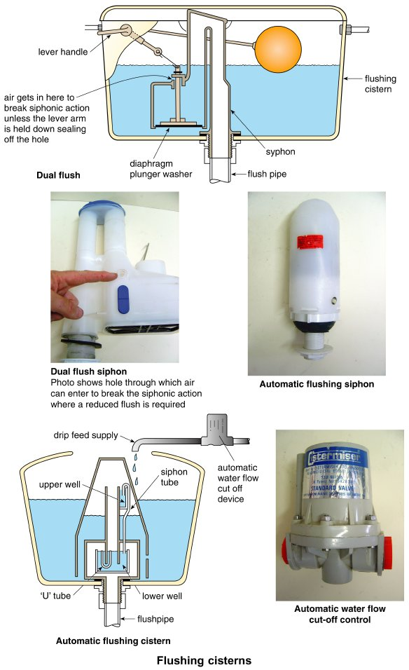
Form Plumbing, 4th Edition. R. D. Treloar. Page 303
© 2012 Blackwell Publishing Ltd. Published 2012 by Blackwell Publishing Ltd.

Slide 6
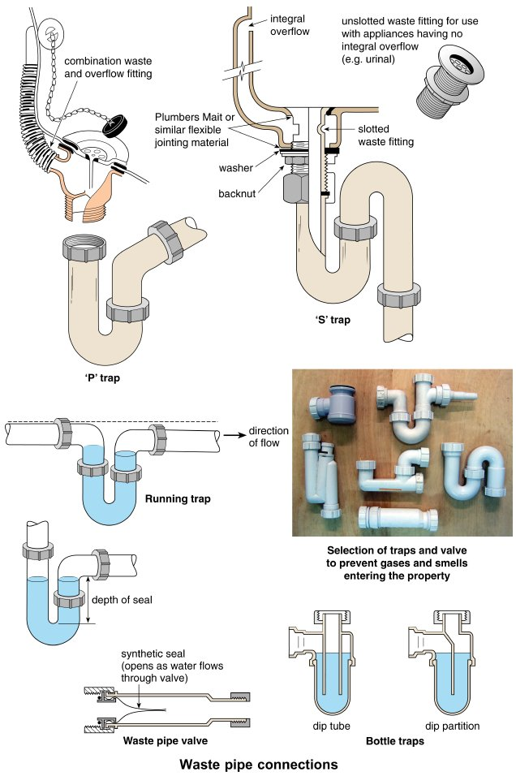
Form Plumbing, 4th Edition. R. D. Treloar. Page 305
© 2012 Blackwell Publishing Ltd. Published 2012 by Blackwell Publishing Ltd.

Slide 7
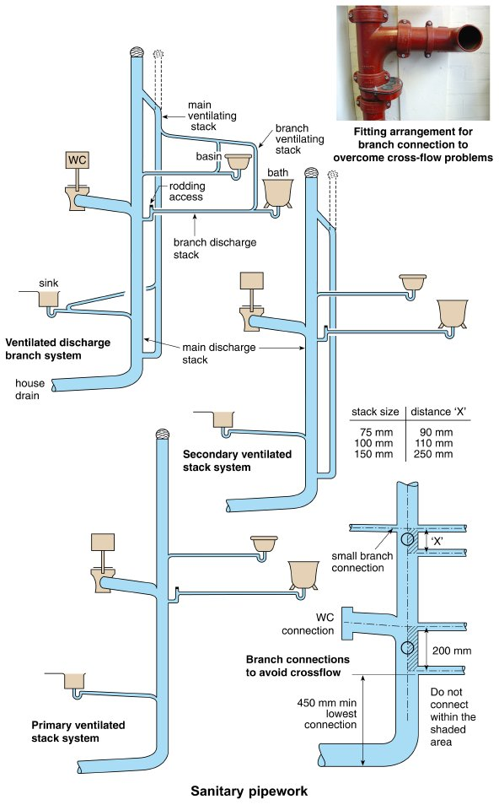
Form Plumbing, 4th Edition. R. D. Treloar. Page 307
© 2012 Blackwell Publishing Ltd. Published 2012 by Blackwell Publishing Ltd.

Slide 8
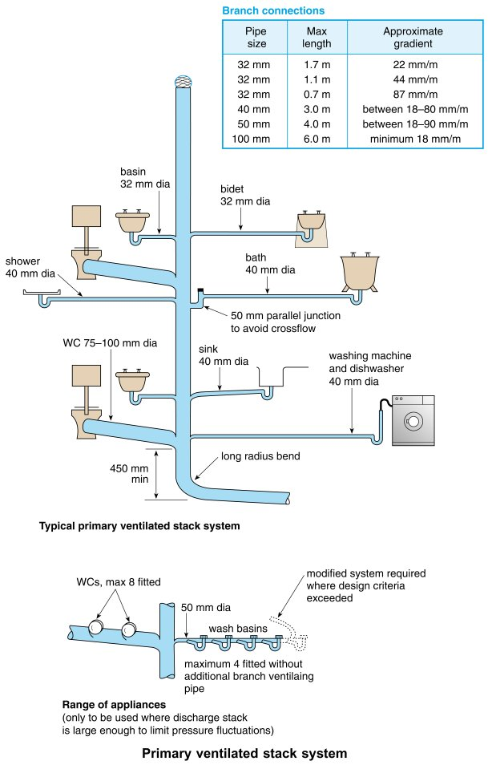
Form Plumbing, 4th Edition. R. D. Treloar. Page 309
© 2012 Blackwell Publishing Ltd. Published 2012 by Blackwell Publishing Ltd.

Slide 9
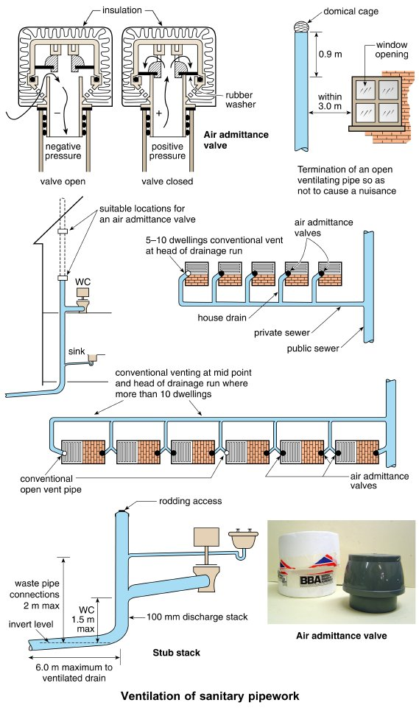
Form Plumbing, 4th Edition. R. D. Treloar. Page 311
© 2012 Blackwell Publishing Ltd. Published 2012 by Blackwell Publishing Ltd.

Slide 10
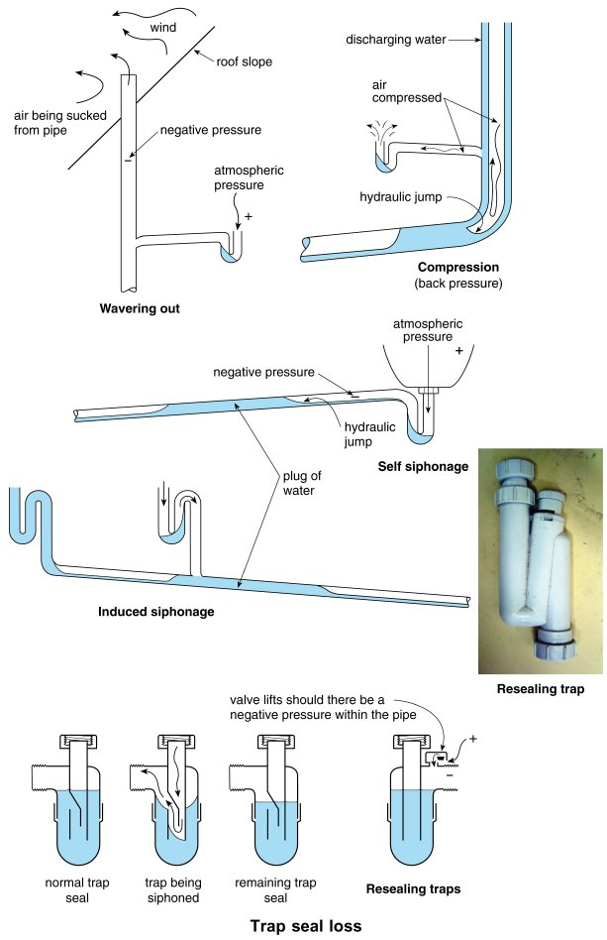
Form Plumbing, 4th Edition. R. D. Treloar. Page 313
© 2012 Blackwell Publishing Ltd. Published 2012 by Blackwell Publishing Ltd.

Slide 11
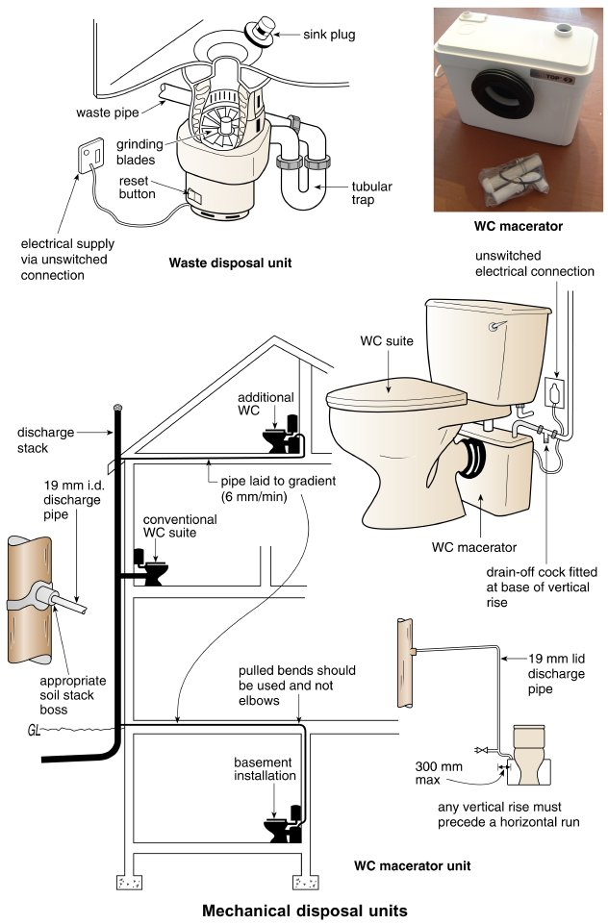
Form Plumbing, 4th Edition. R. D. Treloar. Page 315
© 2012 Blackwell Publishing Ltd. Published 2012 by Blackwell Publishing Ltd.

Slide 12
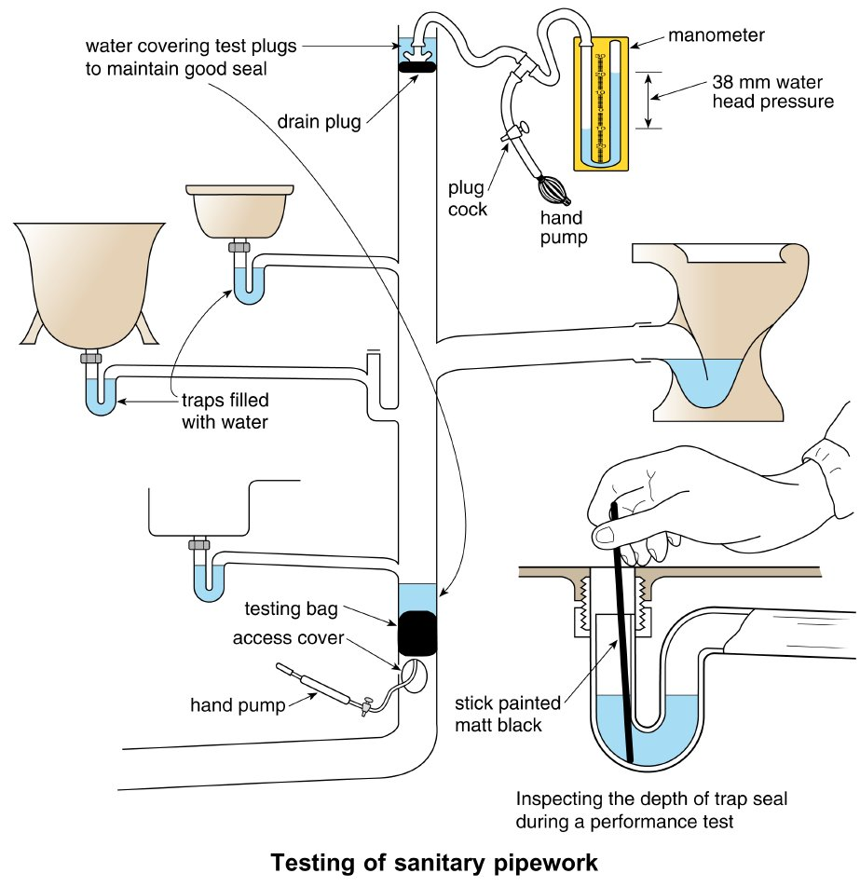
Form Plumbing, 4th Edition. R. D. Treloar. Page 319
© 2012 Blackwell Publishing Ltd. Published 2012 by Blackwell Publishing Ltd.

Slide 13
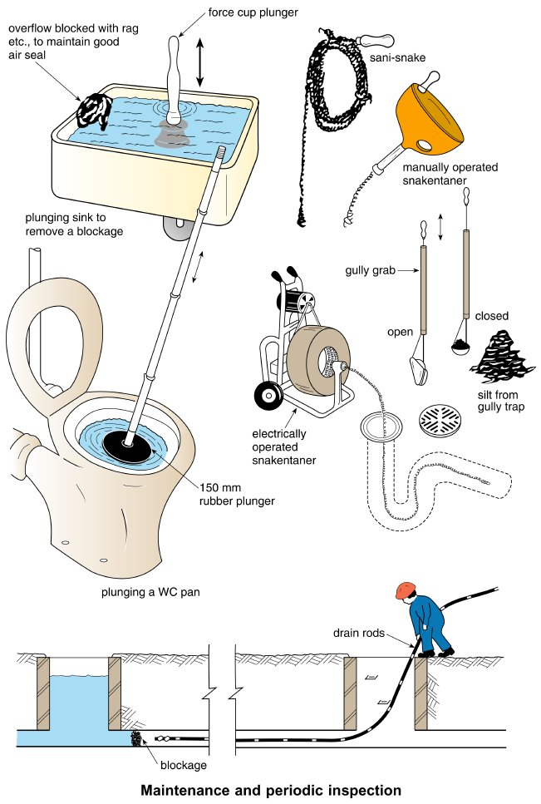
Form Plumbing, 4th Edition. R. D. Treloar. Page 321
© 2012 Blackwell Publishing Ltd. Published 2012 by Blackwell Publishing Ltd.

