Slide 1
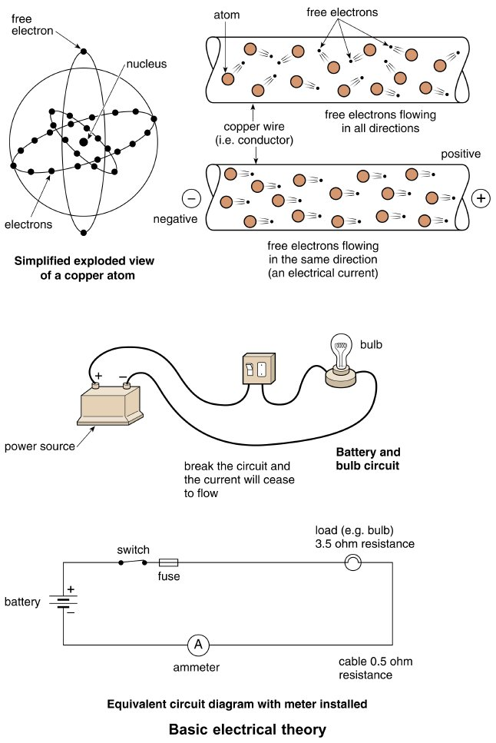
Form Plumbing, 4th Edition. R. D. Treloar. Page 269
© 2012 Blackwell Publishing Ltd. Published 2012 by Blackwell Publishing Ltd.

Slide 2
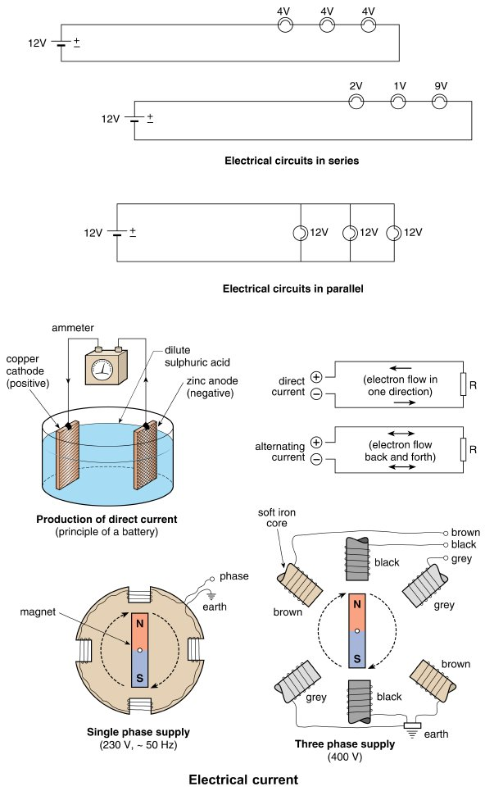
Form Plumbing, 4th Edition. R. D. Treloar. Page 271
© 2012 Blackwell Publishing Ltd. Published 2012 by Blackwell Publishing Ltd.

Slide 3
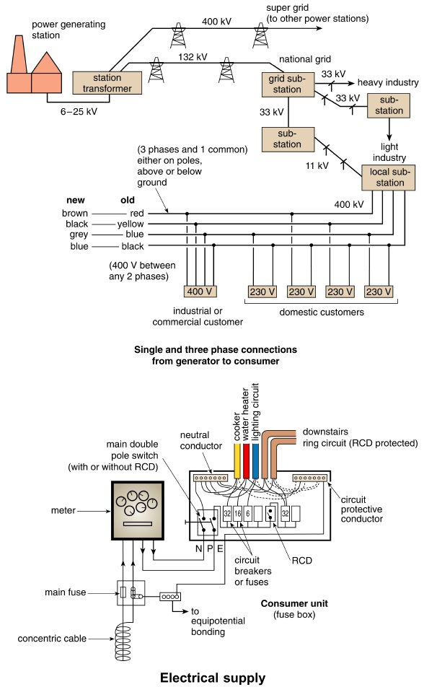
Form Plumbing, 4th Edition. R. D. Treloar. Page 273
© 2012 Blackwell Publishing Ltd. Published 2012 by Blackwell Publishing Ltd.

Slide 4
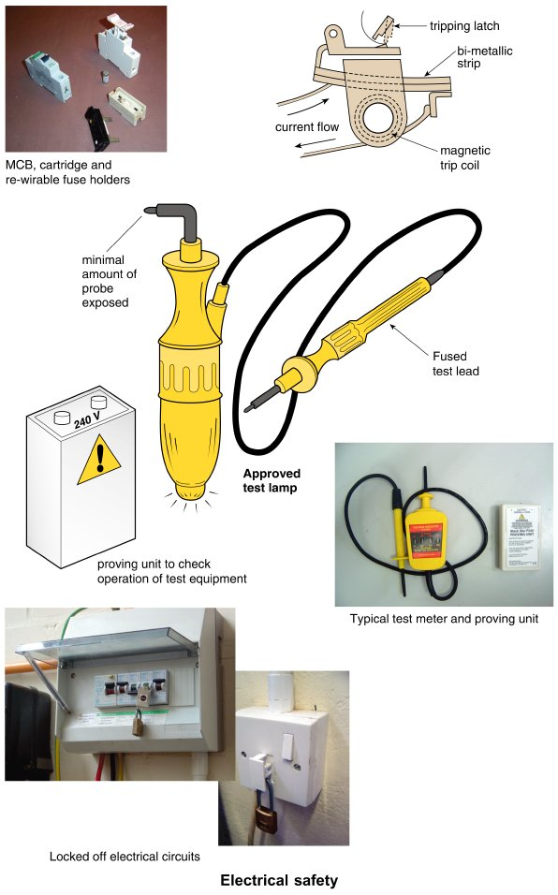
Form Plumbing, 4th Edition. R. D. Treloar. Page 275
© 2012 Blackwell Publishing Ltd. Published 2012 by Blackwell Publishing Ltd.

Slide 5
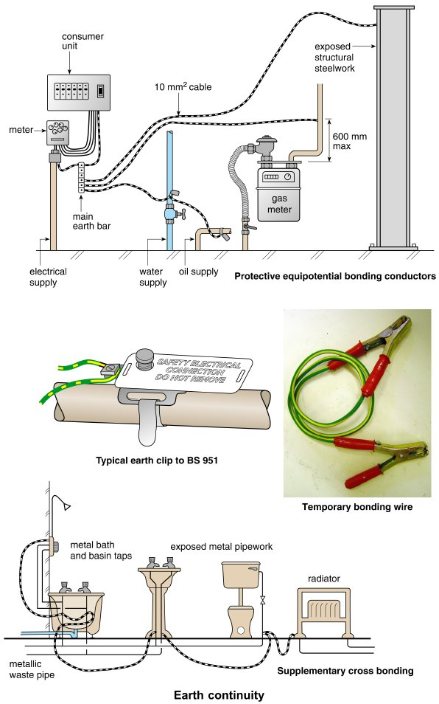
Form Plumbing, 4th Edition. R. D. Treloar. Page 277
© 2012 Blackwell Publishing Ltd. Published 2012 by Blackwell Publishing Ltd.

Slide 6
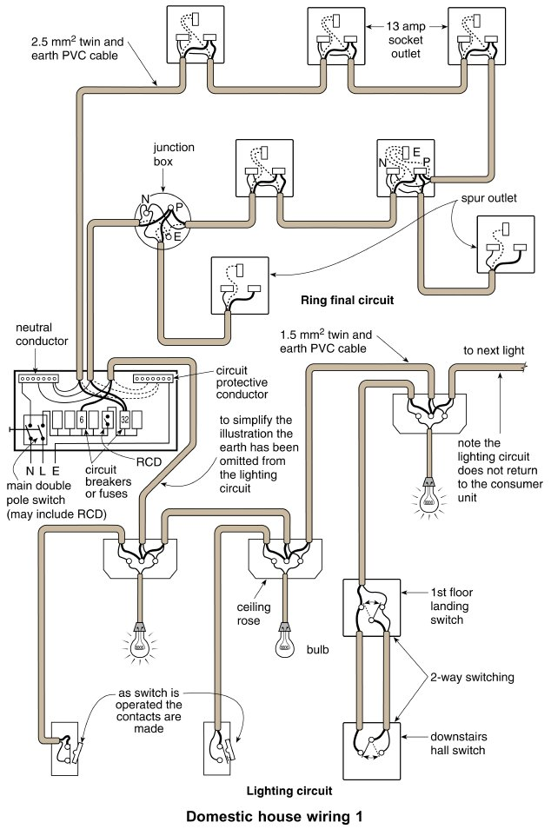
Form Plumbing, 4th Edition. R. D. Treloar. Page 279
© 2012 Blackwell Publishing Ltd. Published 2012 by Blackwell Publishing Ltd.

Slide 7
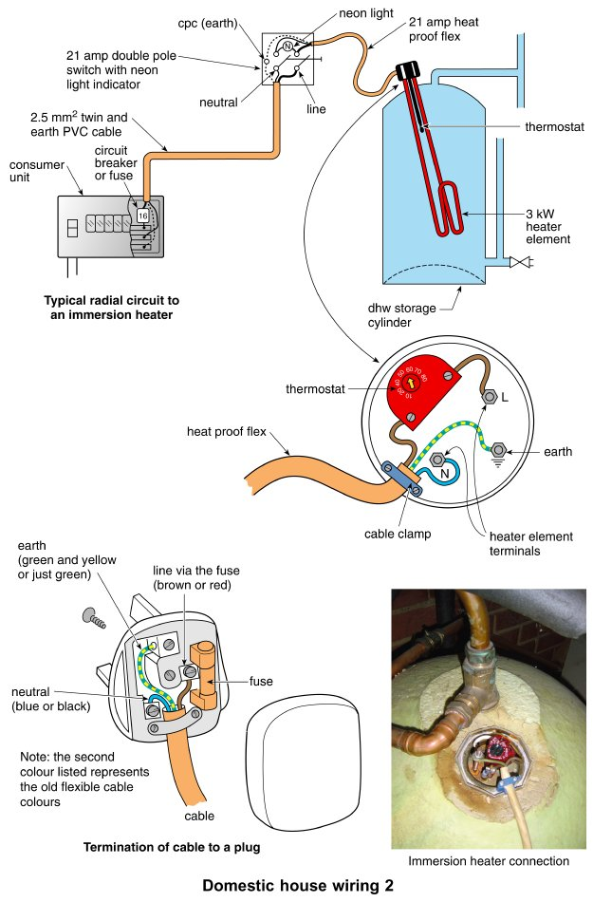
Form Plumbing, 4th Edition. R. D. Treloar. Page 281
© 2012 Blackwell Publishing Ltd. Published 2012 by Blackwell Publishing Ltd.

Slide 8
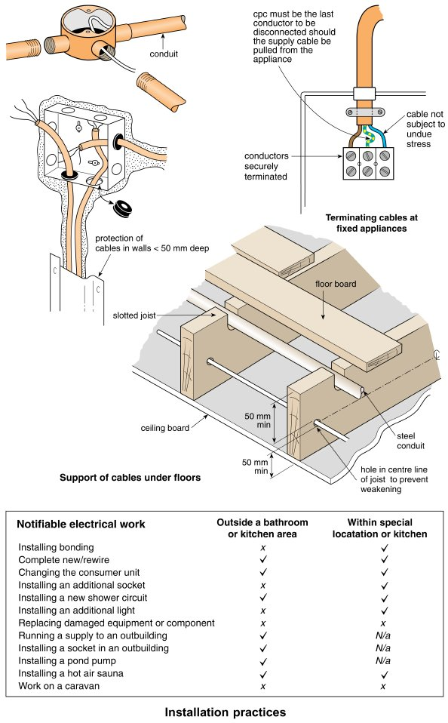
Form Plumbing, 4th Edition. R. D. Treloar. Page 283
© 2012 Blackwell Publishing Ltd. Published 2012 by Blackwell Publishing Ltd.

Slide 9
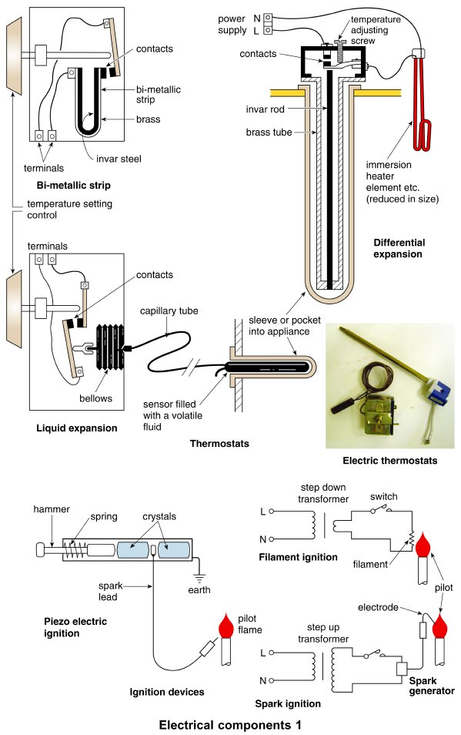
Form Plumbing, 4th Edition. R. D. Treloar. Page 285
© 2012 Blackwell Publishing Ltd. Published 2012 by Blackwell Publishing Ltd.

Slide 10
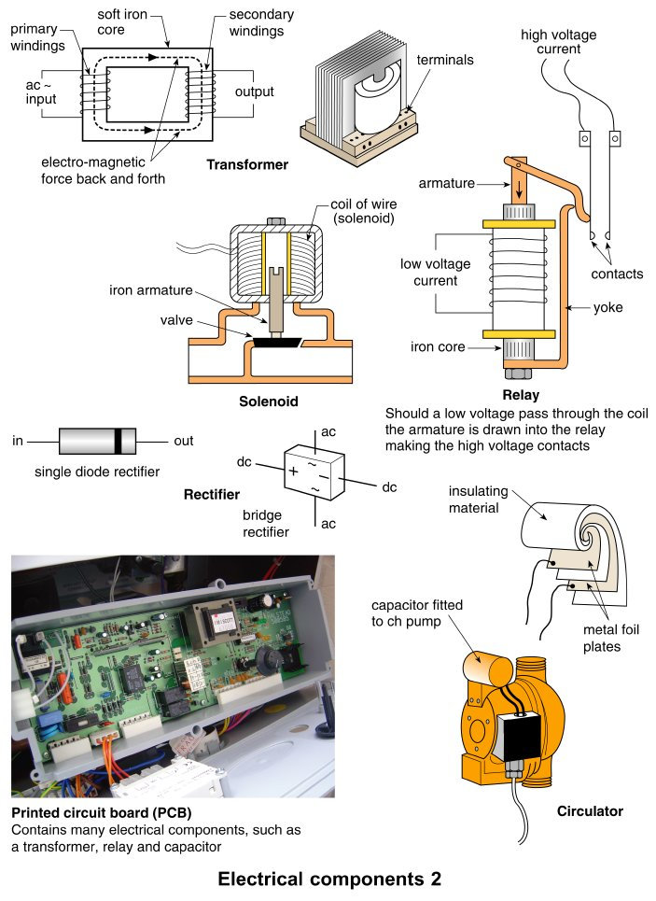
Form Plumbing, 4th Edition. R. D. Treloar. Page 287
© 2012 Blackwell Publishing Ltd. Published 2012 by Blackwell Publishing Ltd.

Slide 11
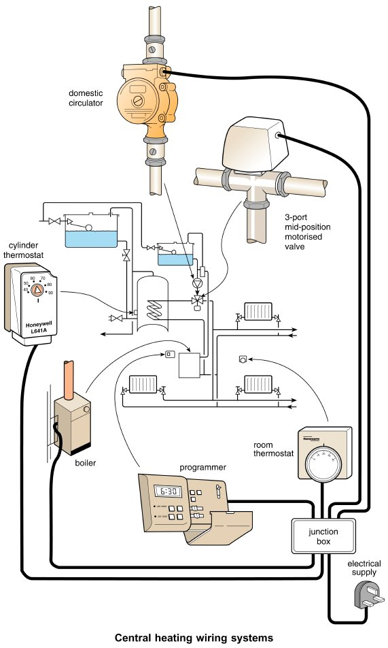
Form Plumbing, 4th Edition. R. D. Treloar. Page 289
© 2012 Blackwell Publishing Ltd. Published 2012 by Blackwell Publishing Ltd.

Slide 12
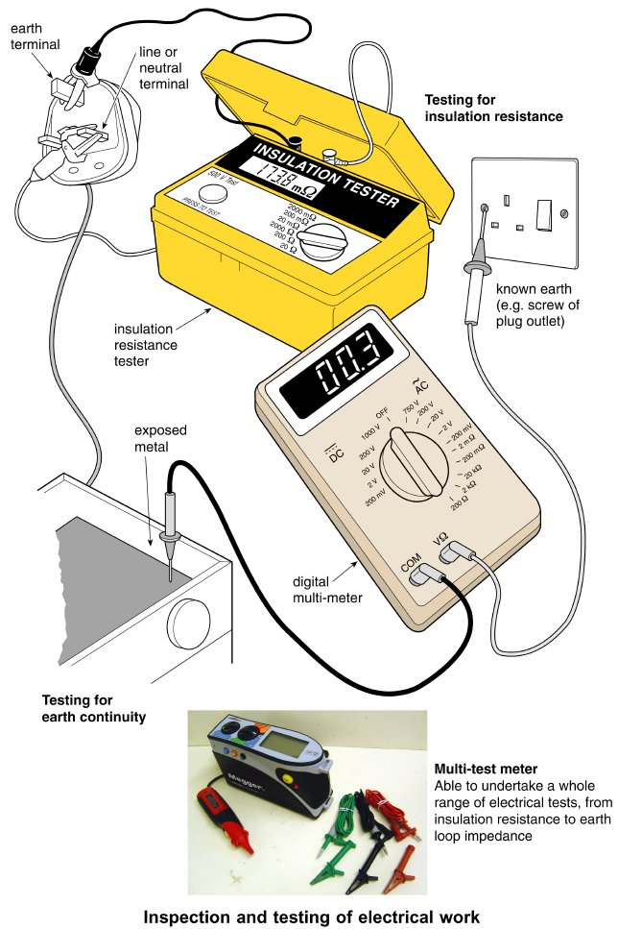
Form Plumbing, 4th Edition. R. D. Treloar. Page 291
© 2012 Blackwell Publishing Ltd. Published 2012 by Blackwell Publishing Ltd.

