Slide 1
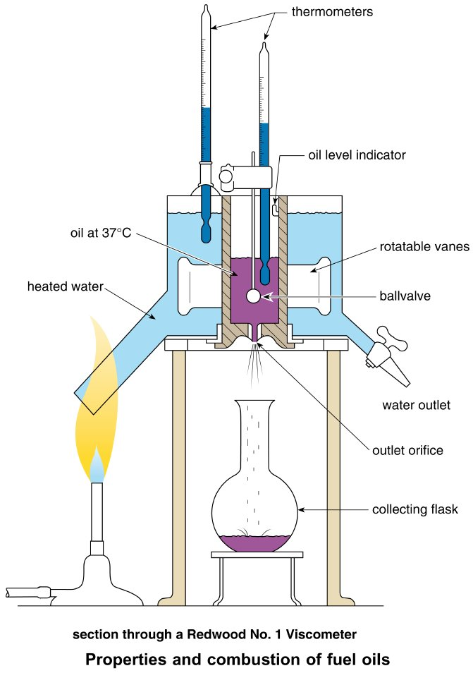
Form Plumbing, 4th Edition. R. D. Treloar. Page 243
© 2012 Blackwell Publishing Ltd. Published 2012 by Blackwell Publishing Ltd.

Slide 2
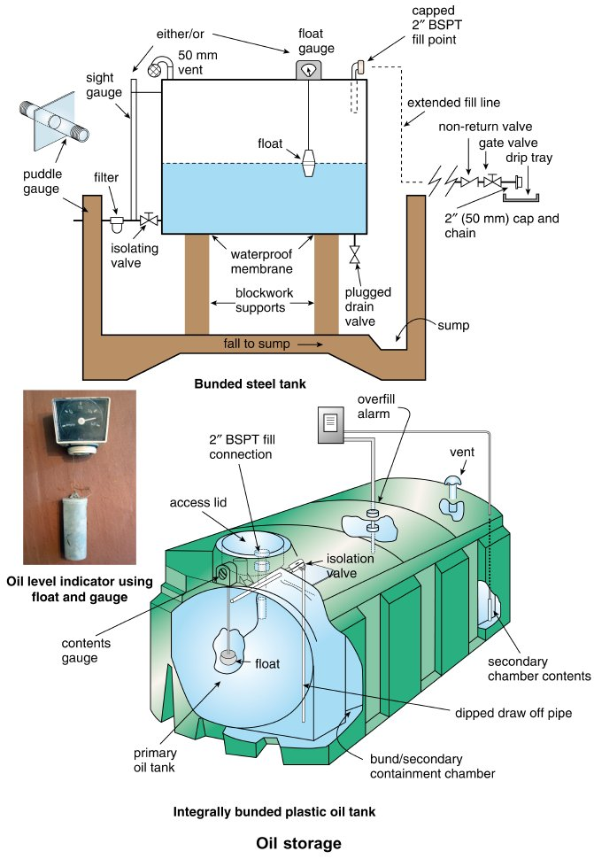
Form Plumbing, 4th Edition. R. D. Treloar. Page 245
© 2012 Blackwell Publishing Ltd. Published 2012 by Blackwell Publishing Ltd.

Slide 3
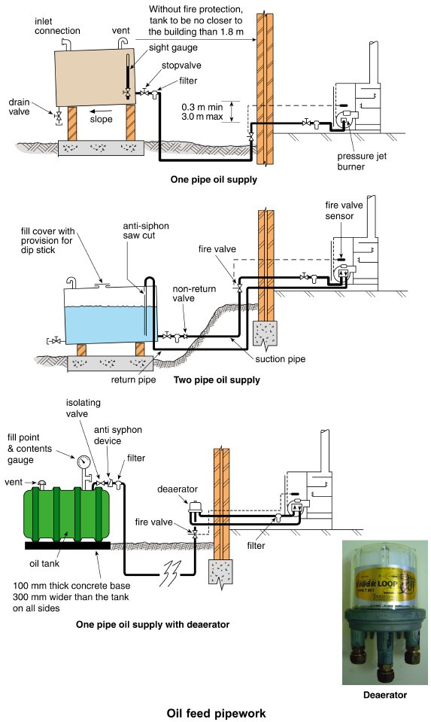
Form Plumbing, 4th Edition. R. D. Treloar. Page 247
© 2012 Blackwell Publishing Ltd. Published 2012 by Blackwell Publishing Ltd.

Slide 4
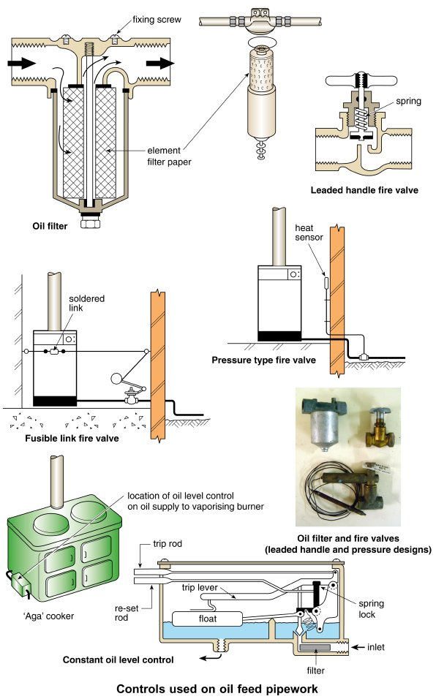
Form Plumbing, 4th Edition. R. D. Treloar. Page 249
© 2012 Blackwell Publishing Ltd. Published 2012 by Blackwell Publishing Ltd.

Slide 5
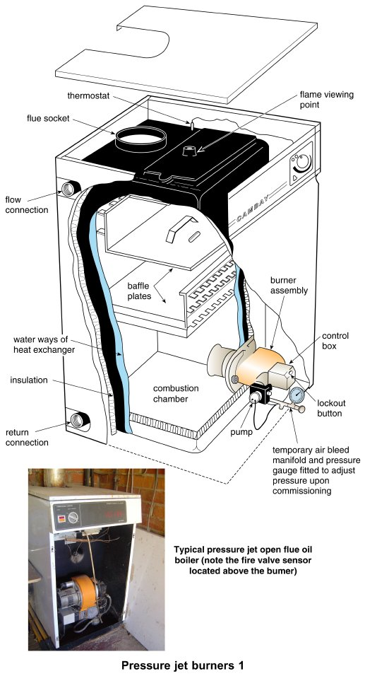
Form Plumbing, 4th Edition. R. D. Treloar. Page 251
© 2012 Blackwell Publishing Ltd. Published 2012 by Blackwell Publishing Ltd.

Slide 6
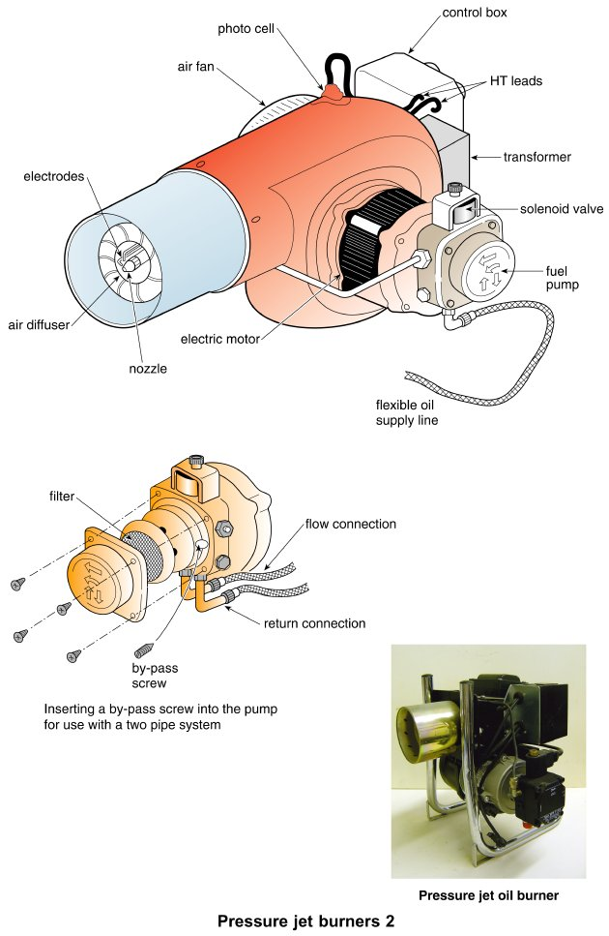
Form Plumbing, 4th Edition. R. D. Treloar. Page 253
© 2012 Blackwell Publishing Ltd. Published 2012 by Blackwell Publishing Ltd.

Slide 7
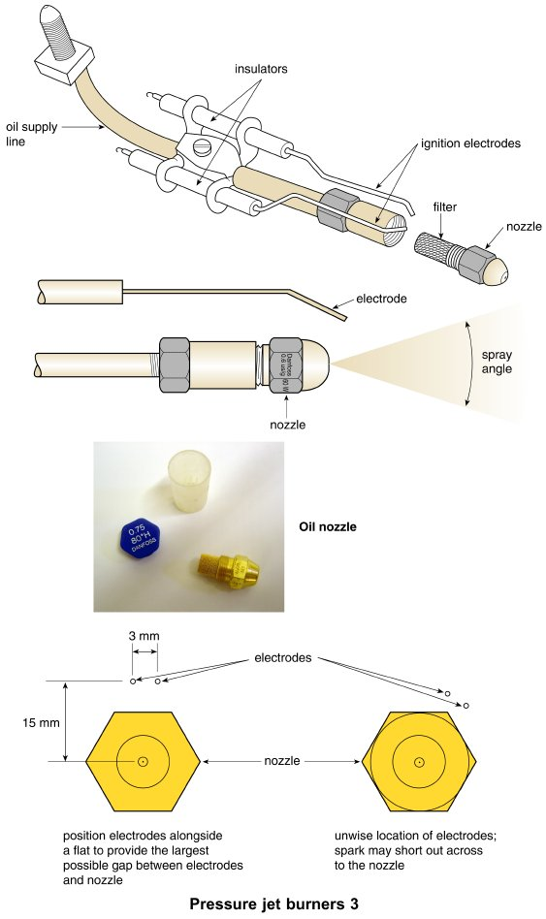
Form Plumbing, 4th Edition. R. D. Treloar. Page 255
© 2012 Blackwell Publishing Ltd. Published 2012 by Blackwell Publishing Ltd.

Slide 8
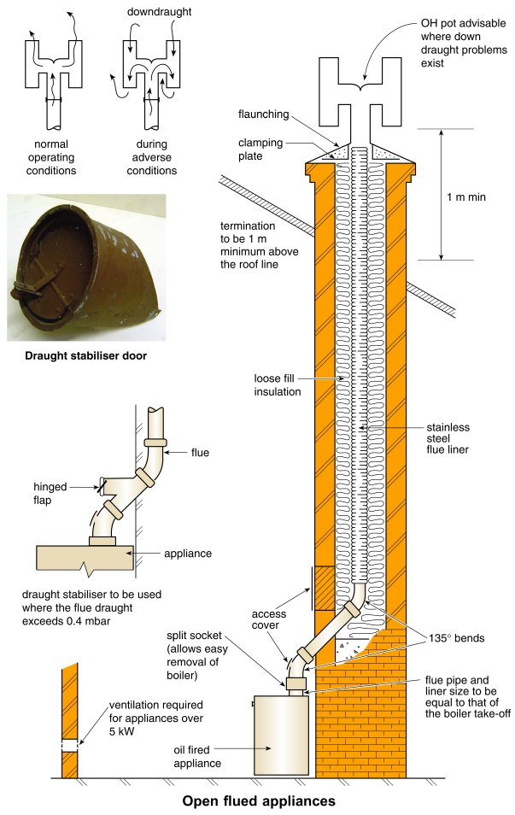
Form Plumbing, 4th Edition. R. D. Treloar. Page 257
© 2012 Blackwell Publishing Ltd. Published 2012 by Blackwell Publishing Ltd.

Slide 9
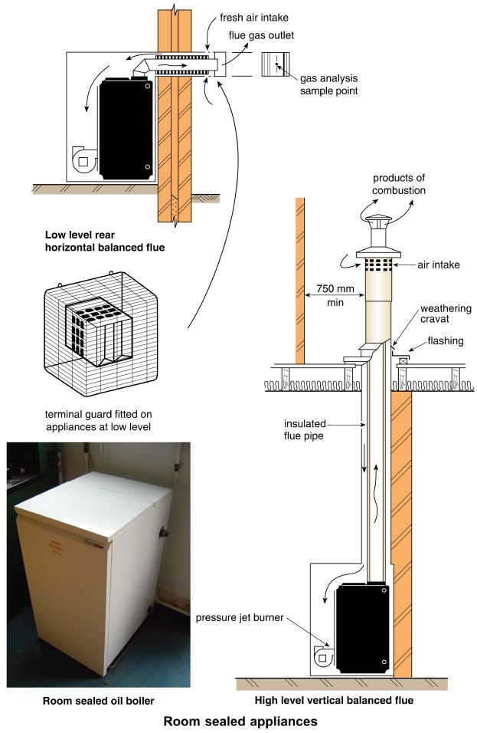
Form Plumbing, 4th Edition. R. D. Treloar. Page 259
© 2012 Blackwell Publishing Ltd. Published 2012 by Blackwell Publishing Ltd.

Slide 10
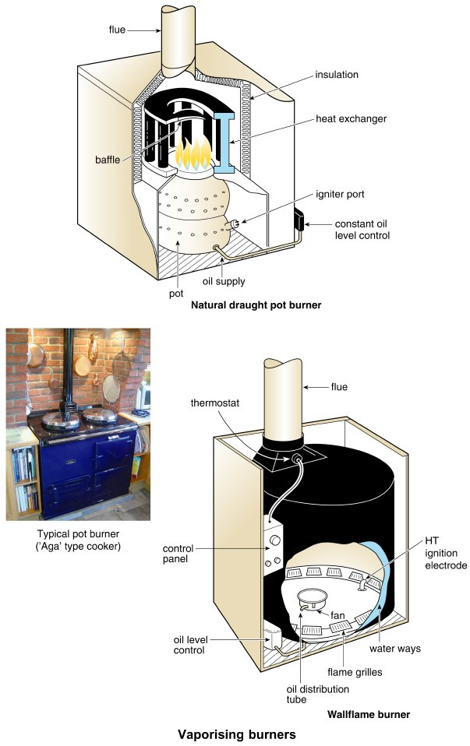
Form Plumbing, 4th Edition. R. D. Treloar. Page 261
© 2012 Blackwell Publishing Ltd. Published 2012 by Blackwell Publishing Ltd.

Slide 11
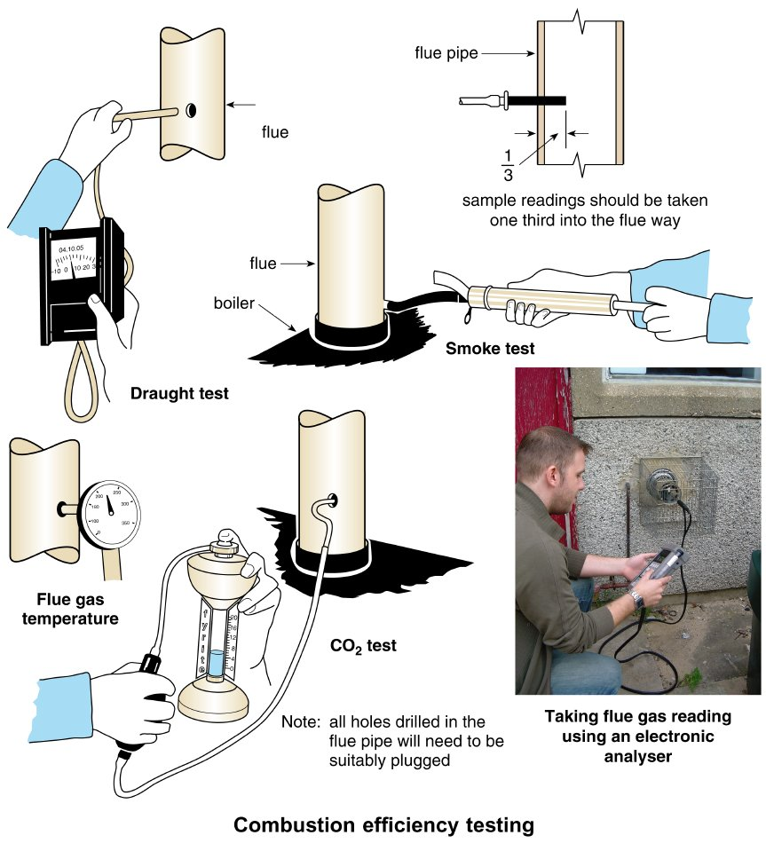
Form Plumbing, 4th Edition. R. D. Treloar. Page 263
© 2012 Blackwell Publishing Ltd. Published 2012 by Blackwell Publishing Ltd.

