Slide 1
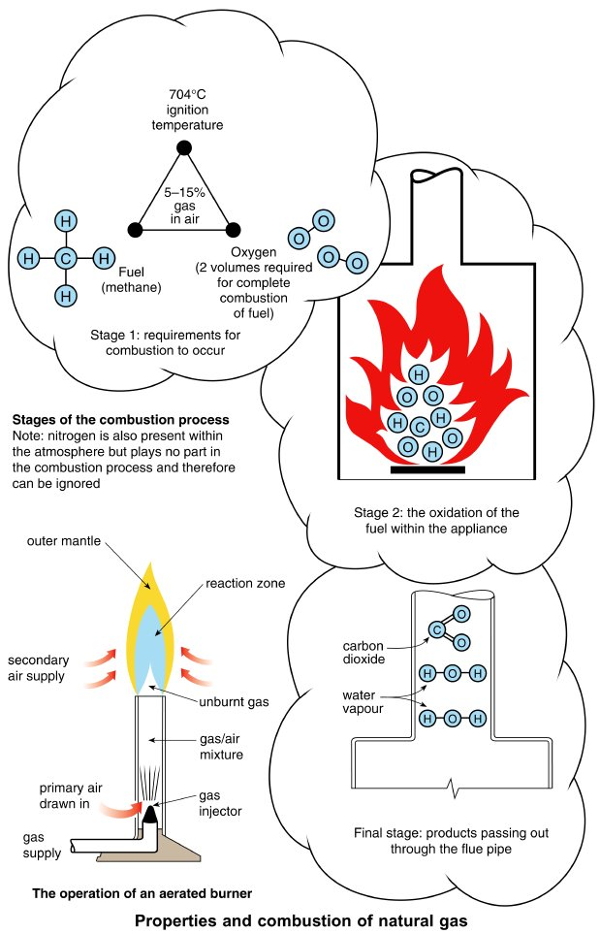
Form Plumbing, 4th Edition. R. D. Treloar. Page 187
© 2012 Blackwell Publishing Ltd. Published 2012 by Blackwell Publishing Ltd.

Slide 2
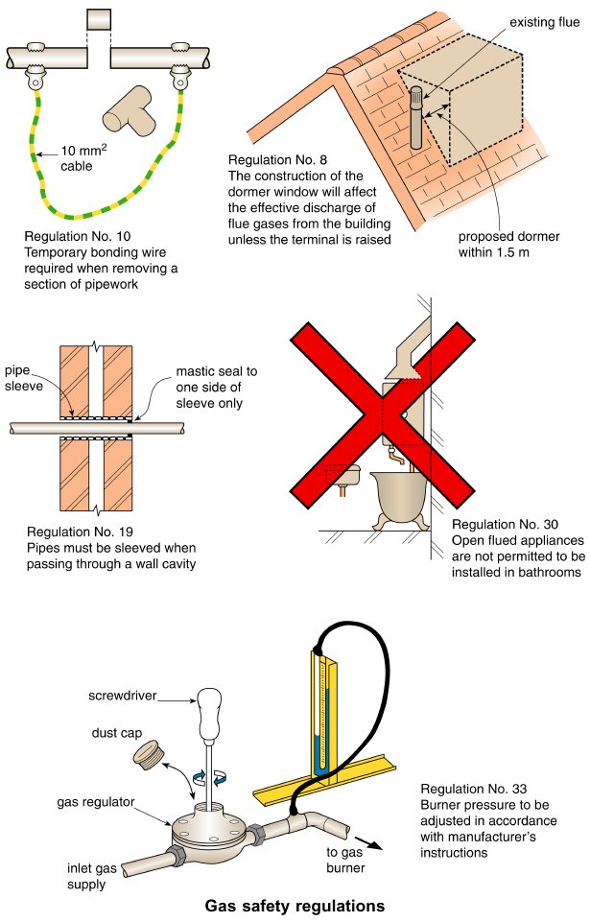
Form Plumbing, 4th Edition. R. D. Treloar. Page 189
© 2012 Blackwell Publishing Ltd. Published 2012 by Blackwell Publishing Ltd.

Slide 3
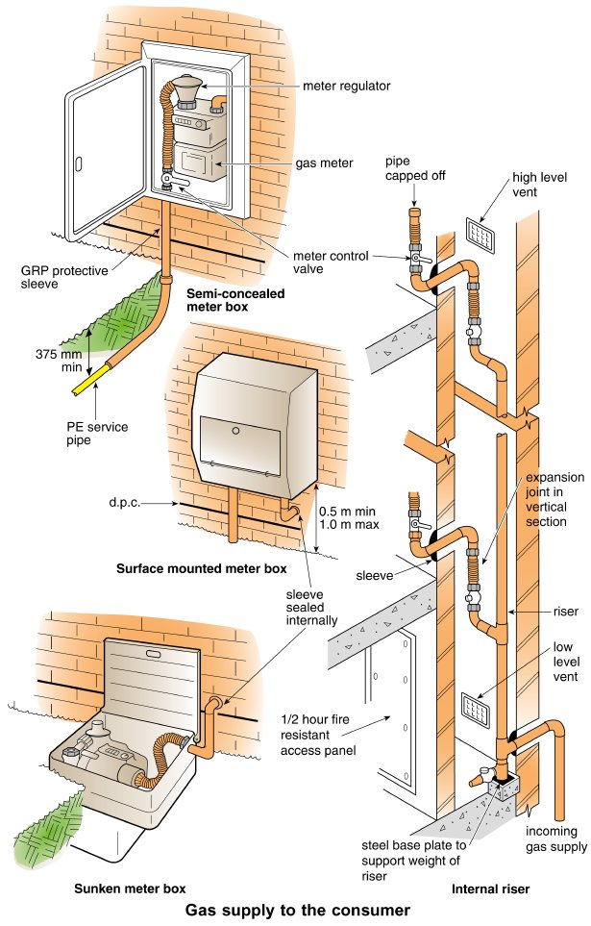
Form Plumbing, 4th Edition. R. D. Treloar. Page 191
© 2012 Blackwell Publishing Ltd. Published 2012 by Blackwell Publishing Ltd.

Slide 4
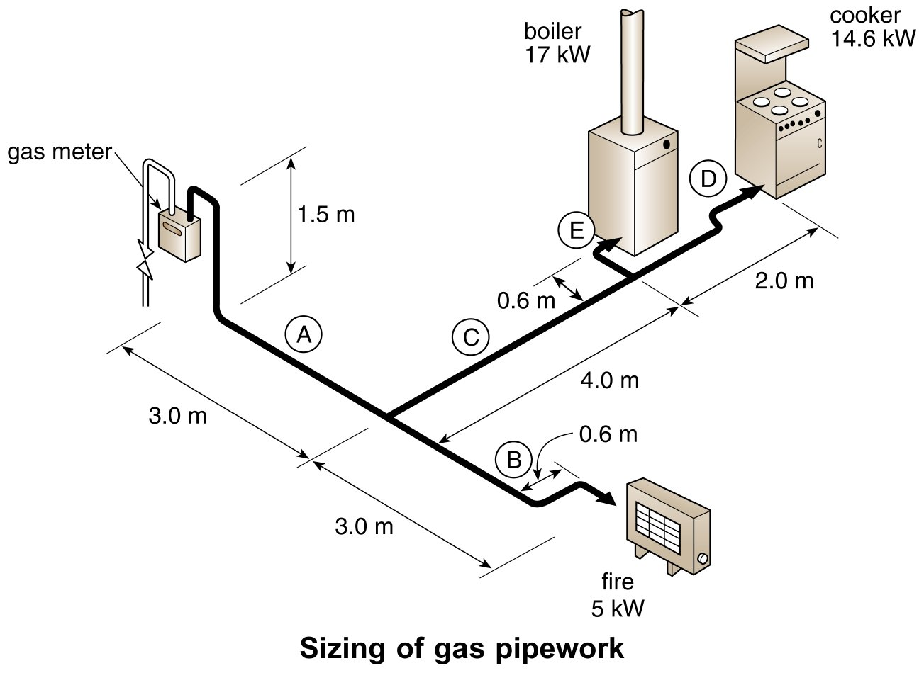
Form Plumbing, 4th Edition. R. D. Treloar. Page 193
© 2012 Blackwell Publishing Ltd. Published 2012 by Blackwell Publishing Ltd.

Slide 5
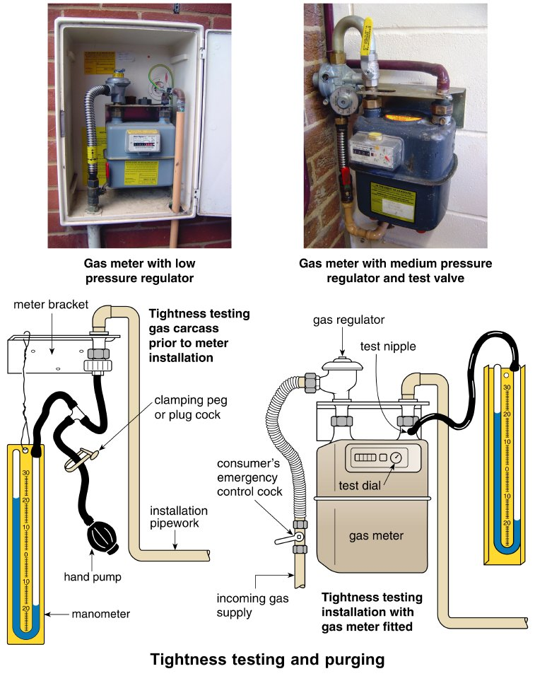
Form Plumbing, 4th Edition. R. D. Treloar. Page 197
© 2012 Blackwell Publishing Ltd. Published 2012 by Blackwell Publishing Ltd.

Slide 6
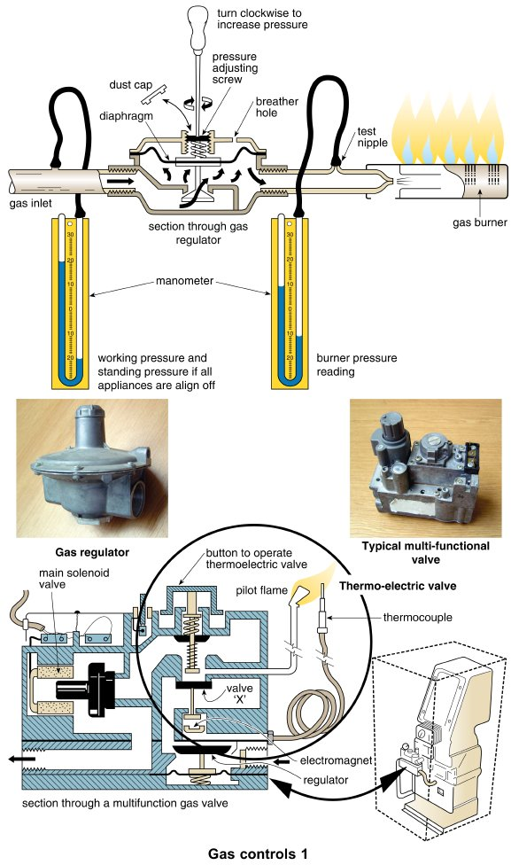
Form Plumbing, 4th Edition. R. D. Treloar. Page 201
© 2012 Blackwell Publishing Ltd. Published 2012 by Blackwell Publishing Ltd.

Slide 7
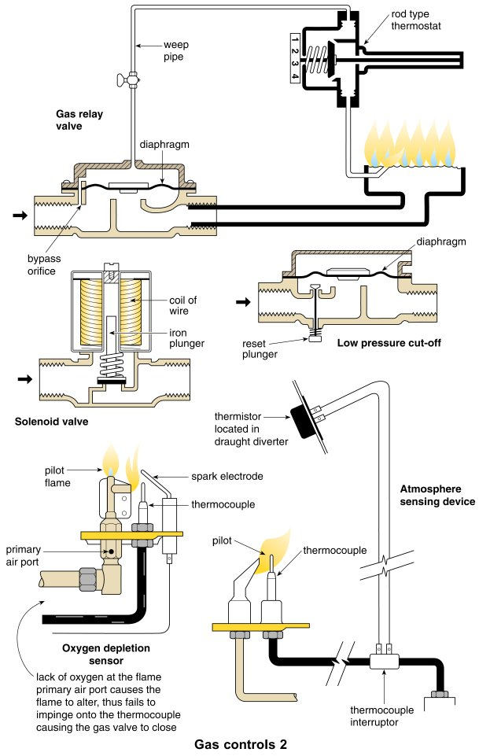
Form Plumbing, 4th Edition. R. D. Treloar. Page 203
© 2012 Blackwell Publishing Ltd. Published 2012 by Blackwell Publishing Ltd.

Slide 8
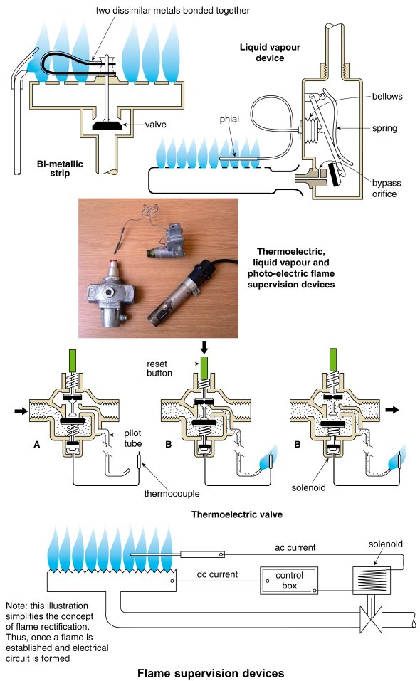
Form Plumbing, 4th Edition. R. D. Treloar. Page 205
© 2012 Blackwell Publishing Ltd. Published 2012 by Blackwell Publishing Ltd.

Slide 9
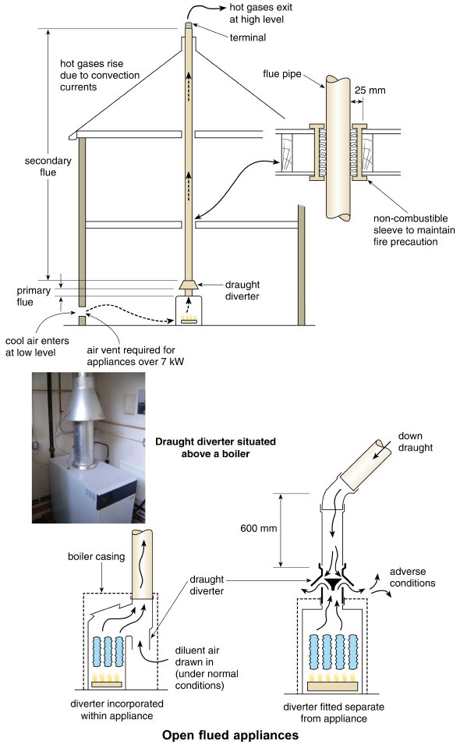
Form Plumbing, 4th Edition. R. D. Treloar. Page 207
© 2012 Blackwell Publishing Ltd. Published 2012 by Blackwell Publishing Ltd.

Slide 10
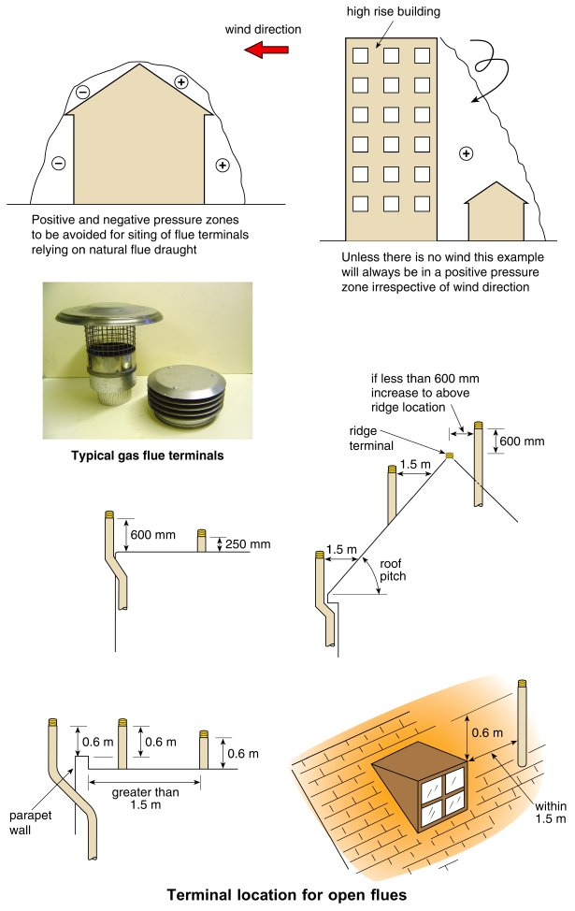
Form Plumbing, 4th Edition. R. D. Treloar. Page 209
© 2012 Blackwell Publishing Ltd. Published 2012 by Blackwell Publishing Ltd.

Slide 11
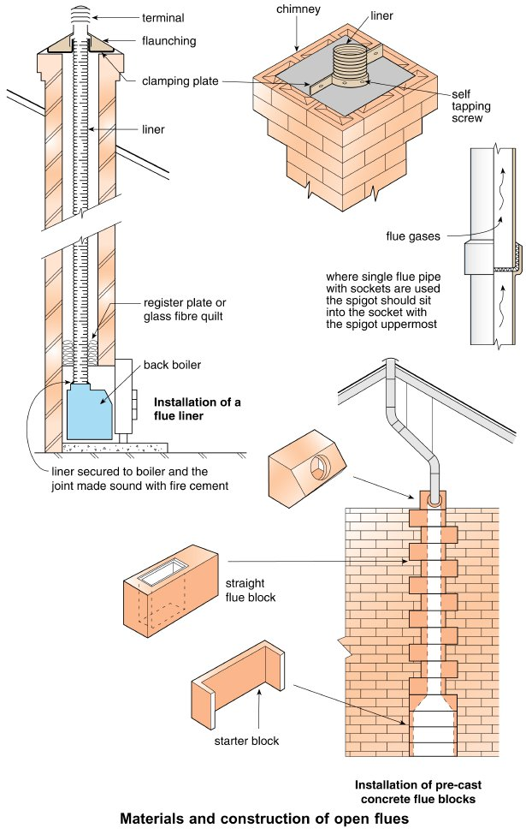
Form Plumbing, 4th Edition. R. D. Treloar. Page 211
© 2012 Blackwell Publishing Ltd. Published 2012 by Blackwell Publishing Ltd.

Slide 12
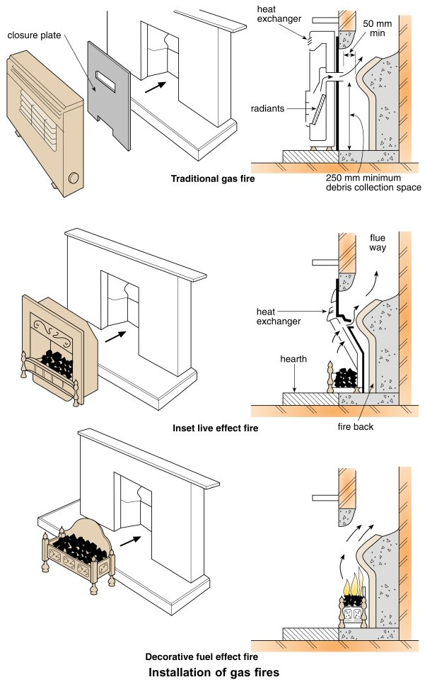
Form Plumbing, 4th Edition. R. D. Treloar. Page 213
© 2012 Blackwell Publishing Ltd. Published 2012 by Blackwell Publishing Ltd.

Slide 13
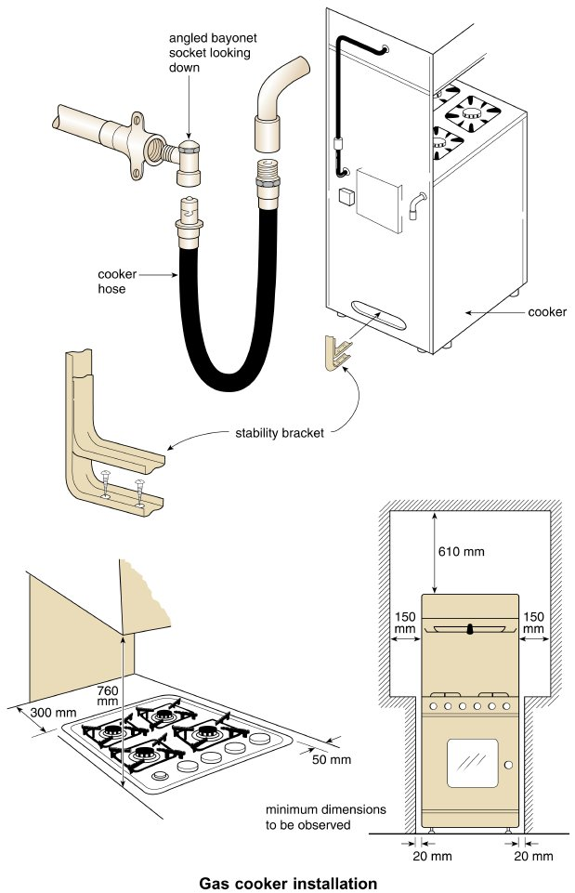
Form Plumbing, 4th Edition. R. D. Treloar. Page 215
© 2012 Blackwell Publishing Ltd. Published 2012 by Blackwell Publishing Ltd.

Slide 14
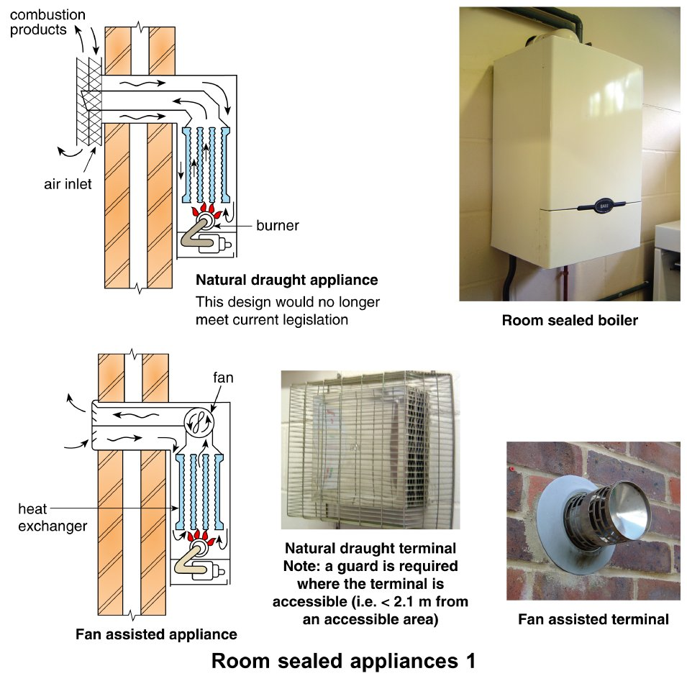
Form Plumbing, 4th Edition. R. D. Treloar. Page 217
© 2012 Blackwell Publishing Ltd. Published 2012 by Blackwell Publishing Ltd.

Slide 15
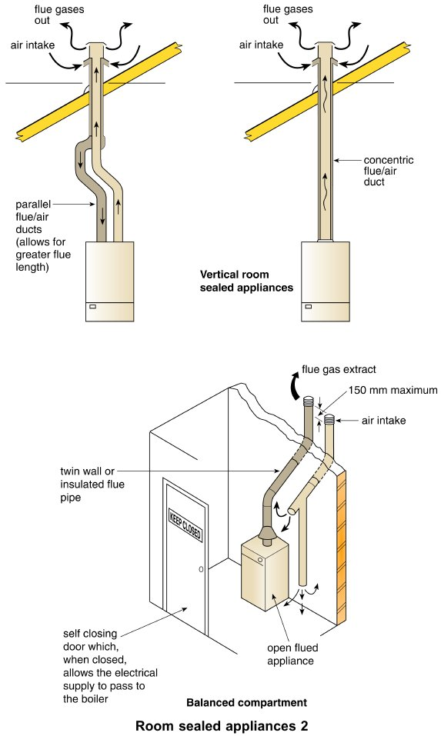
Form Plumbing, 4th Edition. R. D. Treloar. Page 219
© 2012 Blackwell Publishing Ltd. Published 2012 by Blackwell Publishing Ltd.

Slide 16
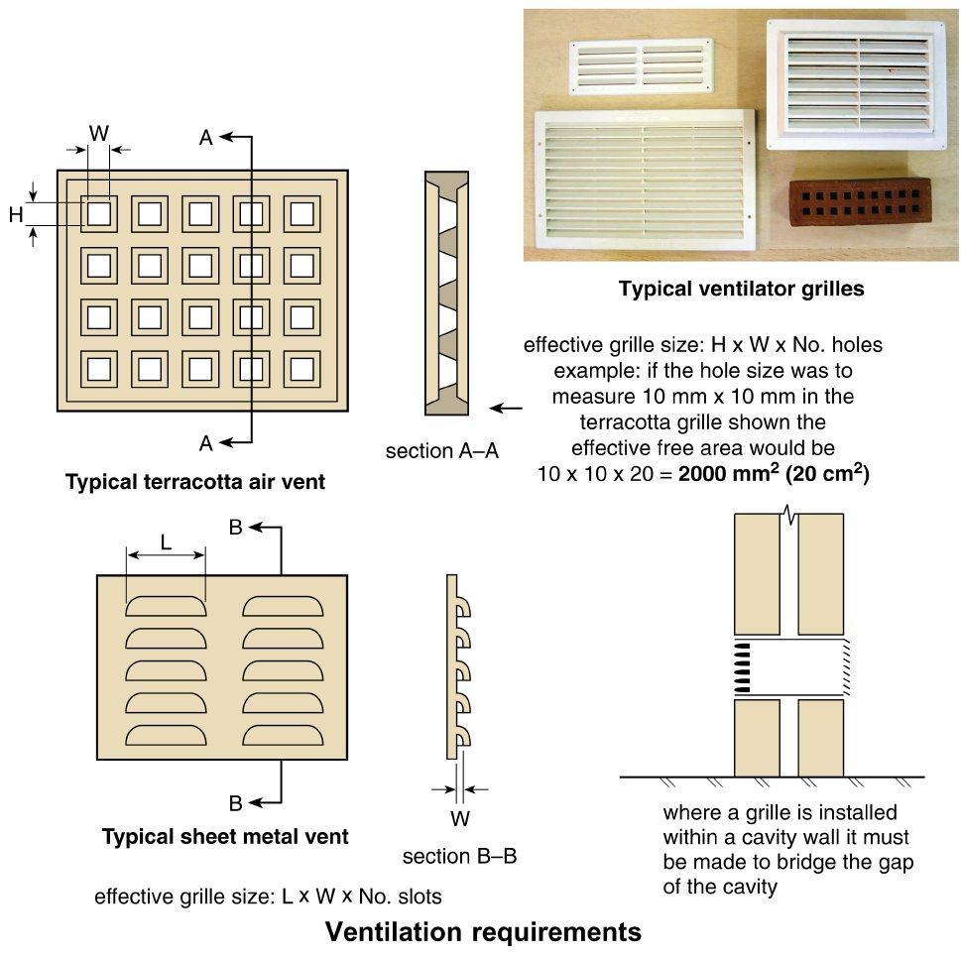
Form Plumbing, 4th Edition. R. D. Treloar. Page 221
© 2012 Blackwell Publishing Ltd. Published 2012 by Blackwell Publishing Ltd.

Slide 17
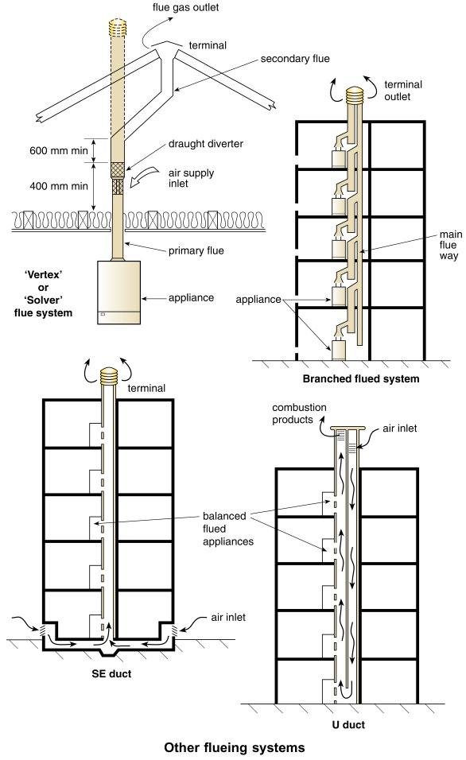
Form Plumbing, 4th Edition. R. D. Treloar. Page 223
© 2012 Blackwell Publishing Ltd. Published 2012 by Blackwell Publishing Ltd.

Slide 18
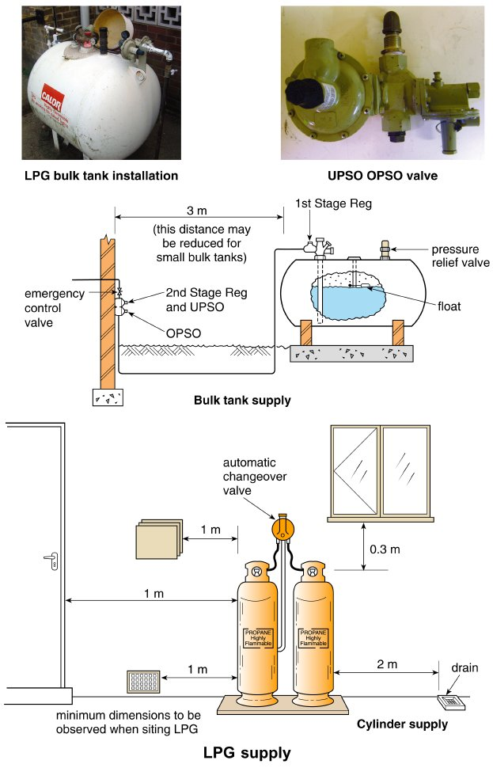
Form Plumbing, 4th Edition. R. D. Treloar. Page 225
© 2012 Blackwell Publishing Ltd. Published 2012 by Blackwell Publishing Ltd.

Slide 19
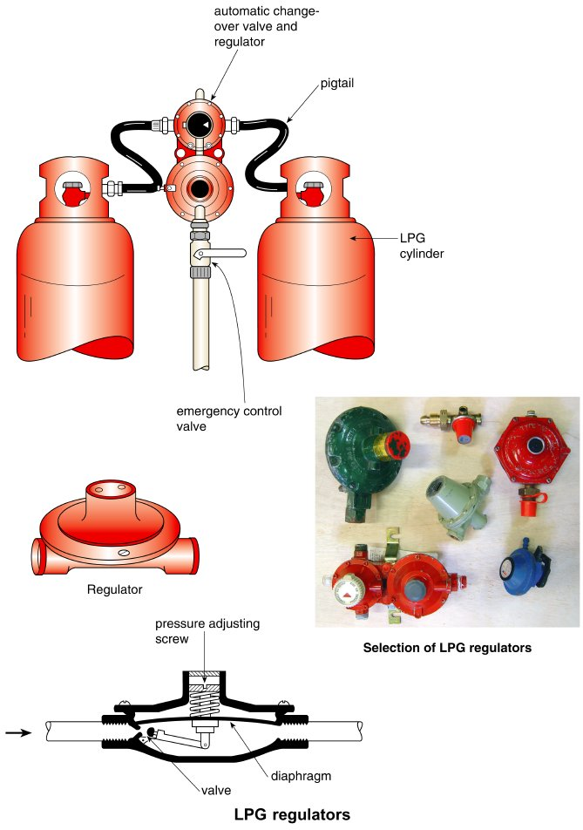
Form Plumbing, 4th Edition. R. D. Treloar. Page 227
© 2012 Blackwell Publishing Ltd. Published 2012 by Blackwell Publishing Ltd.

Slide 20
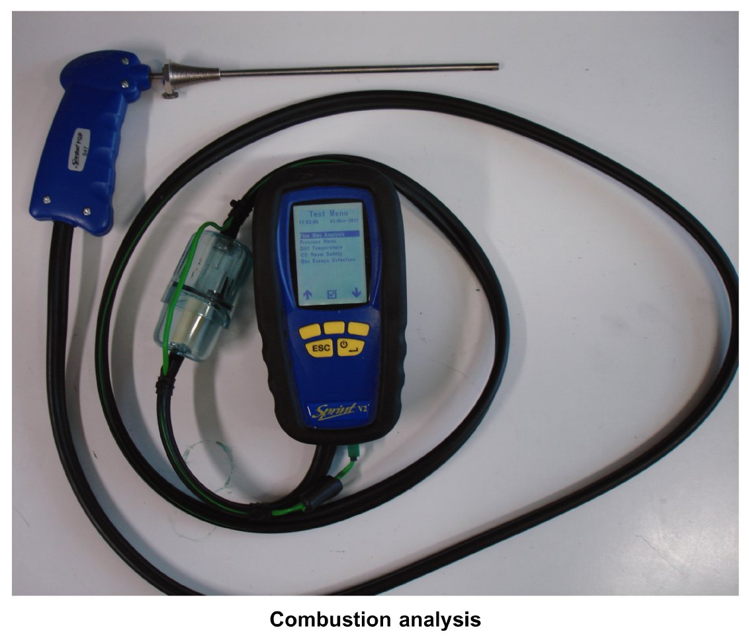
Form Plumbing, 4th Edition. R. D. Treloar. Page 229
© 2012 Blackwell Publishing Ltd. Published 2012 by Blackwell Publishing Ltd.

Slide 21
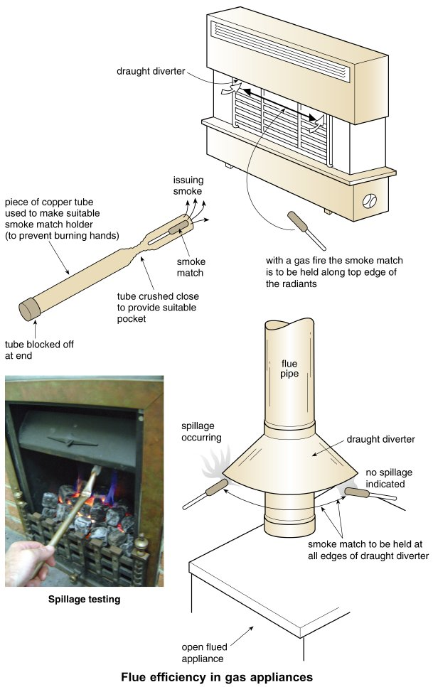
Form Plumbing, 4th Edition. R. D. Treloar. Page 231
© 2012 Blackwell Publishing Ltd. Published 2012 by Blackwell Publishing Ltd.

Slide 22
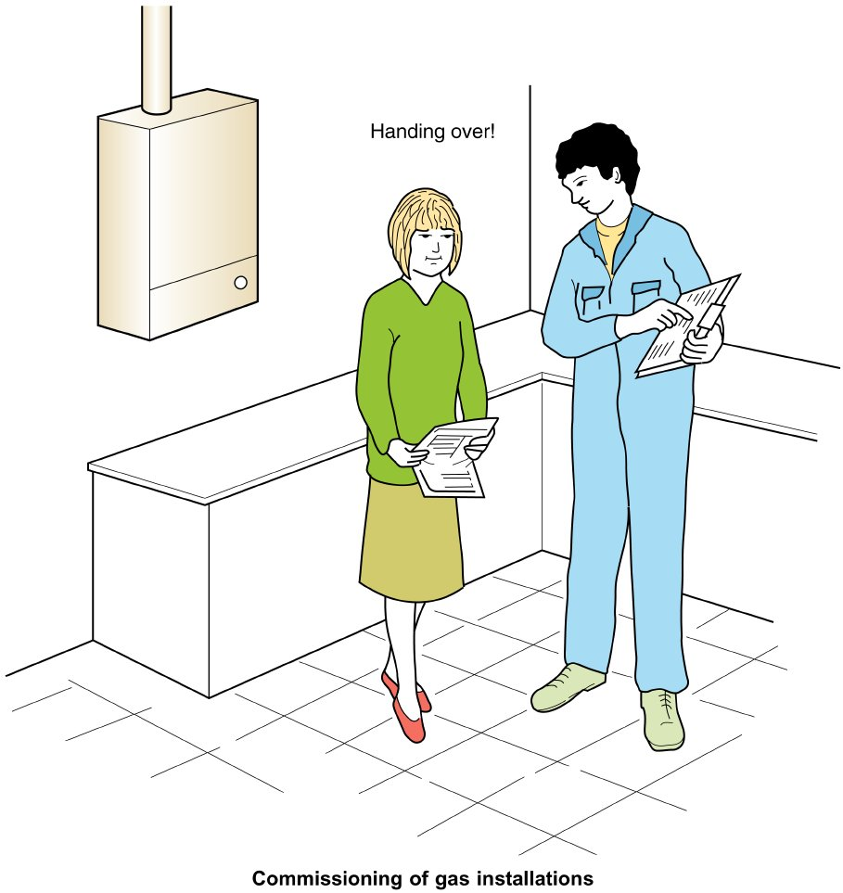
Form Plumbing, 4th Edition. R. D. Treloar. Page 233
© 2012 Blackwell Publishing Ltd. Published 2012 by Blackwell Publishing Ltd.

Slide 23
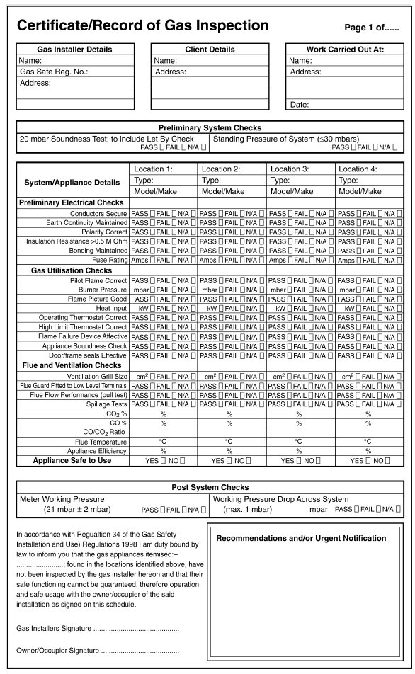
Form Plumbing, 4th Edition. R. D. Treloar. Page 235
© 2012 Blackwell Publishing Ltd. Published 2012 by Blackwell Publishing Ltd.

Slide 24
Form Plumbing, 4th Edition. R. D. Treloar. Page 237
© 2012 Blackwell Publishing Ltd. Published 2012 by Blackwell Publishing Ltd.

Slide 25
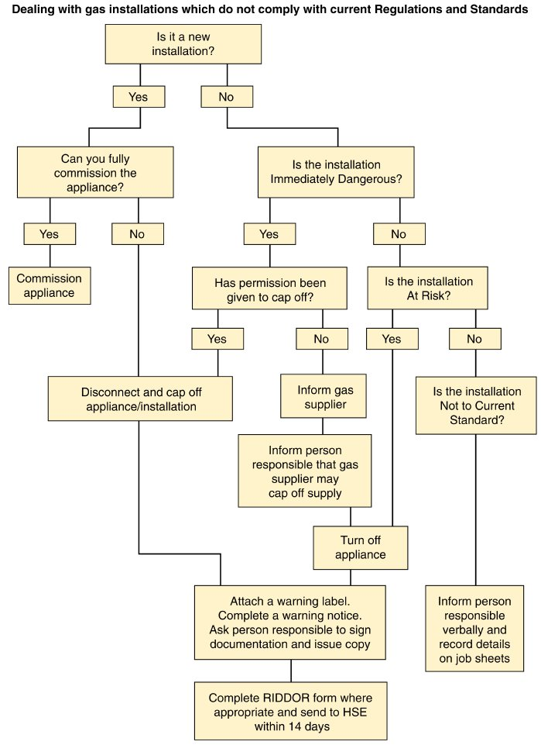
Form Plumbing, 4th Edition. R. D. Treloar. Page 239
© 2012 Blackwell Publishing Ltd. Published 2012 by Blackwell Publishing Ltd.

