Slide 1
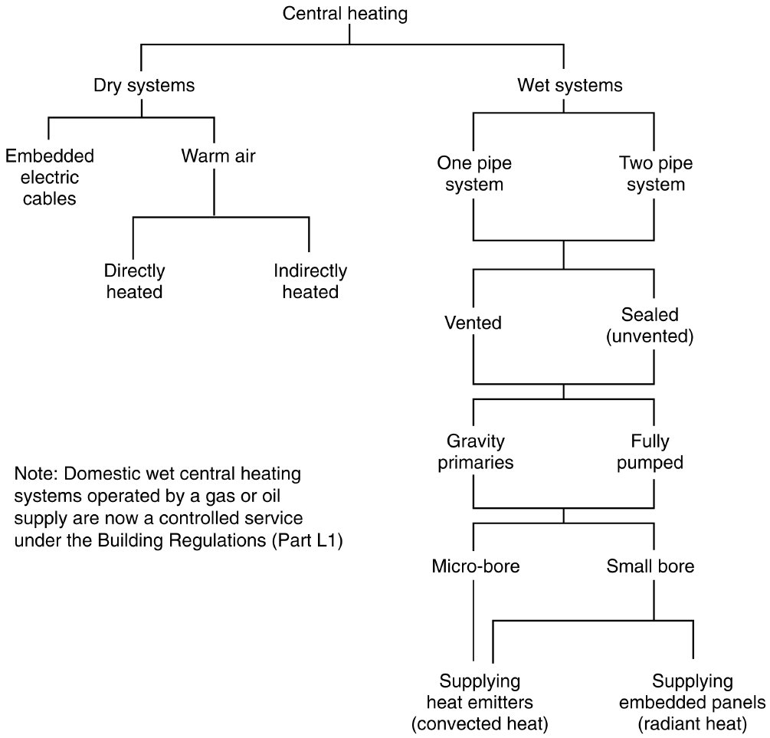
Form Plumbing, 4th Edition. R. D. Treloar. Page 138
© 2012 Blackwell Publishing Ltd. Published 2012 by Blackwell Publishing Ltd.

Slide 2
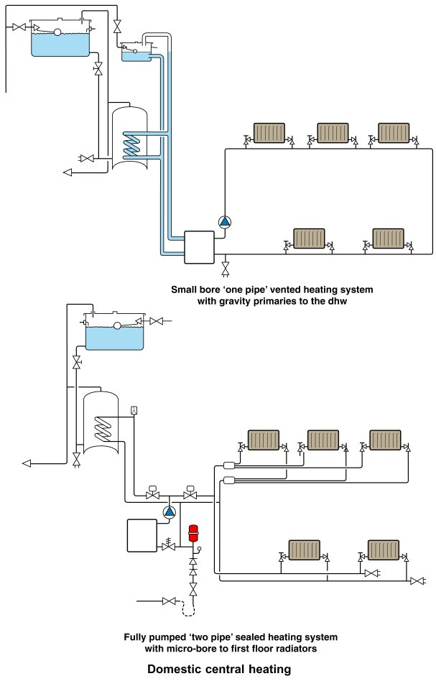
Form Plumbing, 4th Edition. R. D. Treloar. Page 139
© 2012 Blackwell Publishing Ltd. Published 2012 by Blackwell Publishing Ltd.

Slide 3
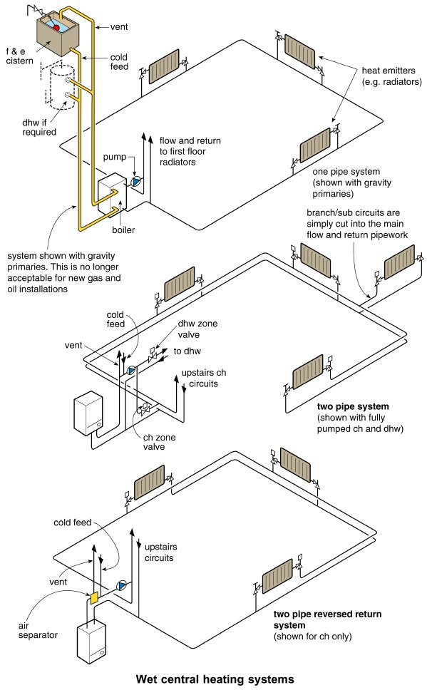
Form Plumbing, 4th Edition. R. D. Treloar. Page 141
© 2012 Blackwell Publishing Ltd. Published 2012 by Blackwell Publishing Ltd.

Slide 4
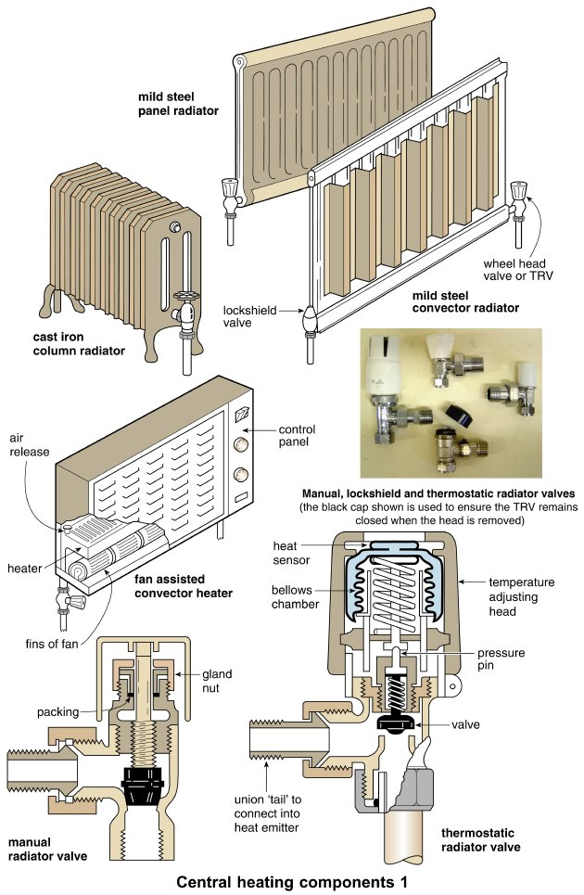
Form Plumbing, 4th Edition. R. D. Treloar. Page 143
© 2012 Blackwell Publishing Ltd. Published 2012 by Blackwell Publishing Ltd.

Slide 5
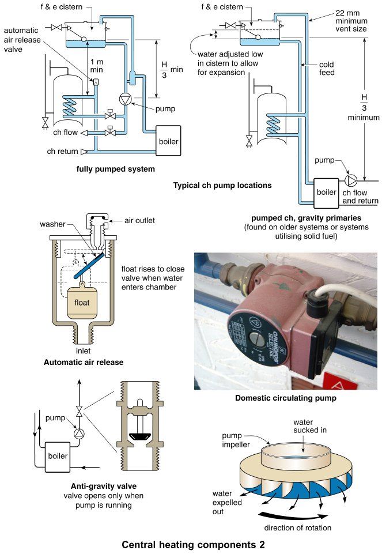
Form Plumbing, 4th Edition. R. D. Treloar. Page 145
© 2012 Blackwell Publishing Ltd. Published 2012 by Blackwell Publishing Ltd.

Slide 6
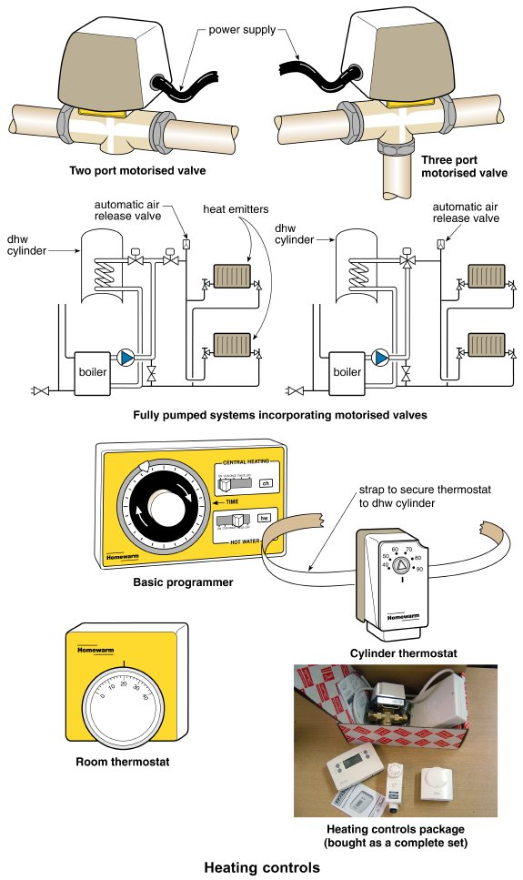
Form Plumbing, 4th Edition. R. D. Treloar. Page 147
© 2012 Blackwell Publishing Ltd. Published 2012 by Blackwell Publishing Ltd.

Slide 7
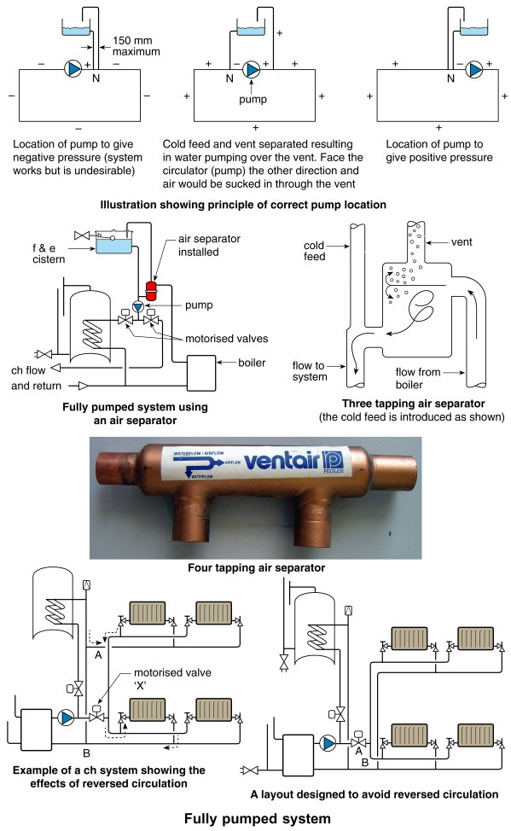
Form Plumbing, 4th Edition. R. D. Treloar. Page 149
© 2012 Blackwell Publishing Ltd. Published 2012 by Blackwell Publishing Ltd.

Slide 8
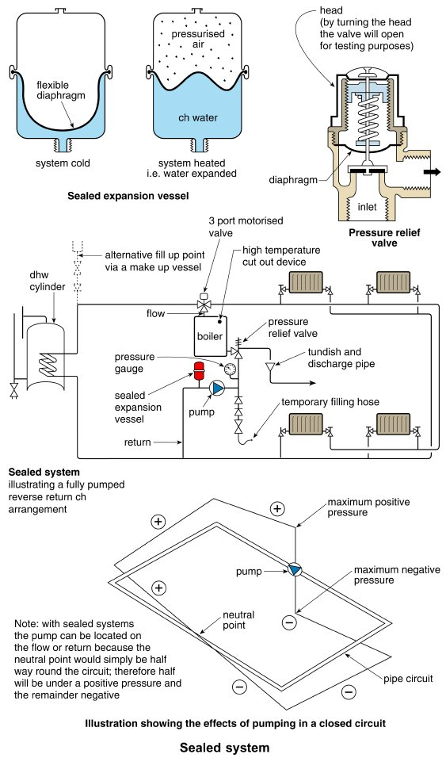
Form Plumbing, 4th Edition. R. D. Treloar. Page 151
© 2012 Blackwell Publishing Ltd. Published 2012 by Blackwell Publishing Ltd.

Slide 9
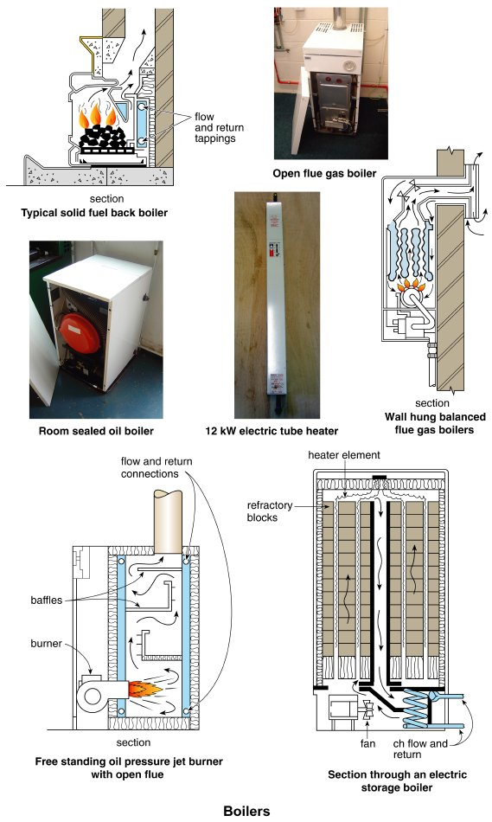
Form Plumbing, 4th Edition. R. D. Treloar. Page 153
© 2012 Blackwell Publishing Ltd. Published 2012 by Blackwell Publishing Ltd.

Slide 10
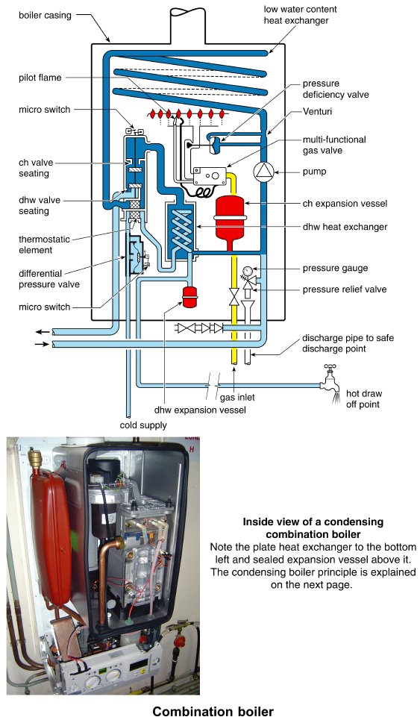
Form Plumbing, 4th Edition. R. D. Treloar. Page 155
© 2012 Blackwell Publishing Ltd. Published 2012 by Blackwell Publishing Ltd.

Slide 11
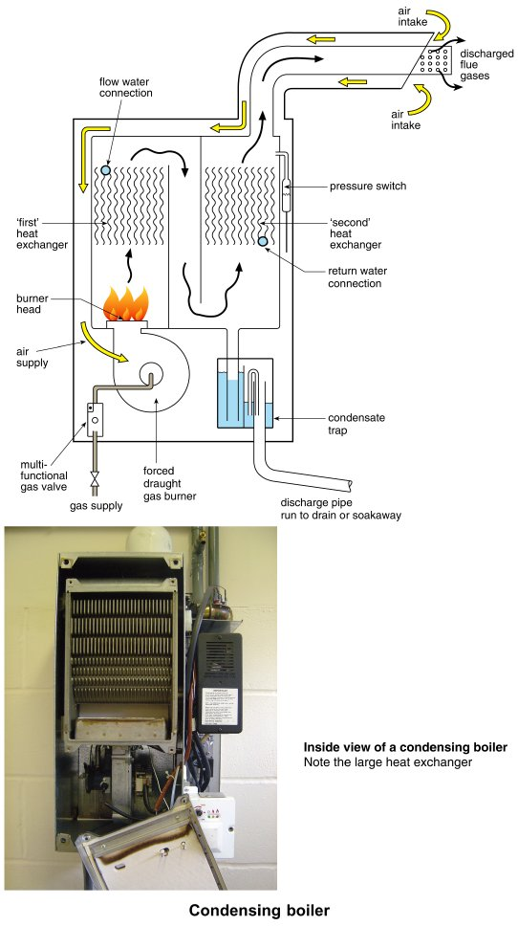
Form Plumbing, 4th Edition. R. D. Treloar. Page 157
© 2012 Blackwell Publishing Ltd. Published 2012 by Blackwell Publishing Ltd.

Slide 12
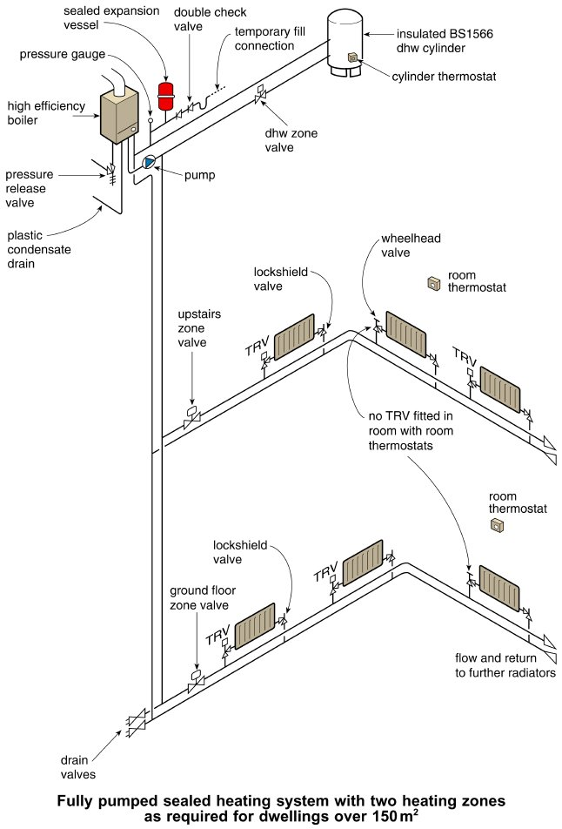
Form Plumbing, 4th Edition. R. D. Treloar. Page 159
© 2012 Blackwell Publishing Ltd. Published 2012 by Blackwell Publishing Ltd.

Slide 13
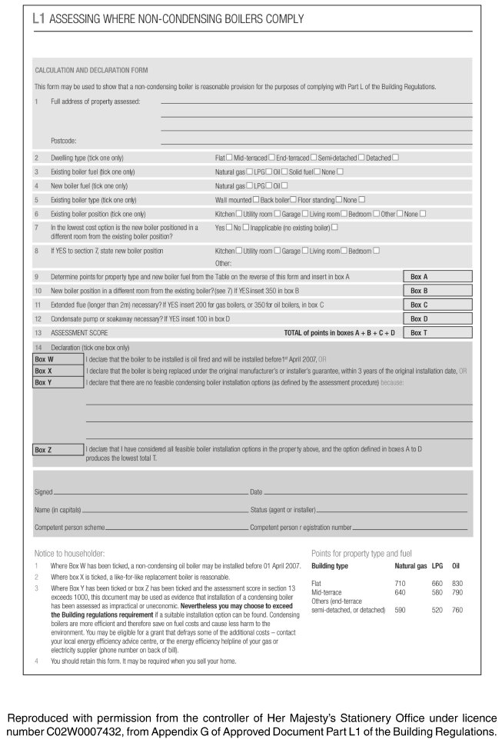
Form Plumbing, 4th Edition. R. D. Treloar. Page 161
© 2012 Blackwell Publishing Ltd. Published 2012 by Blackwell Publishing Ltd.

Slide 14
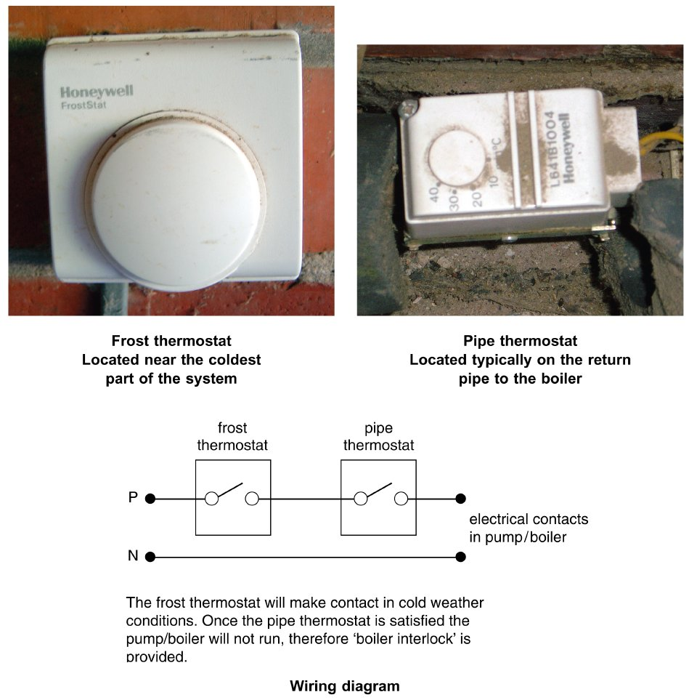
Form Plumbing, 4th Edition. R. D. Treloar. Page 163
© 2012 Blackwell Publishing Ltd. Published 2012 by Blackwell Publishing Ltd.

Slide 15
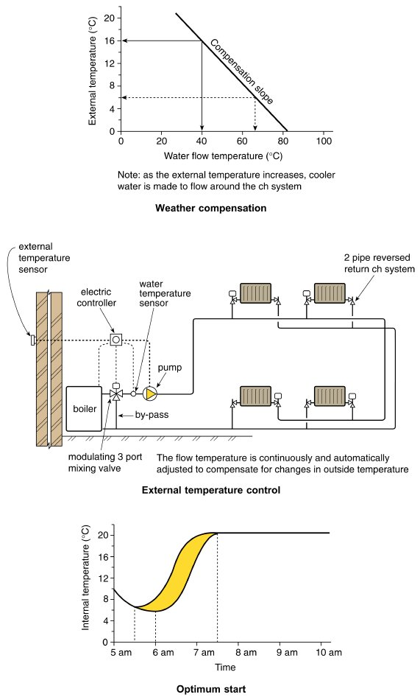
Form Plumbing, 4th Edition. R. D. Treloar. Page 165
© 2012 Blackwell Publishing Ltd. Published 2012 by Blackwell Publishing Ltd.

Slide 16
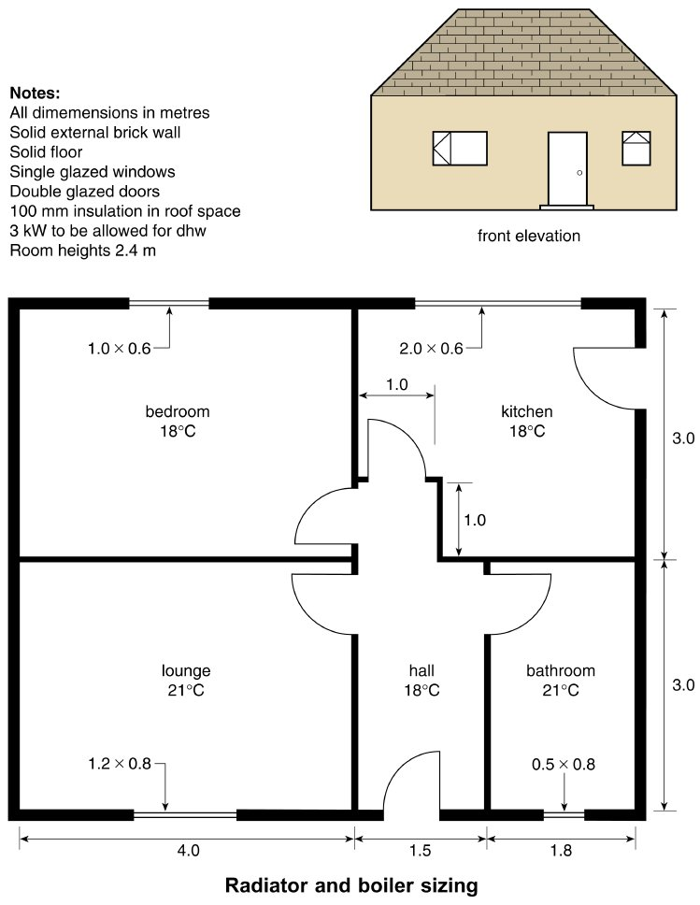
Form Plumbing, 4th Edition. R. D. Treloar. Page 167
© 2012 Blackwell Publishing Ltd. Published 2012 by Blackwell Publishing Ltd.

Slide 17
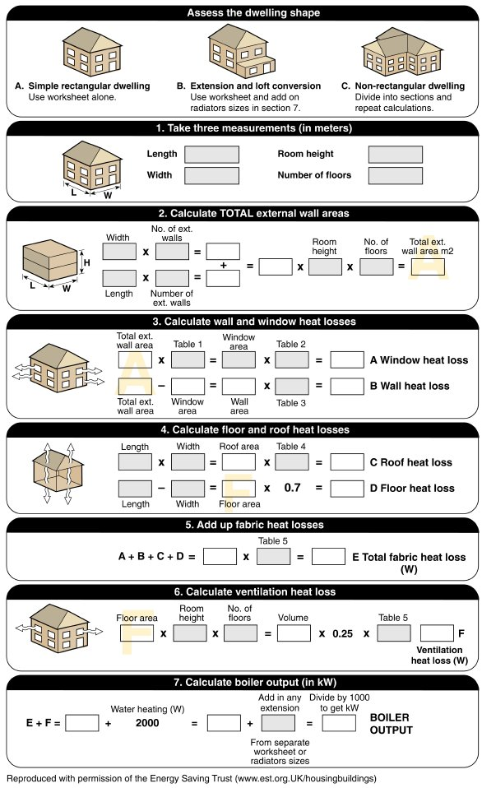
Form Plumbing, 4th Edition. R. D. Treloar. Page 171
© 2012 Blackwell Publishing Ltd. Published 2012 by Blackwell Publishing Ltd.

Slide 18
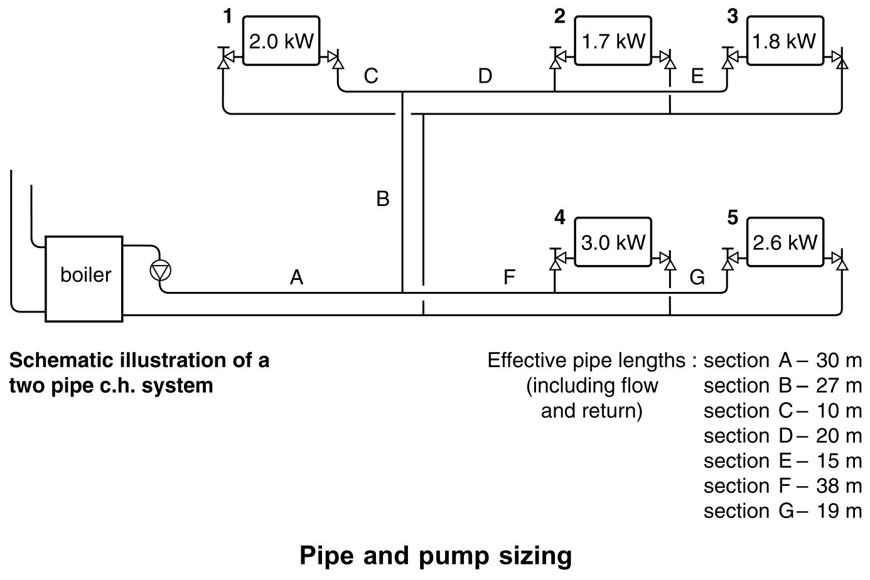
Form Plumbing, 4th Edition. R. D. Treloar. Page 173
© 2012 Blackwell Publishing Ltd. Published 2012 by Blackwell Publishing Ltd.

Slide 19
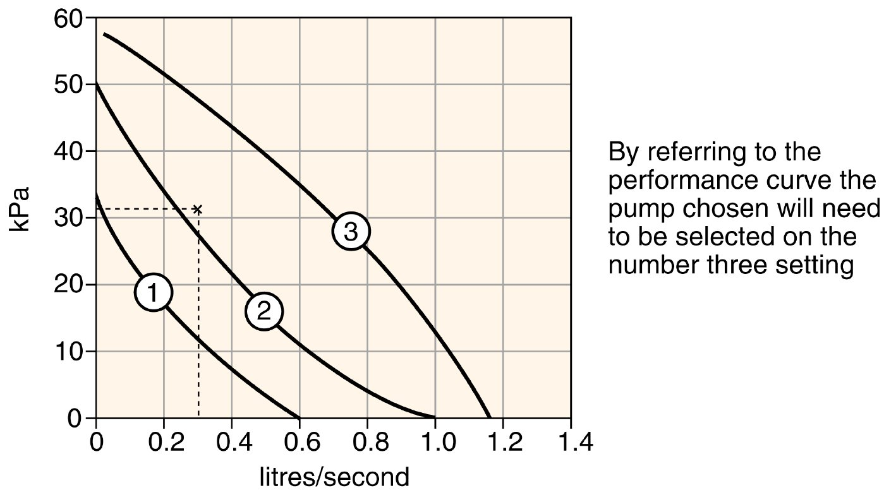
Form Plumbing, 4th Edition. R. D. Treloar. Page 175
© 2012 Blackwell Publishing Ltd. Published 2012 by Blackwell Publishing Ltd.

Slide 20
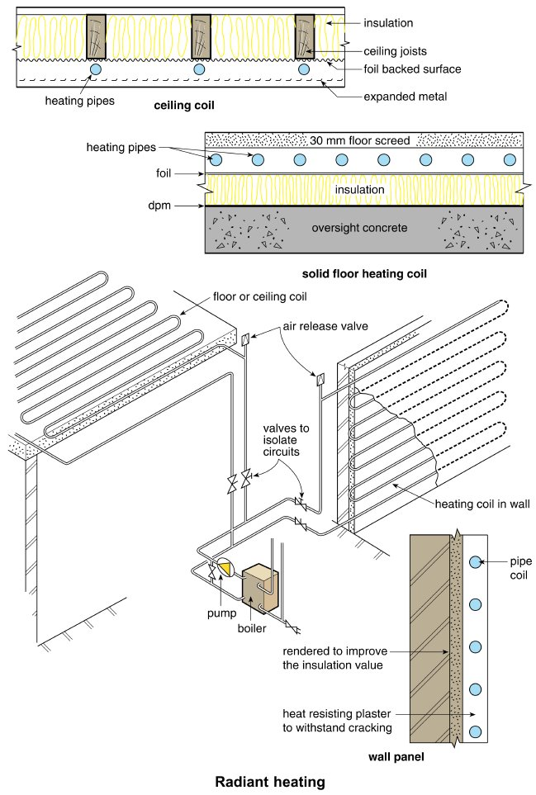
Form Plumbing, 4th Edition. R. D. Treloar. Page 177
© 2012 Blackwell Publishing Ltd. Published 2012 by Blackwell Publishing Ltd.

Slide 21
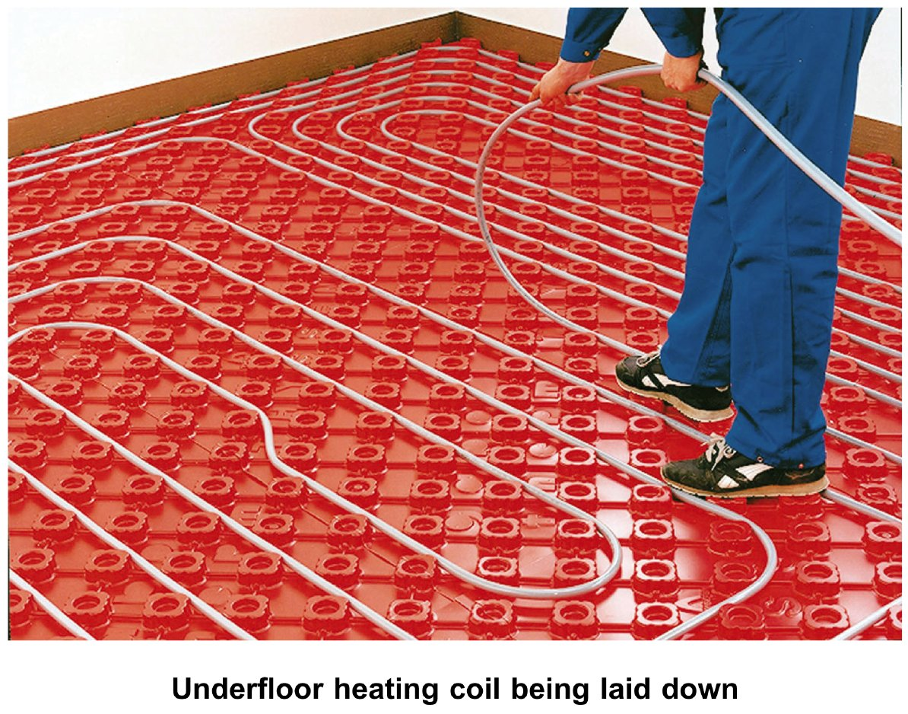
Form Plumbing, 4th Edition. R. D. Treloar. Page 179
© 2012 Blackwell Publishing Ltd. Published 2012 by Blackwell Publishing Ltd.

Slide 22
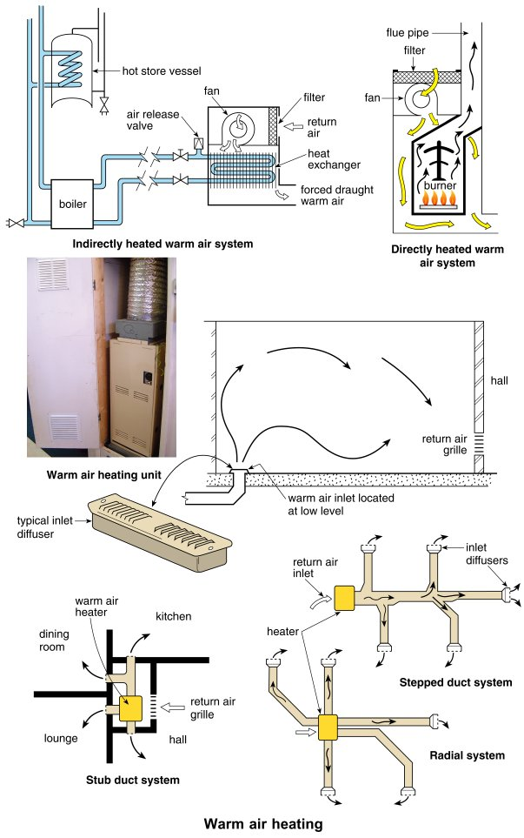
Form Plumbing, 4th Edition. R. D. Treloar. Page 181
© 2012 Blackwell Publishing Ltd. Published 2012 by Blackwell Publishing Ltd.

Slide 23
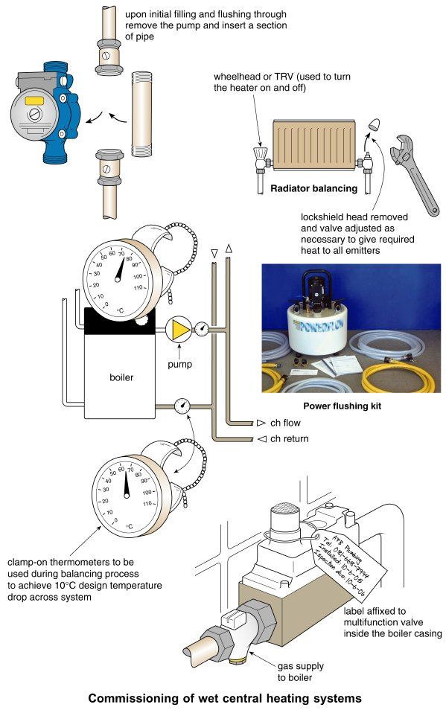
Form Plumbing, 4th Edition. R. D. Treloar. Page 183
© 2012 Blackwell Publishing Ltd. Published 2012 by Blackwell Publishing Ltd.

