Slide 1
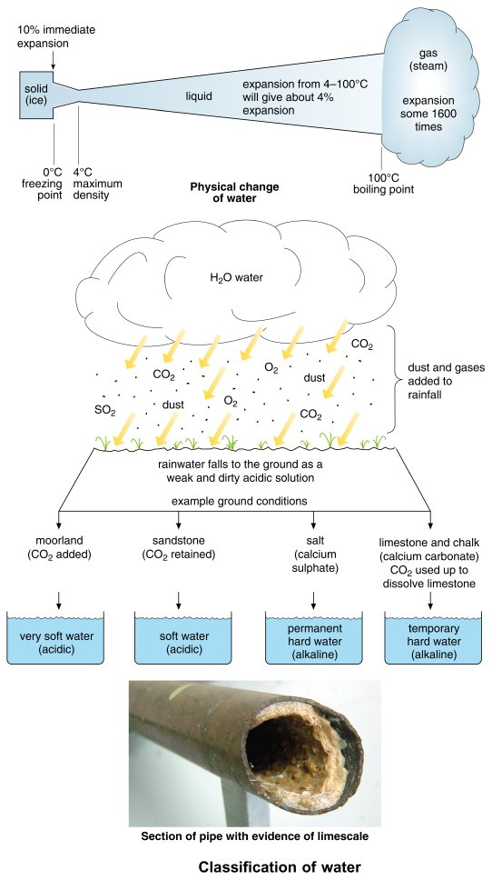
Form Plumbing, 4th Edition. R. D. Treloar. Page 83
© 2012 Blackwell Publishing Ltd. Published 2012 by Blackwell Publishing Ltd.

Slide 2
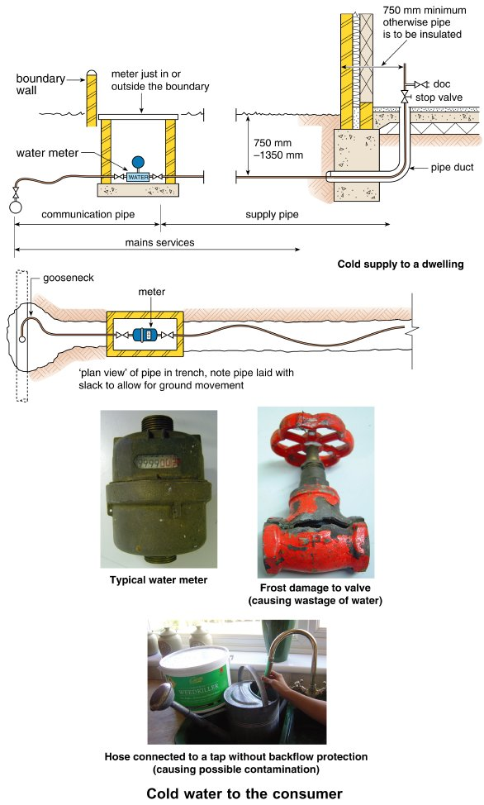
Form Plumbing, 4th Edition. R. D. Treloar. Page 85
© 2012 Blackwell Publishing Ltd. Published 2012 by Blackwell Publishing Ltd.

Slide 3
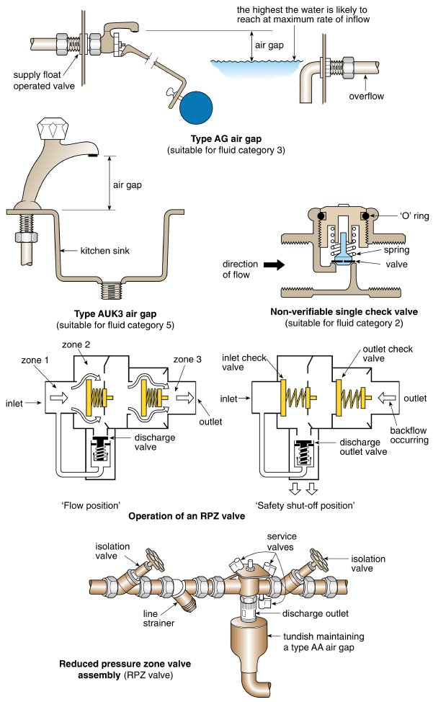
Form Plumbing, 4th Edition. R. D. Treloar. Page 87
© 2012 Blackwell Publishing Ltd. Published 2012 by Blackwell Publishing Ltd.

Slide 4
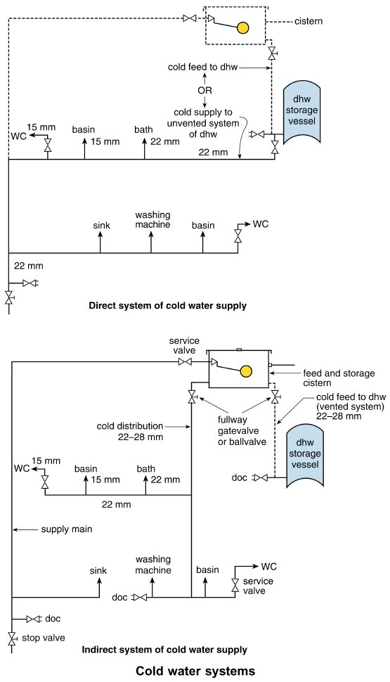
Form Plumbing, 4th Edition. R. D. Treloar. Page 91
© 2012 Blackwell Publishing Ltd. Published 2012 by Blackwell Publishing Ltd.

Slide 5
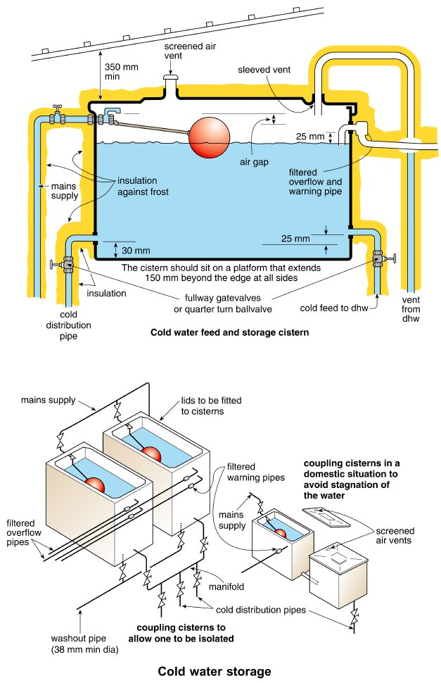
Form Plumbing, 4th Edition. R. D. Treloar. Page 93
© 2012 Blackwell Publishing Ltd. Published 2012 by Blackwell Publishing Ltd.

Slide 6
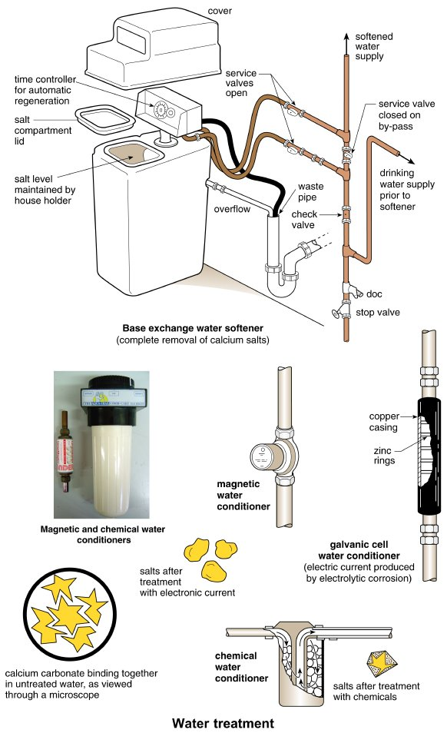
Form Plumbing, 4th Edition. R. D. Treloar. Page 95
© 2012 Blackwell Publishing Ltd. Published 2012 by Blackwell Publishing Ltd.

Slide 7
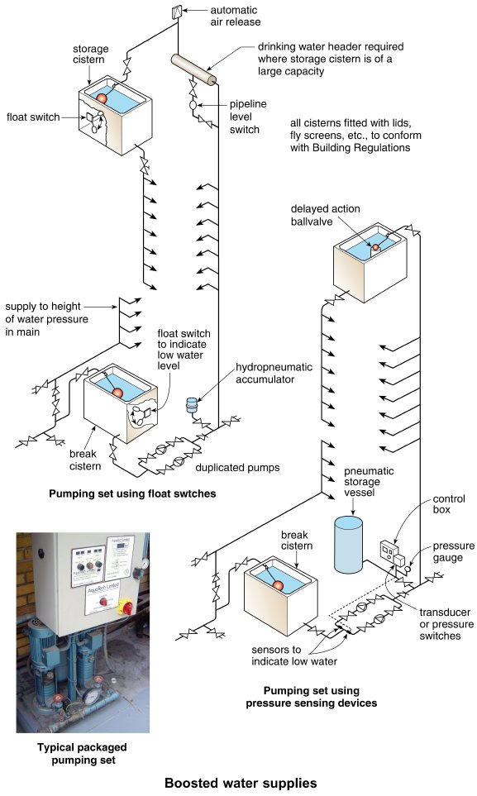
Form Plumbing, 4th Edition. R. D. Treloar. Page 97
© 2012 Blackwell Publishing Ltd. Published 2012 by Blackwell Publishing Ltd.

Slide 8
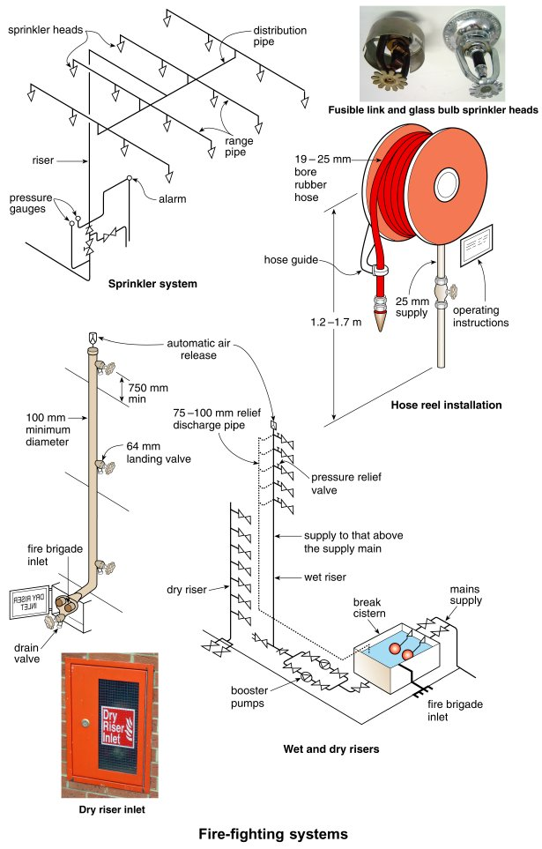
Form Plumbing, 4th Edition. R. D. Treloar. Page 99
© 2012 Blackwell Publishing Ltd. Published 2012 by Blackwell Publishing Ltd.

Slide 9
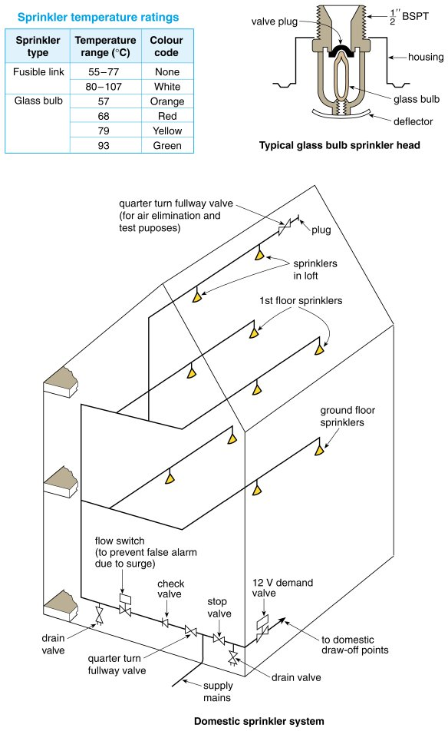
Form Plumbing, 4th Edition. R. D. Treloar. Page 101
© 2012 Blackwell Publishing Ltd. Published 2012 by Blackwell Publishing Ltd.

Slide 10
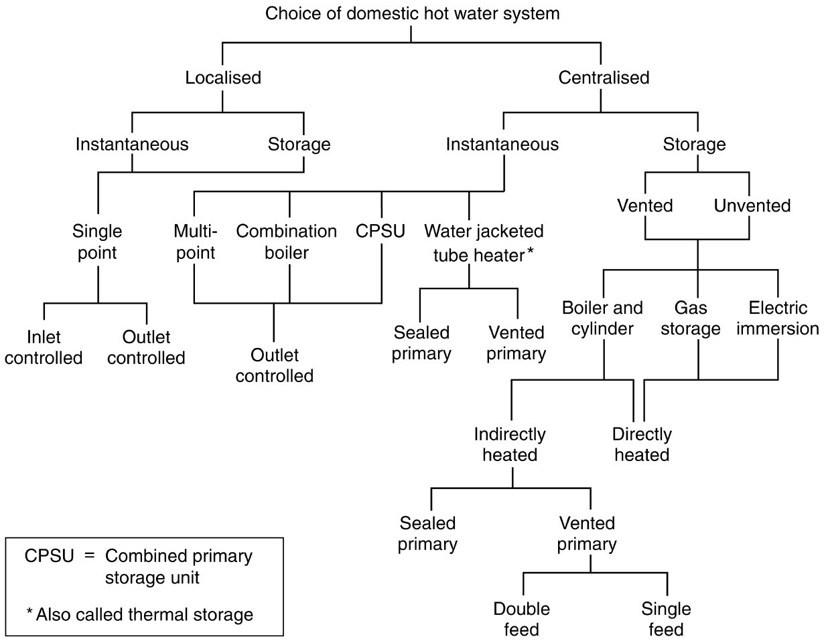
Form Plumbing, 4th Edition. R. D. Treloar. Page 102
© 2012 Blackwell Publishing Ltd. Published 2012 by Blackwell Publishing Ltd.

Slide 11
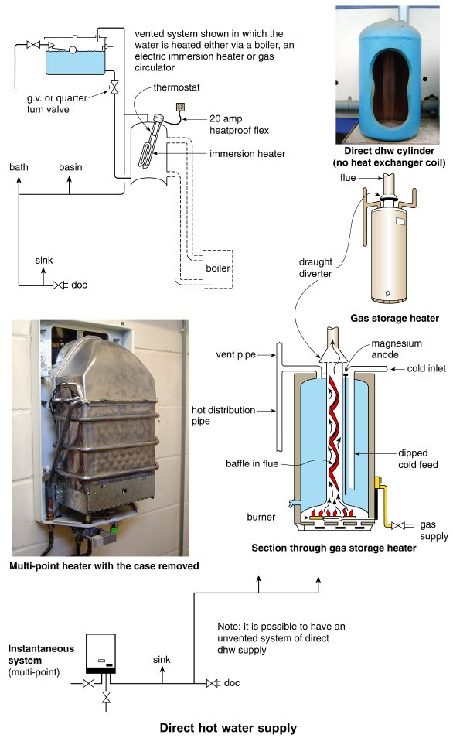
Form Plumbing, 4th Edition. R. D. Treloar. Page 105
© 2012 Blackwell Publishing Ltd. Published 2012 by Blackwell Publishing Ltd.

Slide 12
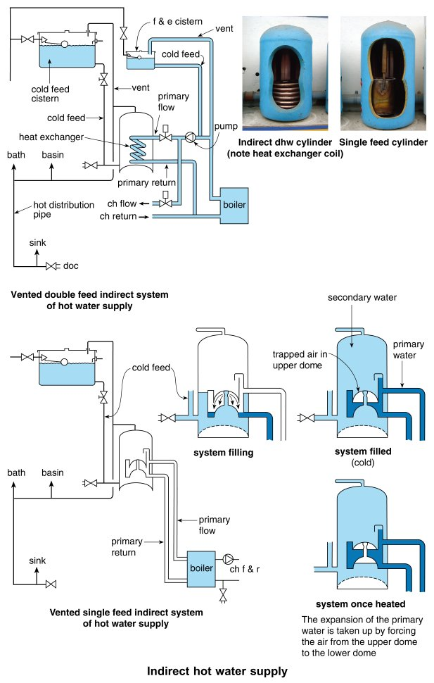
Form Plumbing, 4th Edition. R. D. Treloar. Page 107
© 2012 Blackwell Publishing Ltd. Published 2012 by Blackwell Publishing Ltd.

Slide 13
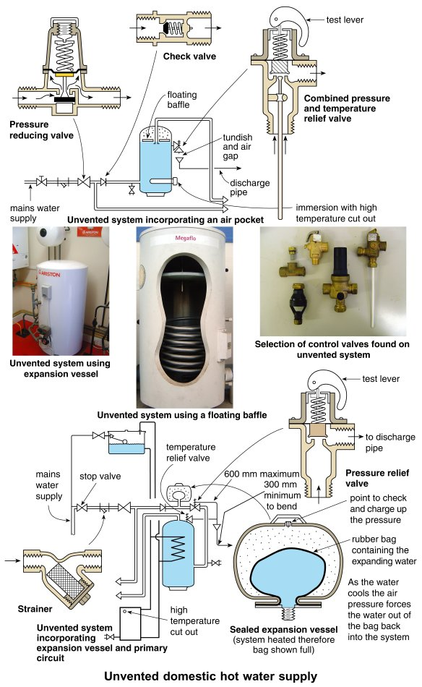
Form Plumbing, 4th Edition. R. D. Treloar. Page 109
© 2012 Blackwell Publishing Ltd. Published 2012 by Blackwell Publishing Ltd.

Slide 14
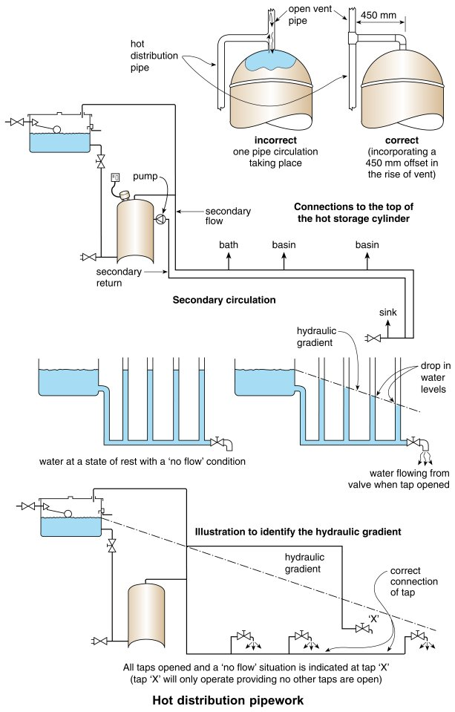
Form Plumbing, 4th Edition. R. D. Treloar. Page 111
© 2012 Blackwell Publishing Ltd. Published 2012 by Blackwell Publishing Ltd.

Slide 15
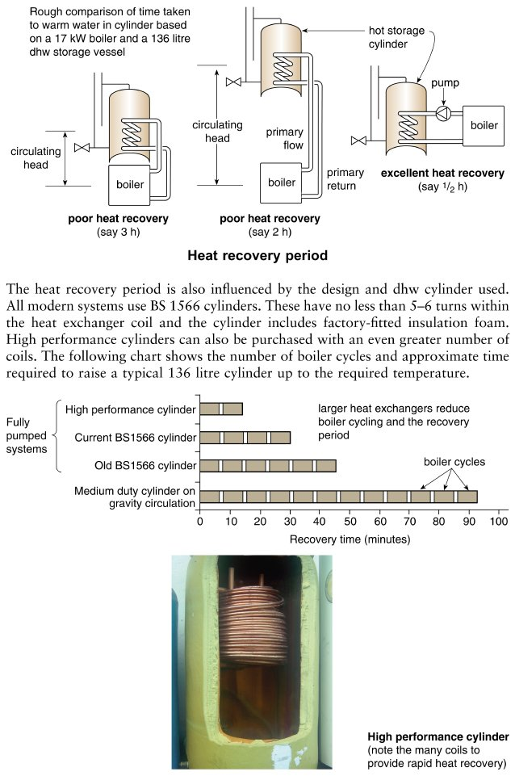
Form Plumbing, 4th Edition. R. D. Treloar. Page 113
© 2012 Blackwell Publishing Ltd. Published 2012 by Blackwell Publishing Ltd.

Slide 16
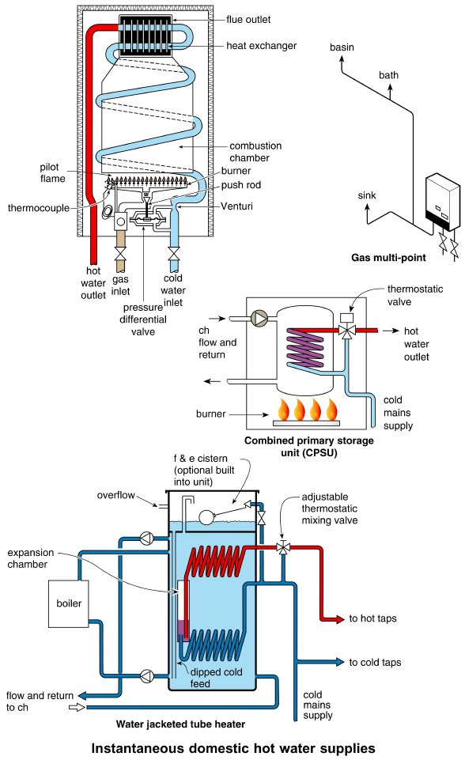
Form Plumbing, 4th Edition. R. D. Treloar. Page 115
© 2012 Blackwell Publishing Ltd. Published 2012 by Blackwell Publishing Ltd.

Slide 17
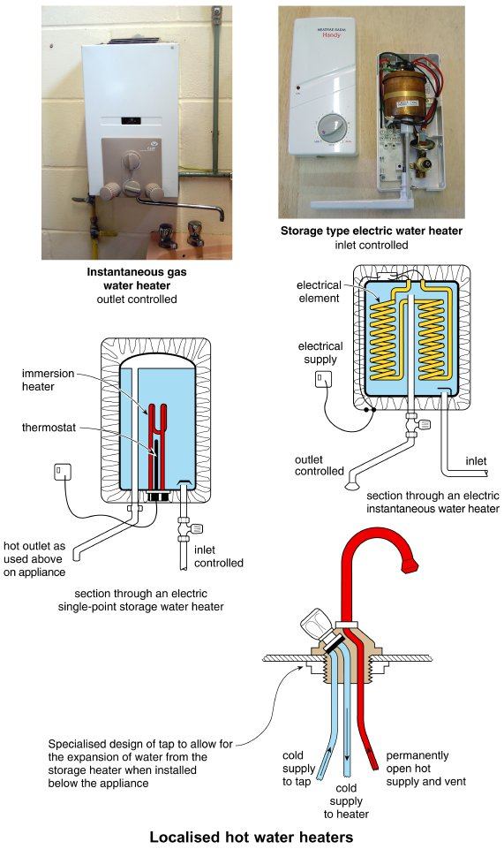
Form Plumbing, 4th Edition. R. D. Treloar. Page 117
© 2012 Blackwell Publishing Ltd. Published 2012 by Blackwell Publishing Ltd.

Slide 18
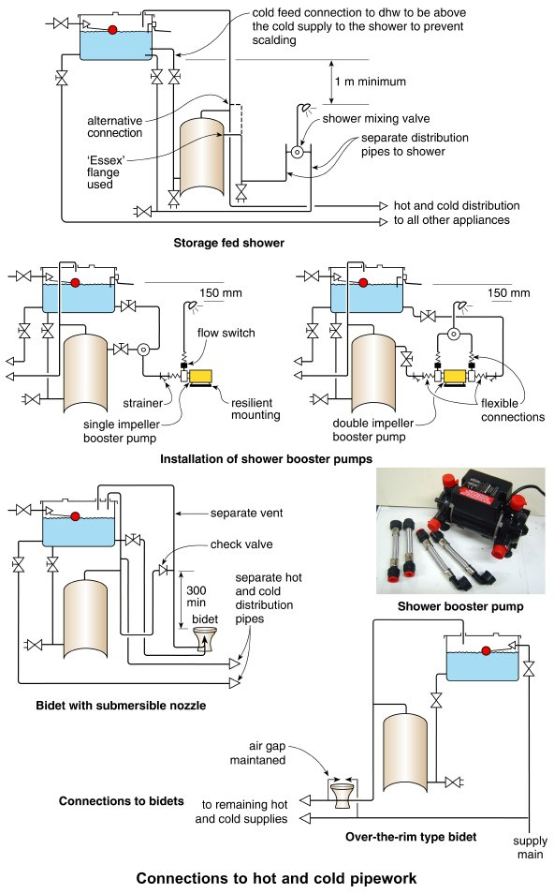
Form Plumbing, 4th Edition. R. D. Treloar. Page 119
© 2012 Blackwell Publishing Ltd. Published 2012 by Blackwell Publishing Ltd.

Slide 19
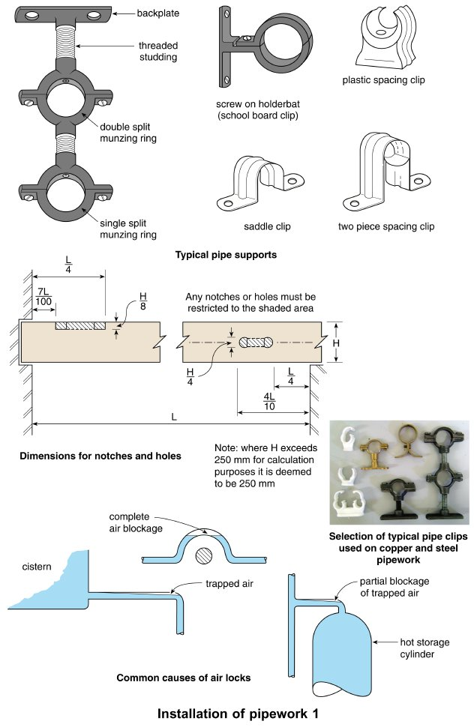
Form Plumbing, 4th Edition. R. D. Treloar. Page 121
© 2012 Blackwell Publishing Ltd. Published 2012 by Blackwell Publishing Ltd.

Slide 20
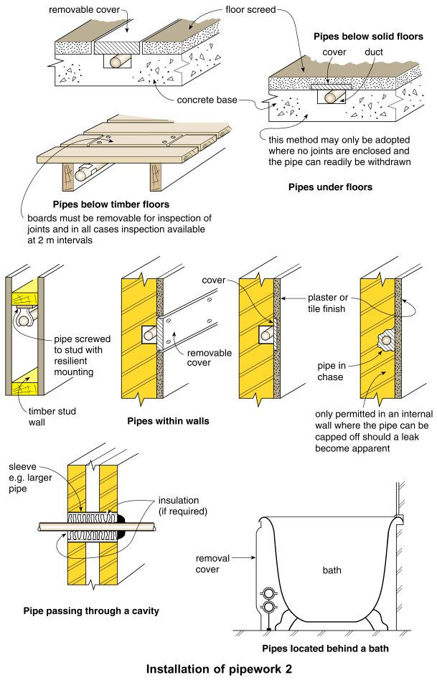
Form Plumbing, 4th Edition. R. D. Treloar. Page 123
© 2012 Blackwell Publishing Ltd. Published 2012 by Blackwell Publishing Ltd.

Slide 21
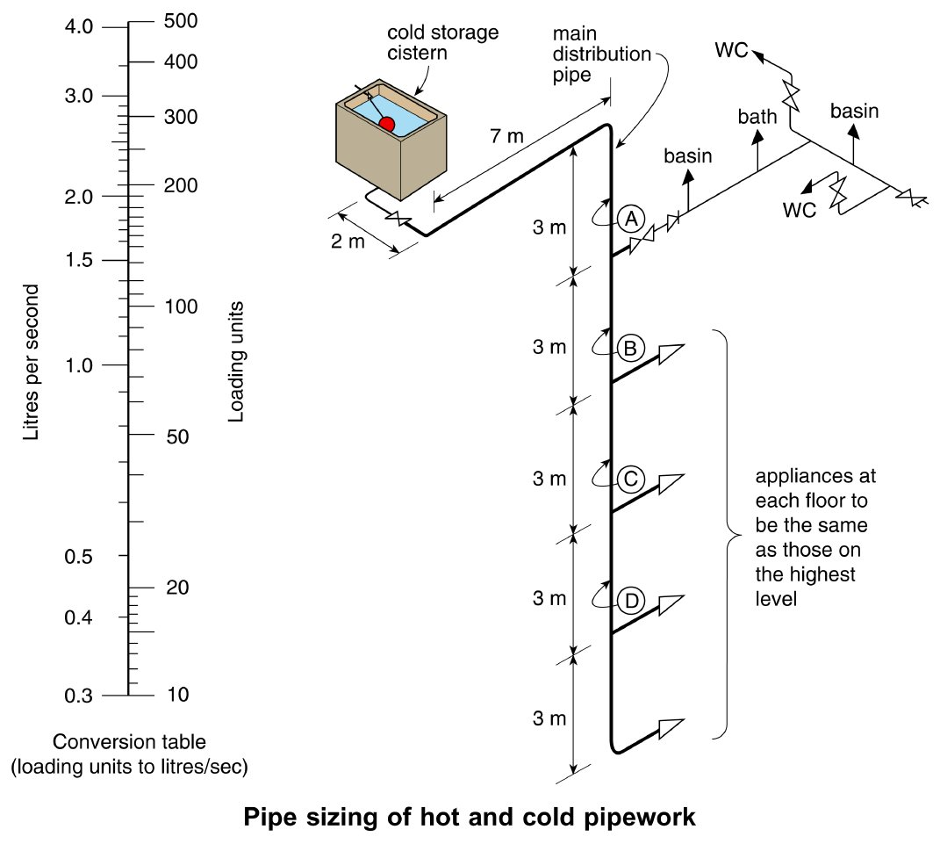
Form Plumbing, 4th Edition. R. D. Treloar. Page 125
© 2012 Blackwell Publishing Ltd. Published 2012 by Blackwell Publishing Ltd.

Slide 22
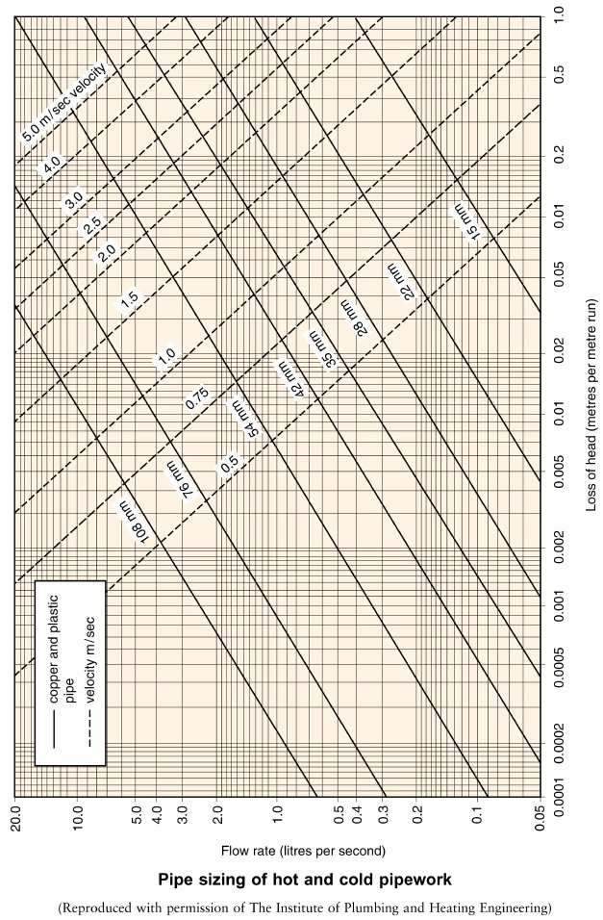
Form Plumbing, 4th Edition. R. D. Treloar. Page 127
© 2012 Blackwell Publishing Ltd. Published 2012 by Blackwell Publishing Ltd.

Slide 23
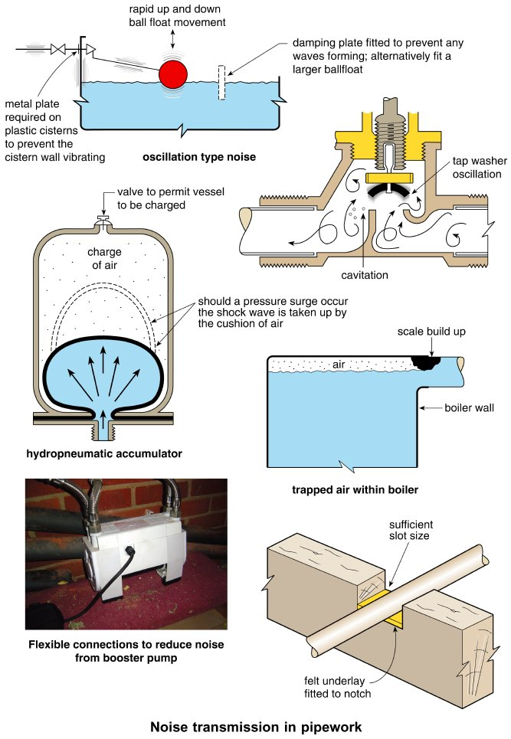
Form Plumbing, 4th Edition. R. D. Treloar. Page 129
© 2012 Blackwell Publishing Ltd. Published 2012 by Blackwell Publishing Ltd.

Slide 24
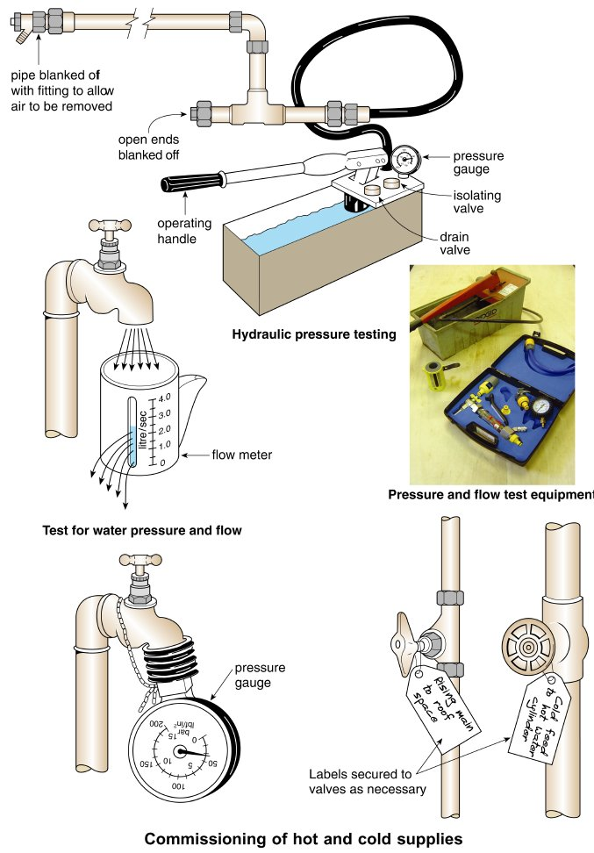
Form Plumbing, 4th Edition. R. D. Treloar. Page 131
© 2012 Blackwell Publishing Ltd. Published 2012 by Blackwell Publishing Ltd.

Slide 25
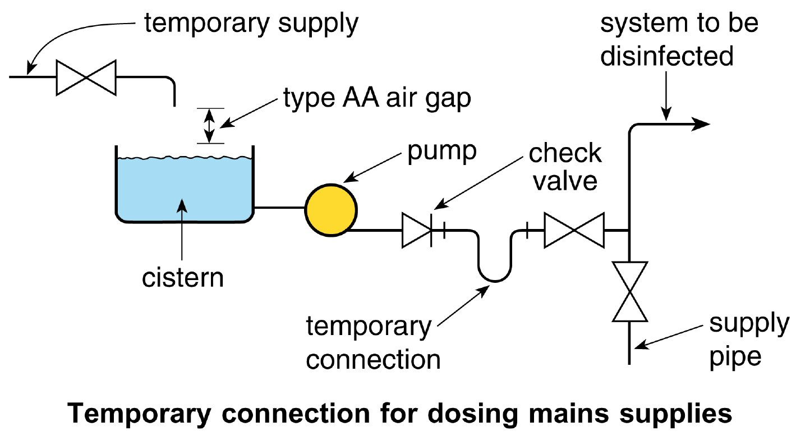
Form Plumbing, 4th Edition. R. D. Treloar. Page 133
© 2012 Blackwell Publishing Ltd. Published 2012 by Blackwell Publishing Ltd.

Slide 26
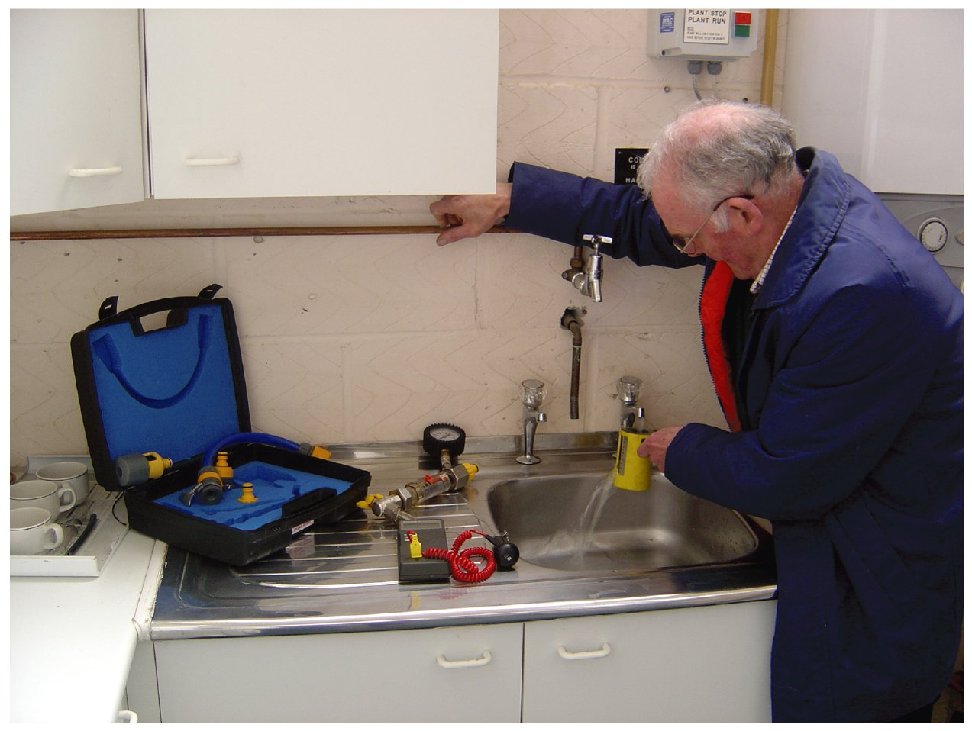
Form Plumbing, 4th Edition. R. D. Treloar. Page 135
© 2012 Blackwell Publishing Ltd. Published 2012 by Blackwell Publishing Ltd.

