Slide 1
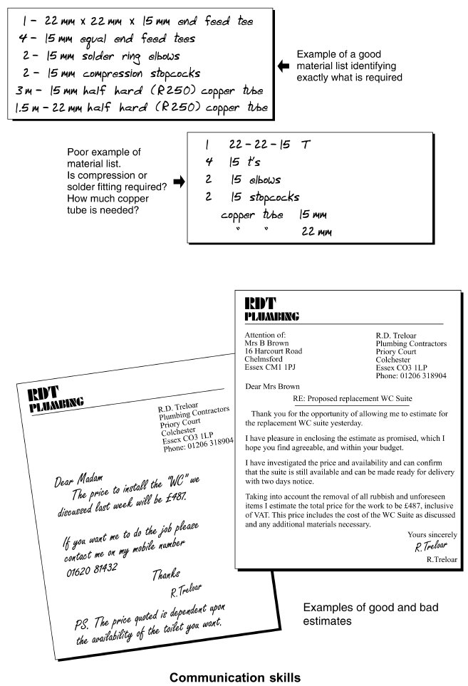
Form Plumbing, 4th Edition. R. D. Treloar. Page 05
© 2012 Blackwell Publishing Ltd. Published 2012 by Blackwell Publishing Ltd.

Slide 2
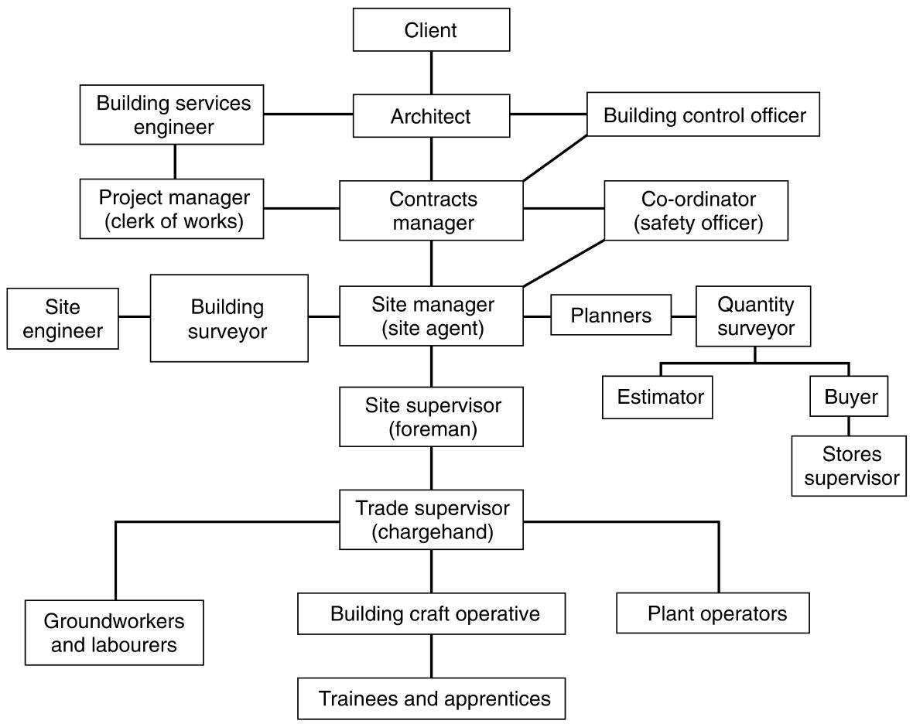
Form Plumbing, 4th Edition. R. D. Treloar. Page 11
© 2012 Blackwell Publishing Ltd. Published 2012 by Blackwell Publishing Ltd.

Slide 3
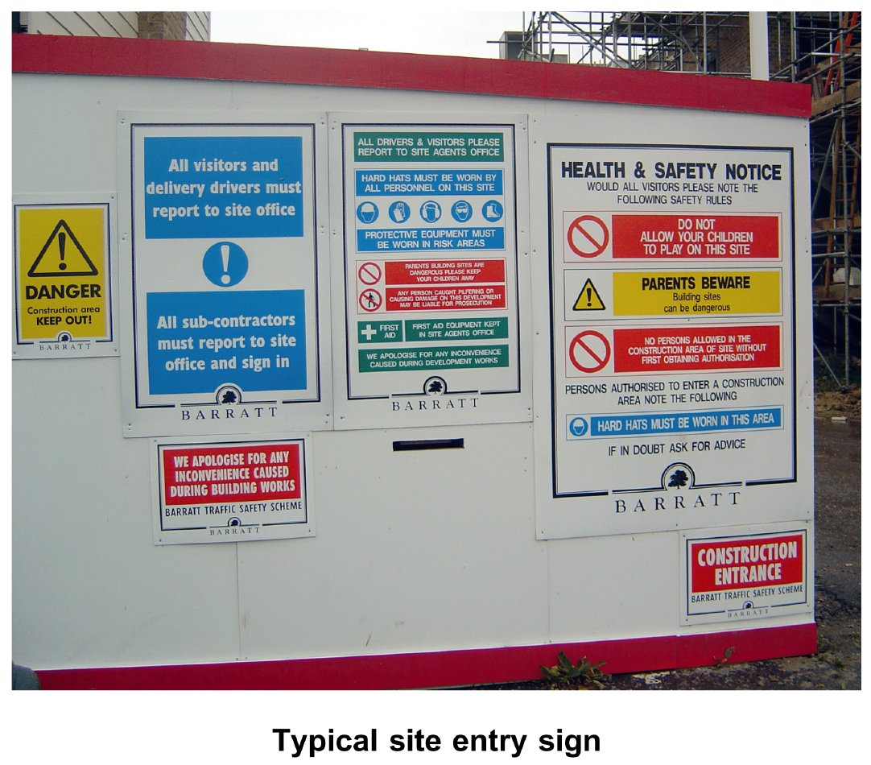
Form Plumbing, 4th Edition. R. D. Treloar. Page 13
© 2012 Blackwell Publishing Ltd. Published 2012 by Blackwell Publishing Ltd.

Slide 4
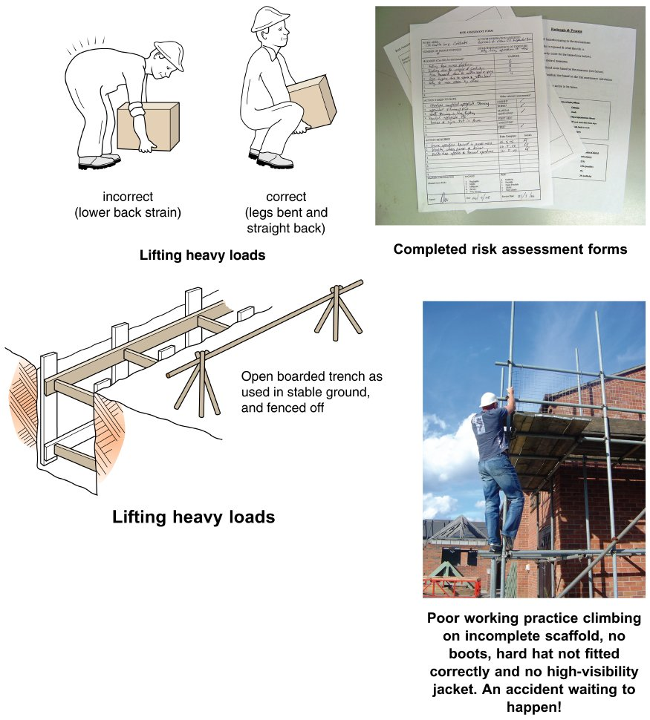
Form Plumbing, 4th Edition. R. D. Treloar. Page 15
© 2012 Blackwell Publishing Ltd. Published 2012 by Blackwell Publishing Ltd.

Slide 5
Form Plumbing, 4th Edition. R. D. Treloar. Page 17
© 2012 Blackwell Publishing Ltd. Published 2012 by Blackwell Publishing Ltd.

Slide 6
Form Plumbing, 4th Edition. R. D. Treloar. Page 19
© 2012 Blackwell Publishing Ltd. Published 2012 by Blackwell Publishing Ltd.

Slide 7
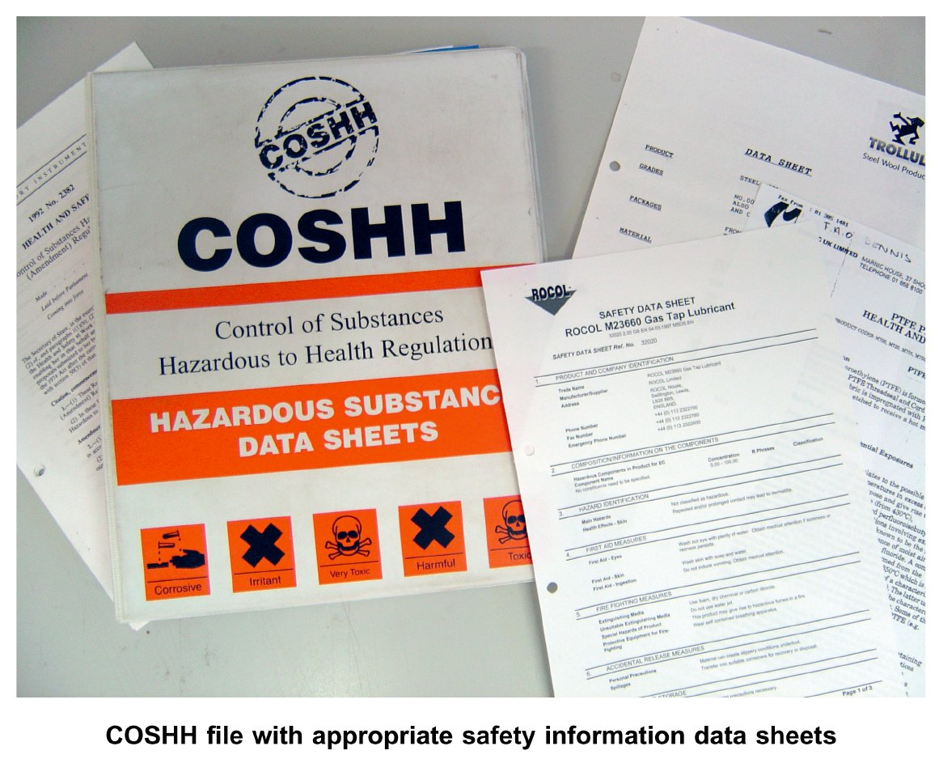
Form Plumbing, 4th Edition. R. D. Treloar. Page 21
© 2012 Blackwell Publishing Ltd. Published 2012 by Blackwell Publishing Ltd.

Slide 8
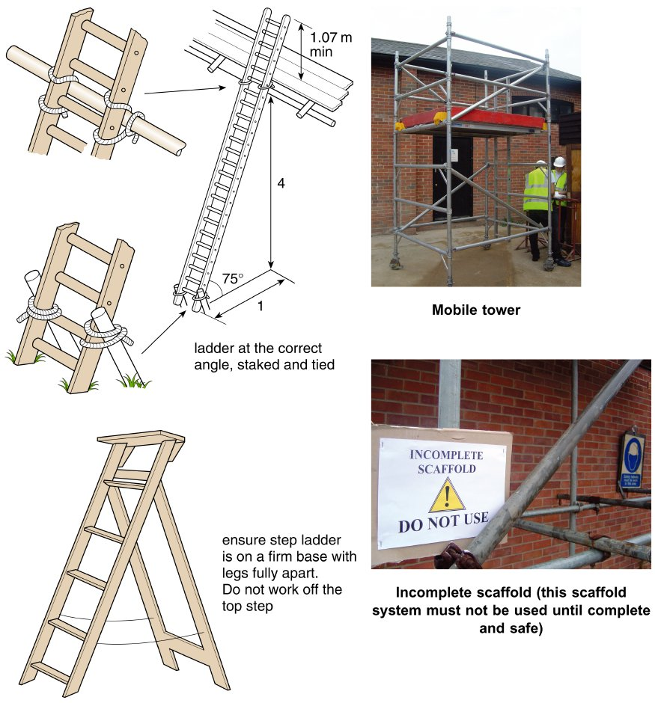
Form Plumbing, 4th Edition. R. D. Treloar. Page 23
© 2012 Blackwell Publishing Ltd. Published 2012 by Blackwell Publishing Ltd.

Slide 9
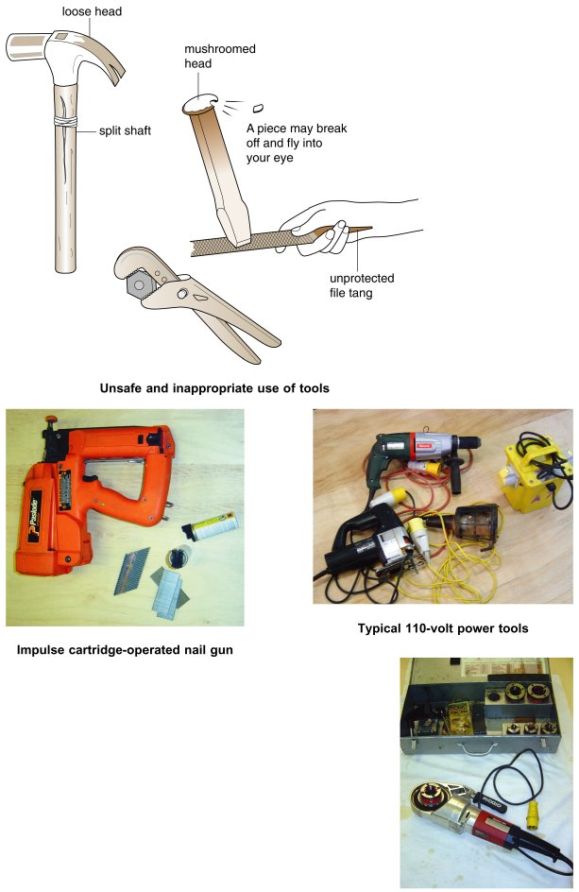
Form Plumbing, 4th Edition. R. D. Treloar. Page 25
© 2012 Blackwell Publishing Ltd. Published 2012 by Blackwell Publishing Ltd.

Slide 10
Form Plumbing, 4th Edition. R. D. Treloar. Page 27
© 2012 Blackwell Publishing Ltd. Published 2012 by Blackwell Publishing Ltd.

Slide 11
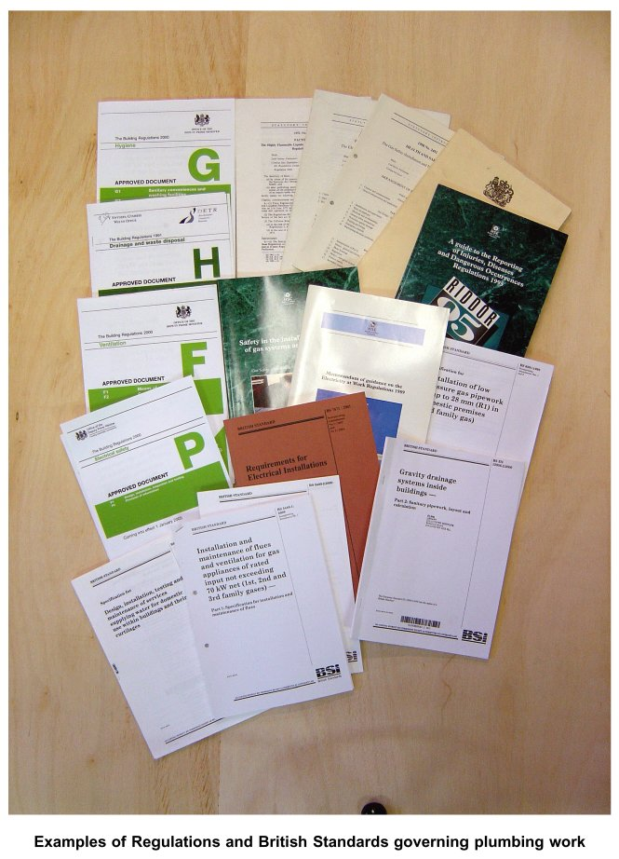
Form Plumbing, 4th Edition. R. D. Treloar. Page 29
© 2012 Blackwell Publishing Ltd. Published 2012 by Blackwell Publishing Ltd.

Slide 12
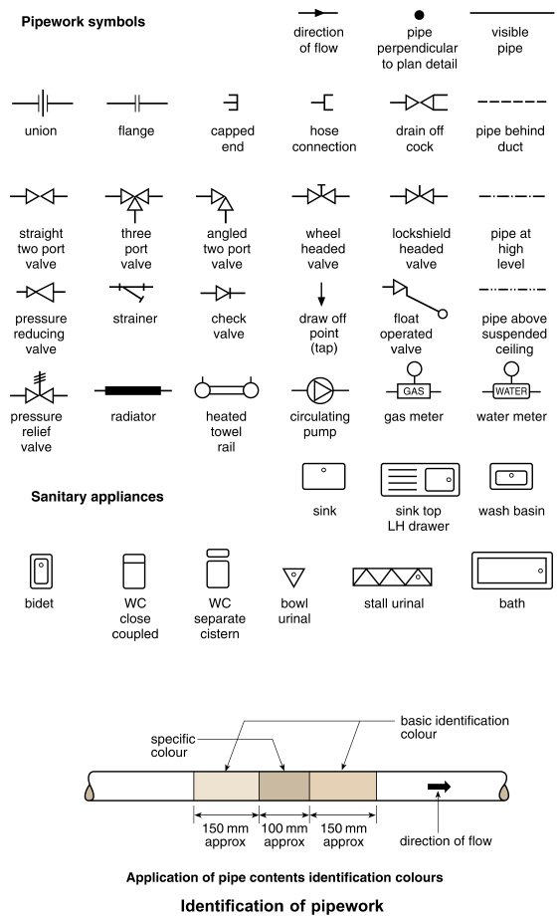
Form Plumbing, 4th Edition. R. D. Treloar. Page 31
© 2012 Blackwell Publishing Ltd. Published 2012 by Blackwell Publishing Ltd.

Slide 13
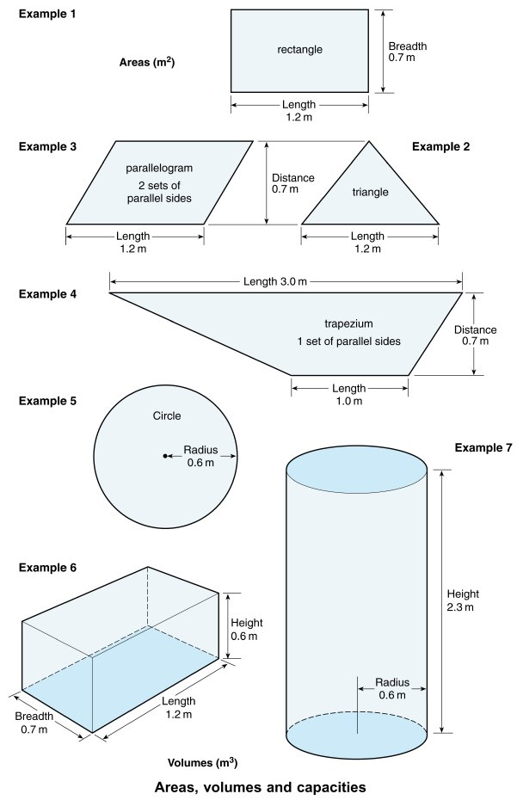
Form Plumbing, 4th Edition. R. D. Treloar. Page 35
© 2012 Blackwell Publishing Ltd. Published 2012 by Blackwell Publishing Ltd.

Slide 14
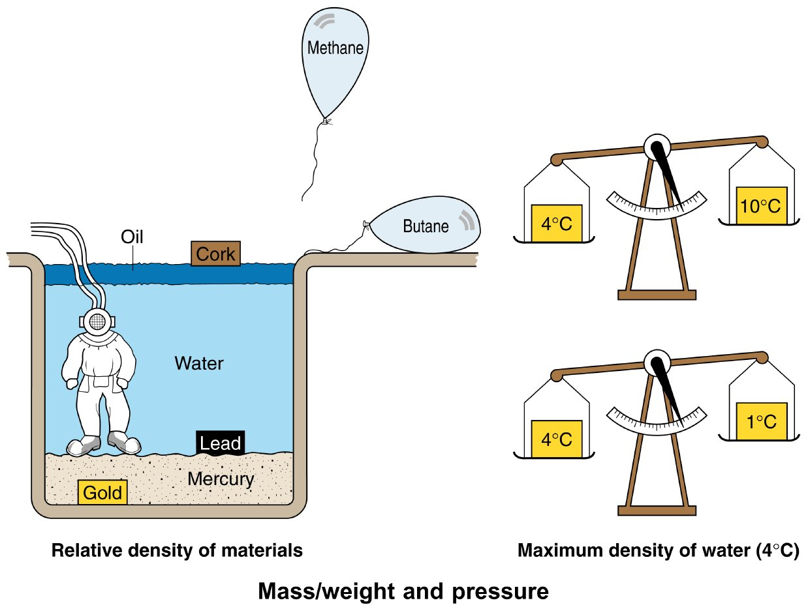
Form Plumbing, 4th Edition. R. D. Treloar. Page 37
© 2012 Blackwell Publishing Ltd. Published 2012 by Blackwell Publishing Ltd.

Slide 15
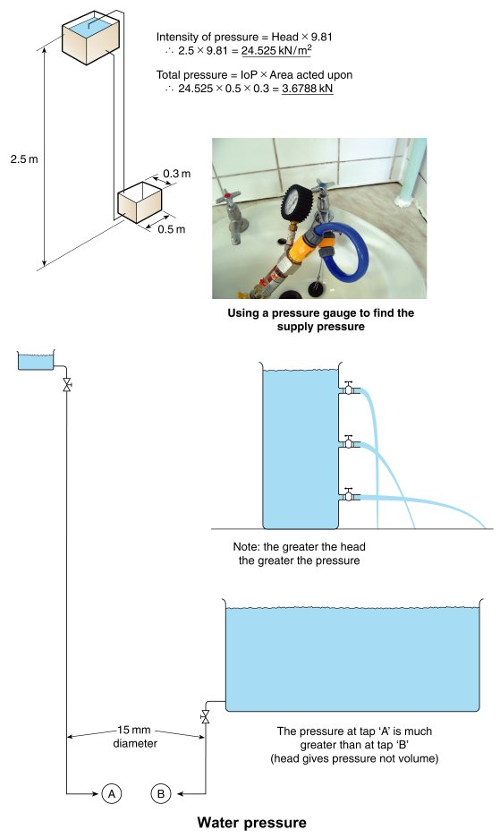
Form Plumbing, 4th Edition. R. D. Treloar. Page 39
© 2012 Blackwell Publishing Ltd. Published 2012 by Blackwell Publishing Ltd.

Slide 16
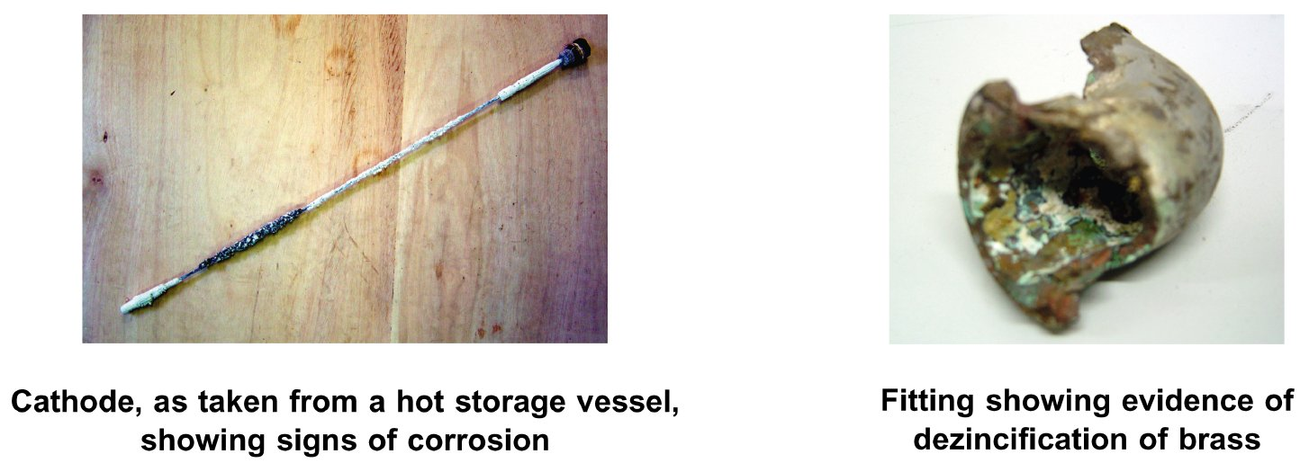
Form Plumbing, 4th Edition. R. D. Treloar. Page 45
© 2012 Blackwell Publishing Ltd. Published 2012 by Blackwell Publishing Ltd.

Slide 17
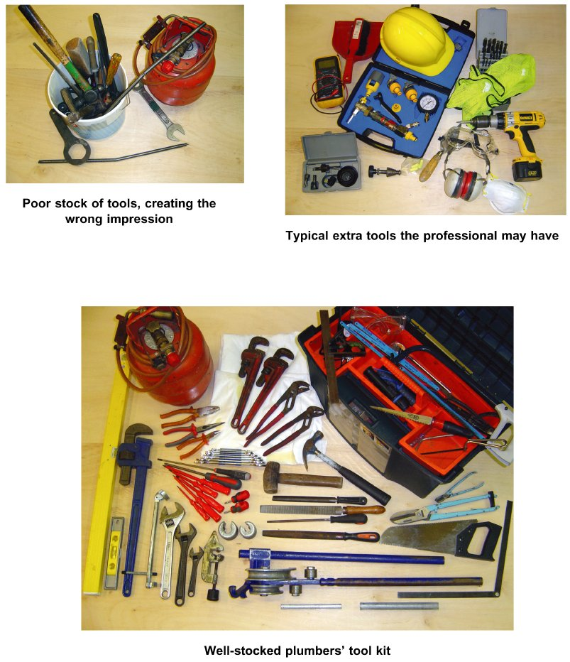
Form Plumbing, 4th Edition. R. D. Treloar. Page 47
© 2012 Blackwell Publishing Ltd. Published 2012 by Blackwell Publishing Ltd.

Slide 18
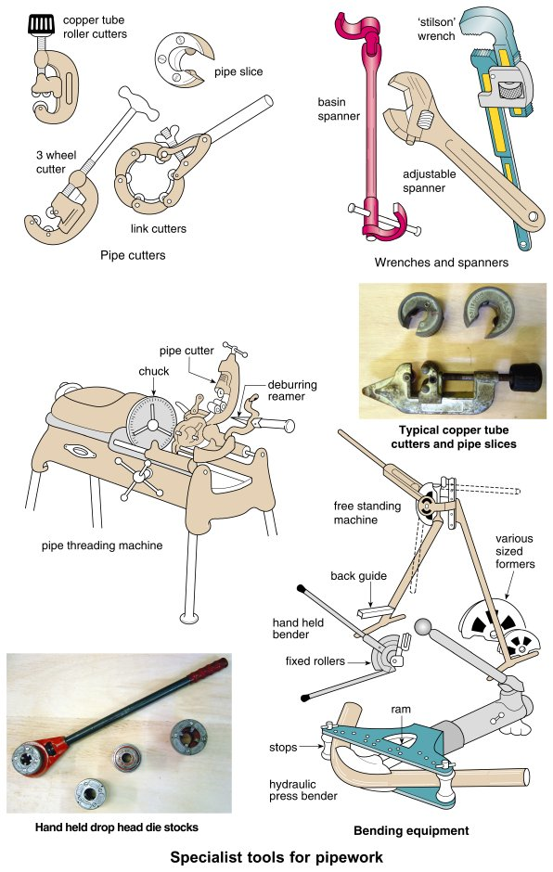
Form Plumbing, 4th Edition. R. D. Treloar. Page 49
© 2012 Blackwell Publishing Ltd. Published 2012 by Blackwell Publishing Ltd.

Slide 19
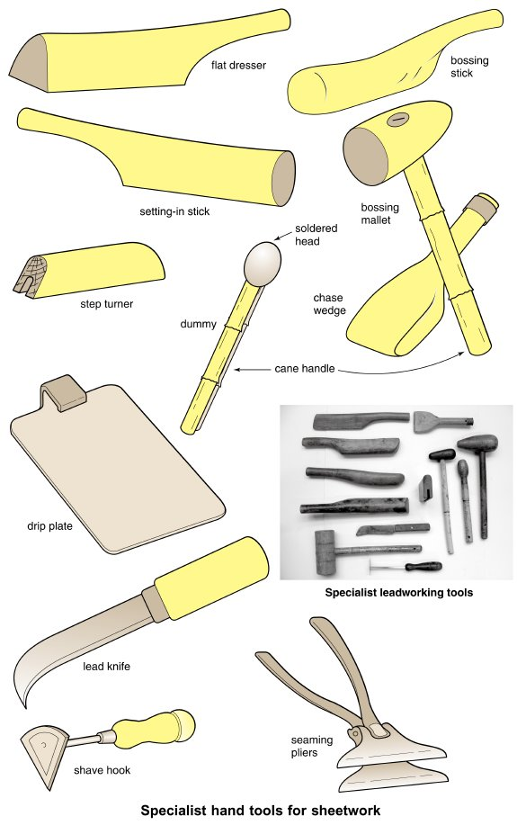
Form Plumbing, 4th Edition. R. D. Treloar. Page 51
© 2012 Blackwell Publishing Ltd. Published 2012 by Blackwell Publishing Ltd.

Slide 20
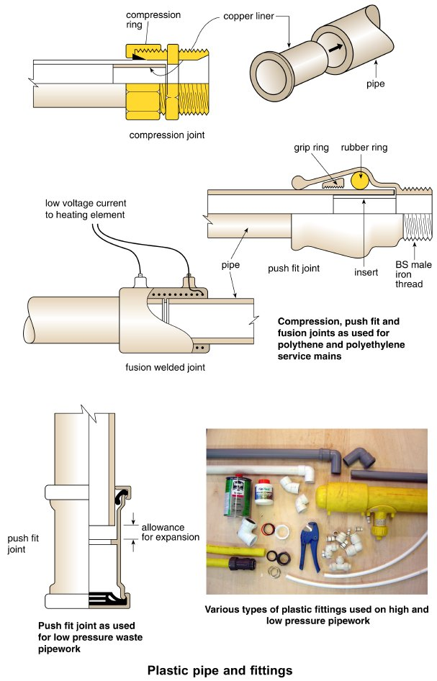
Form Plumbing, 4th Edition. R. D. Treloar. Page 53
© 2012 Blackwell Publishing Ltd. Published 2012 by Blackwell Publishing Ltd.

Slide 21
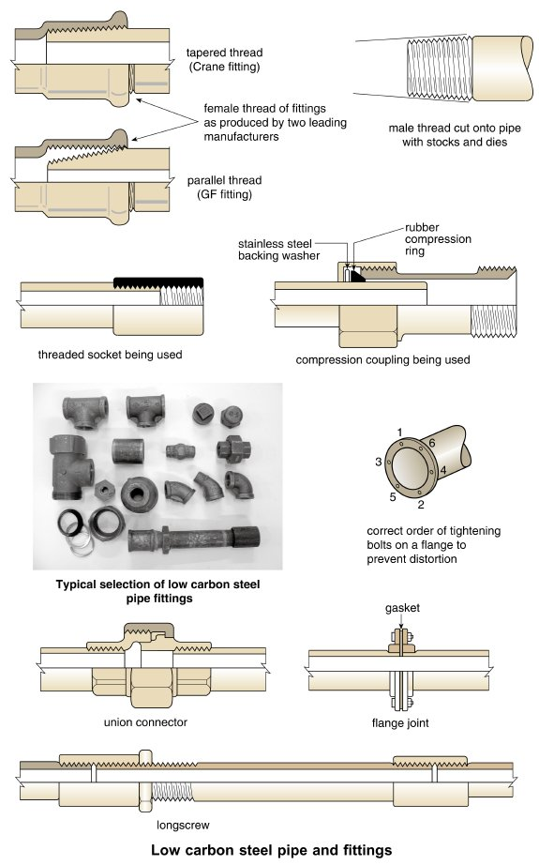
Form Plumbing, 4th Edition. R. D. Treloar. Page 55
© 2012 Blackwell Publishing Ltd. Published 2012 by Blackwell Publishing Ltd.

Slide 22
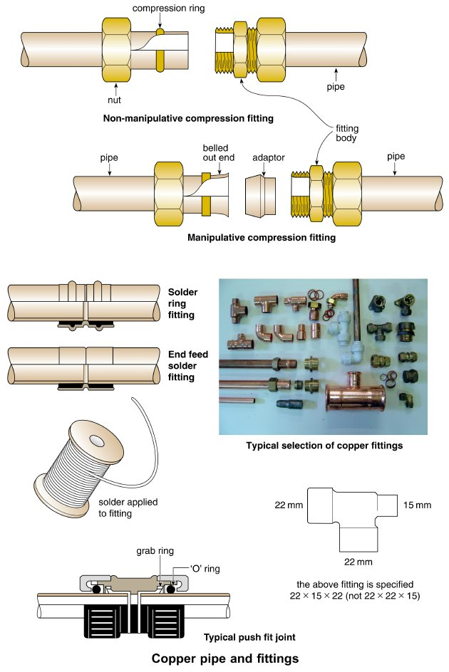
Form Plumbing, 4th Edition. R. D. Treloar. Page 57
© 2012 Blackwell Publishing Ltd. Published 2012 by Blackwell Publishing Ltd.

Slide 23
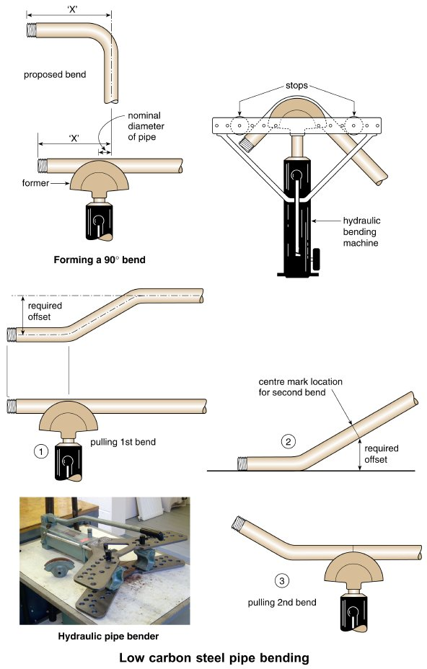
Form Plumbing, 4th Edition. R. D. Treloar. Page 59
© 2012 Blackwell Publishing Ltd. Published 2012 by Blackwell Publishing Ltd.

Slide 24
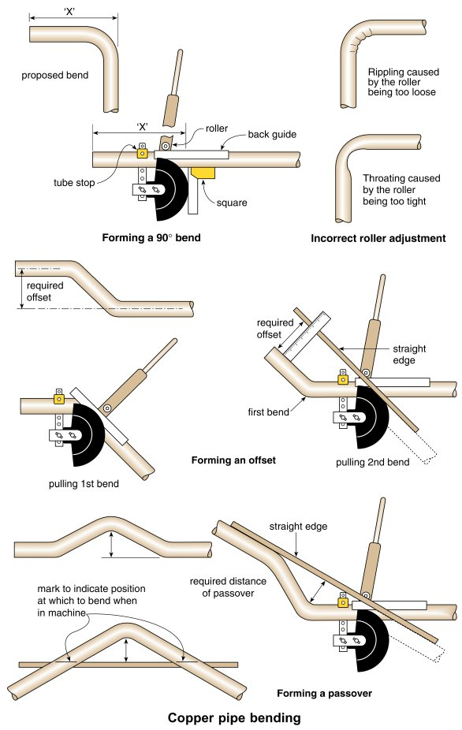
Form Plumbing, 4th Edition. R. D. Treloar. Page 61
© 2012 Blackwell Publishing Ltd. Published 2012 by Blackwell Publishing Ltd.

Slide 25
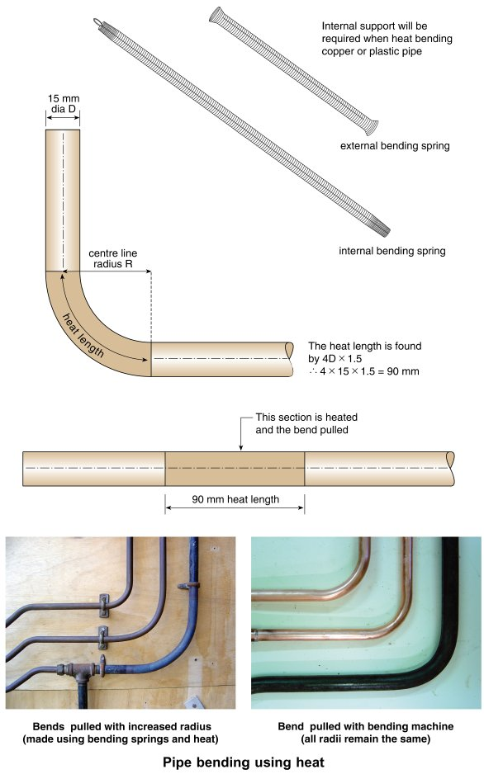
Form Plumbing, 4th Edition. R. D. Treloar. Page 63
© 2012 Blackwell Publishing Ltd. Published 2012 by Blackwell Publishing Ltd.

Slide 26
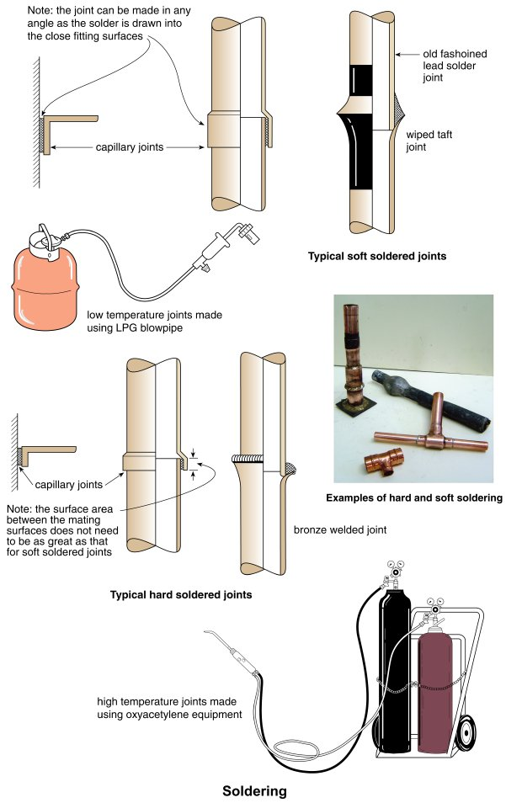
Form Plumbing, 4th Edition. R. D. Treloar. Page 65
© 2012 Blackwell Publishing Ltd. Published 2012 by Blackwell Publishing Ltd.

Slide 27
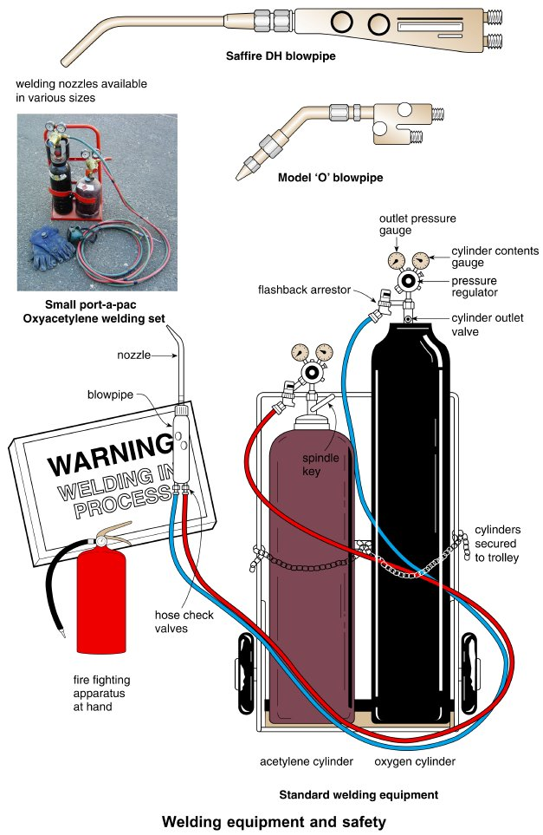
Form Plumbing, 4th Edition. R. D. Treloar. Page 67
© 2012 Blackwell Publishing Ltd. Published 2012 by Blackwell Publishing Ltd.

Slide 28
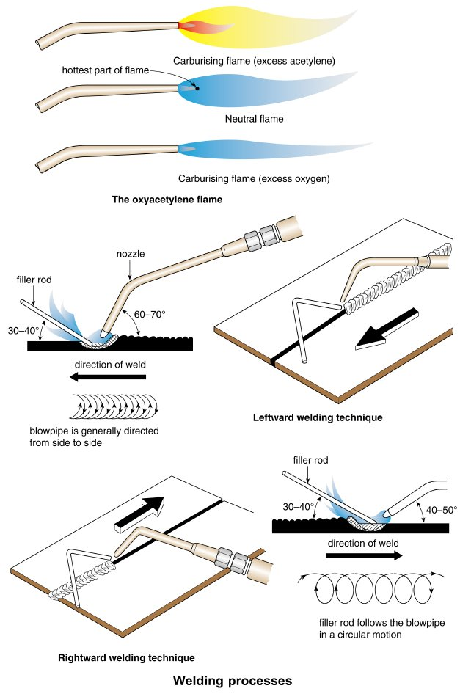
Form Plumbing, 4th Edition. R. D. Treloar. Page 69
© 2012 Blackwell Publishing Ltd. Published 2012 by Blackwell Publishing Ltd.

Slide 29
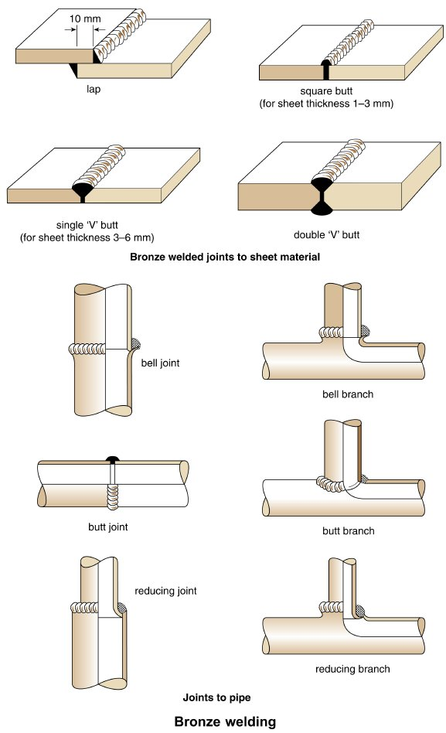
Form Plumbing, 4th Edition. R. D. Treloar. Page 71
© 2012 Blackwell Publishing Ltd. Published 2012 by Blackwell Publishing Ltd.

Slide 30
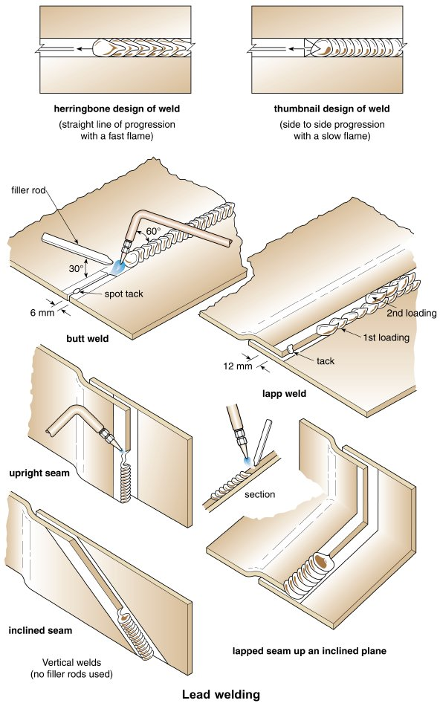
Form Plumbing, 4th Edition. R. D. Treloar. Page 73
© 2012 Blackwell Publishing Ltd. Published 2012 by Blackwell Publishing Ltd.

Slide 31
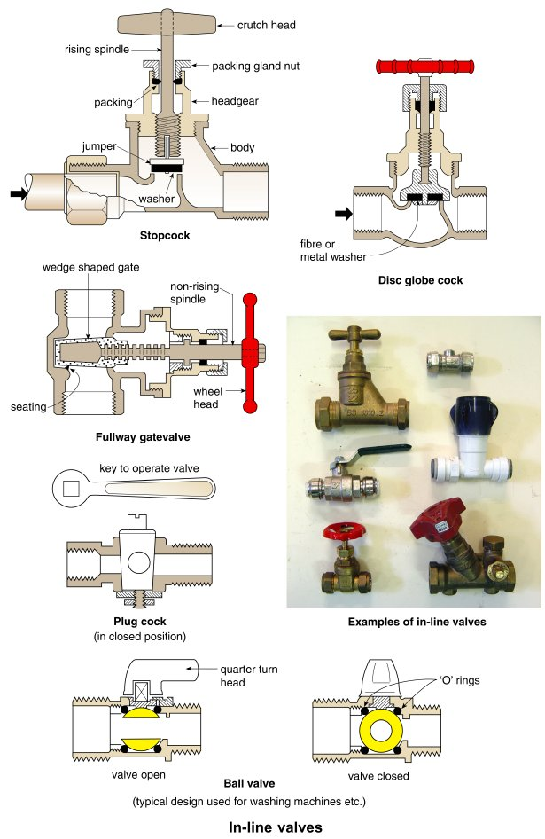
Form Plumbing, 4th Edition. R. D. Treloar. Page 75
© 2012 Blackwell Publishing Ltd. Published 2012 by Blackwell Publishing Ltd.

Slide 32
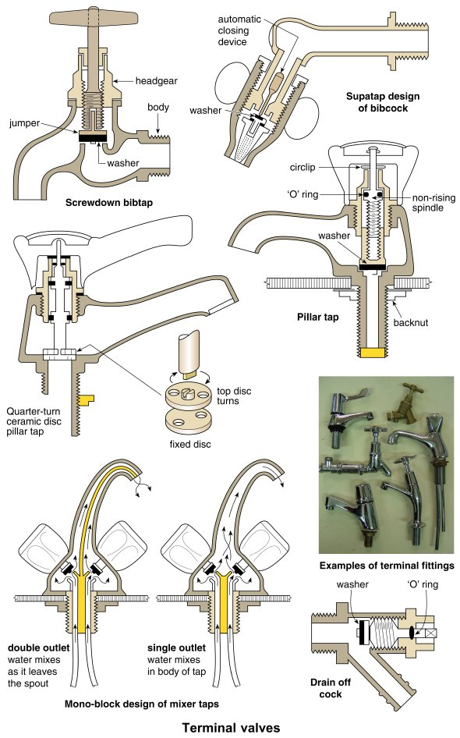
Form Plumbing, 4th Edition. R. D. Treloar. Page 77
© 2012 Blackwell Publishing Ltd. Published 2012 by Blackwell Publishing Ltd.

Slide 33
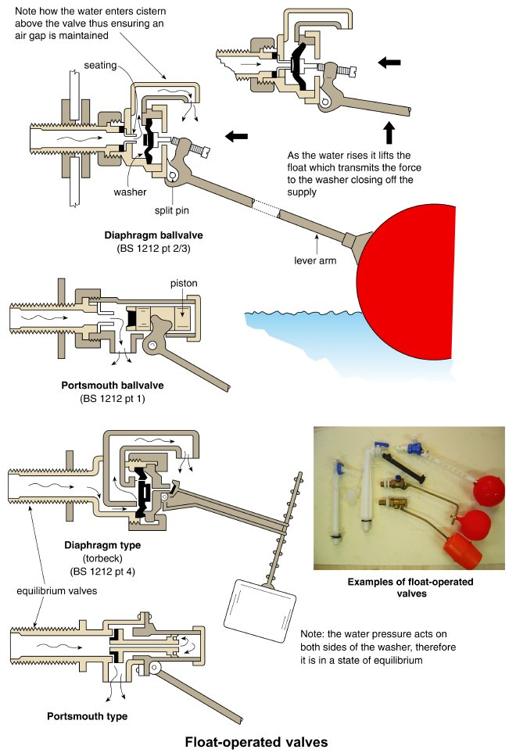
Form Plumbing, 4th Edition. R. D. Treloar. Page 79
© 2012 Blackwell Publishing Ltd. Published 2012 by Blackwell Publishing Ltd.

