Slide 1
Health Communication in the 21st Century
By Kevin B. Wright, Lisa Sparks, and H. Dan O’Hair

Slide 2
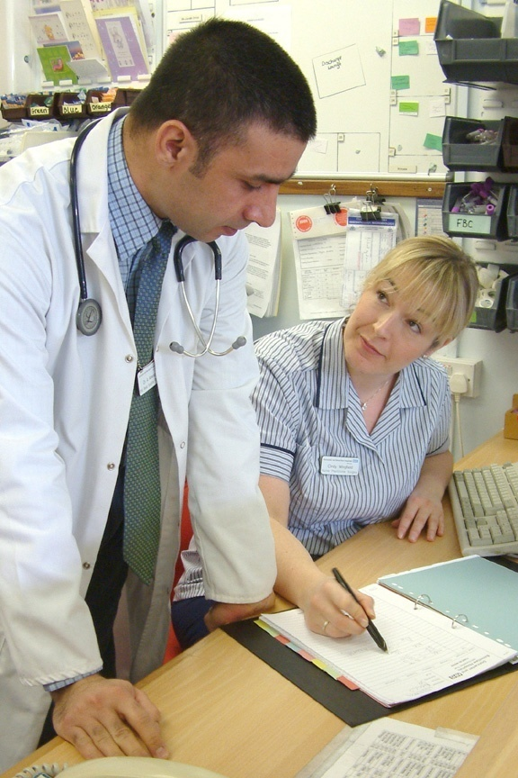
Chapter One
Introduction

Slide 3
Overview
Health communication can be used to study:
provider-patient relationships
relationships and physical health
new communication technologies in healthcare

Slide 4
Why study health communication?
1/2 of deaths in the U.S. are caused by behavioral and social factors.
The rate of mortality in cancer patients could be reduced by 60% if people followed early detection recommendations.
Healthcare, war, poverty, hunger, environmental justice, and lack of education about health issues could be improved

Slide 5
A Brief History of Health Communication Research
Began studying late 1960’s
1972-Therapeutic Communication interest group of the International Communication Association formed
1985-National Communication Association formed
1989-first issue of Health Communication
1996-first issue of Journal of Health Communication

Slide 6
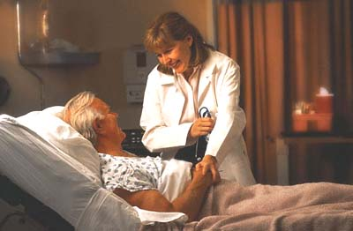
Current Challenges to the Healthcare System and the Role of Health Communication Research
Aging Population
Age expectancy increasing
Negative stereotypes
Health insurance

Slide 7
Current Challenges to the Healthcare System and the Role of Health Communication Research
Cultural Diversity and Healthcare
Perceptions of health
Health disparities
Healthcare access
Health Literacy

Slide 8
Current Challenges to the Healthcare System and the Role of Health Communication Research
Tension Between Traditional and New Approaches to Healthcare
Biomedical model of medicine
Homeopathic treatments
Palliative care

Slide 9
Current Challenges to the Healthcare System and the Role of Health Communication Research
Funding for Health Research
Funding for healthcare going to War on Terror
Funds going to Department of Homeland Security

Slide 10
Current Challenges to the Healthcare System and the Role of Health Communication Research
Changes to Health Insurance and Managed Care
Health insurance rising in cost
High provider turnover rates related to communication

Slide 11
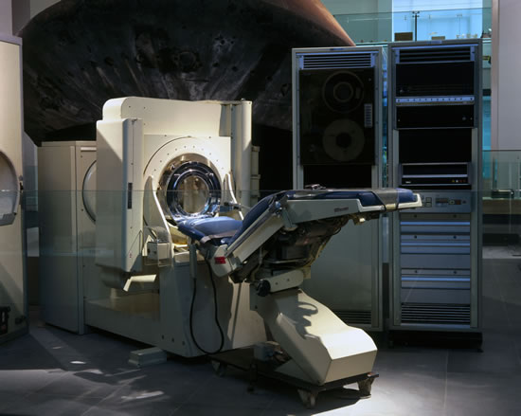
Current Challenges to the Healthcare System and the Role of Health Communication Research
The Impact of New Technologies on Healthcare
Affects how we communicate
Some people lack skills or access to technology

Slide 12
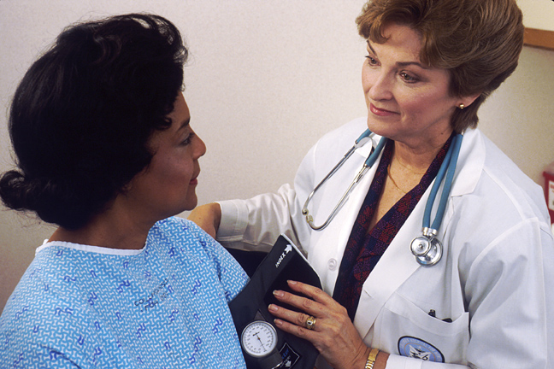
Chapter Two
Provider-Patient Communication

Slide 13
Provider Perspective
Provider Training
Medical doctors respected because of education level
4 years of medical school
Internship
Residency

Slide 14
Provider Perspective
Provider Communication Skills Training
AMA implementing communication tests to training
Medical students argue communication skills are common sense
Female medical students are found to communicate better than males

Slide 15
Provider Perspective
Provider Perceptions of Patients and Communication: Assessing Patient Cues
Age, race, gender, and physical cues can communicate to a provider.
Providers can engage in selective perception when communicating with patients.

Slide 16
Patient Perspective
Patient Perceptions and Expectations
Paternalistic view: patients believe that the provider should take control in a health situation.
Consumeristic view: patients believe they should ask questions and take control in a health situation.

Slide 17
Patient Perspective
Patient Uncertainty
Technical language
Providers can misdiagnose
Receiving large amounts of information while trying to stay positive
Patient Needs and Goals
Provider must show concern
Provider must take patient seriously
Provider must give emotional support

Slide 18
Communication Accommodation Theory
When we are communicating with people we modify or adjust our communication to fit in with whomever we are communicating with.
Convergence: adapt our communication to emphasize similarities in terms of speech, gestures, topics, etc.
Divergence: shows differences between ourselves and other individuals based upon differences in social groups.

Slide 19
Improving Patient-Provider Communication
Addressing Patient Concerns
Providers should:
Not interrupt patients
Ask open-ended questions
Avoid patronizing
Not use too many technical terms

Slide 20
Communication and Medical Malpractice Suits
Between 1995 and 2000, medical malpractice rates rose 70%
Causes insurance rates to skyrocket
Most patients claimed bad communication with provider

Slide 21
Chapter Three
Caregiving and Communication

Slide 22
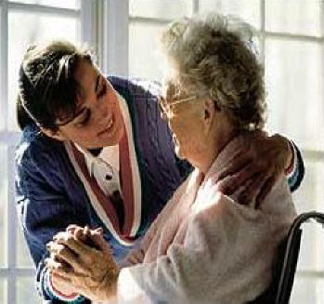
Caregiving
Roles of Caregivers
Communication can affect patient’s health
Increased stress as patient gets closer to death and requires more attention on top of everyday tasks.

Slide 23
Caregiving
Communication issues surrounding symptom management
Patient should communicate level of pain to caregiver
Caregiver should be careful of either over-medicating or under-medicating a patient who cannot communicate pain
Caregiver should rely on non-verbal cues if patient cannot communicate pain

Slide 24
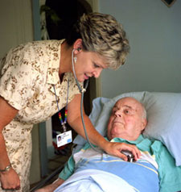
Hospice and Palliative Care
Hospice Services and Care
Most have hospice in their home, however facilities are available
Hospice teams provide patients with ways to cope with death emotionally, psychosocially, and spiritually

Slide 25
Hospice and Palliative Care
Palliative Care
Palliation is any treatment that relieves pain and suffering
Curative care is treatment that prolongs life
Hospices utilize palliative care to make the last days of life comfortable
Limited by insurance reimbursement restrictions

Slide 26
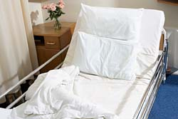
Attitudes Towards Death and Dying
Communicating with Others About Death and Dying
Advance care directives: legal documents that tell family members what the patient wants after he/she dies
Come in many forms: instruction directives, proxy directives, non-detailed directives, and disease detailed directives

Slide 27
Attitudes Towards Death and Dying
Coping with the Death of a Loved One
Reactions to grief:
Everyone reacts to grief differently, whether it be a loss of appetite or simple shock.
Grieving period varies between each individual, and thoughts of the loved one can either bring on joy or sadness.
Some may react to grief negatively, such as depression or substance abuse.

Slide 28
Chapter Four
Social Support and Health

Slide 29
Types and Functions of Social Support
Instrumental support: offers tangible types of support to loved ones.
Emotional support: listening to a loved one’s troubles.
Esteem or appraisal support: given when a person is feeling stressed and one can validate their stressful situation.
Informational support: information you receive from a friend involving relationship advice.
Proactive support: a type of assistance that helps someone circumvent their problems.
Reactive support: helps someone who is having a disruption from normal life events.

Slide 30
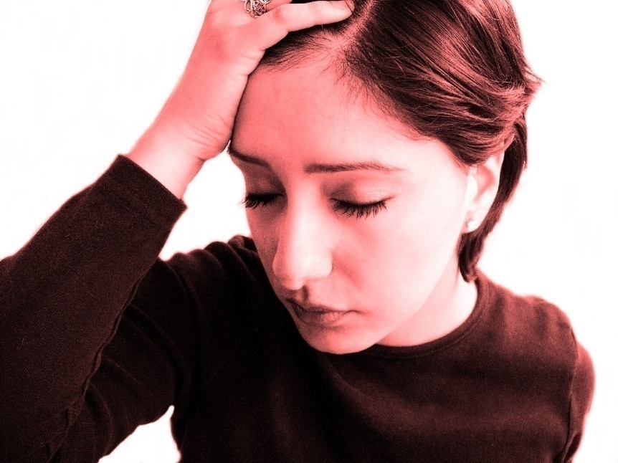
Models of Social Support and Health
Stress and Social Support
Buffering model of social support: social support can protect individuals from the negative effects of stress
Main effects model of social support: direct relationship between social support and physical and psychosocial outcomes
Relationship between social support and health varies between individuals depending on coping styles and adaptation to stressful situations.

Slide 31
Models of Social Support and Health
Coping Strategies and Health Outcomes
Problem-focused: an action-taking strategy to coping with stress.
Emotional-focused: venting one’s frustrations to an individual.
Avoidance-focused: ignoring the stressful issue.

Slide 32
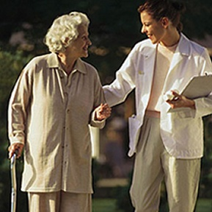
Perceptions of Support Providers
Reciprocity and social support
Equity theory: individuals feel underbenefitted when there are more costs than rewards in a relationship, and vice versa when they feel overbenefitted.
Caregivers may feel underbenefitted, and patients being cared for may feel overbenefitted.

Slide 33
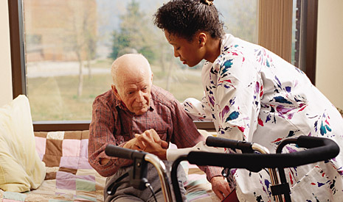
The Role of Communication in the Social Support Process
Social support provider can either:
Solve the problem
Support emotionally
Dismiss problem
Escape from issue

Slide 34
Support Groups for People with Health Concerns
25 million Americans use support groups
Some affiliated with hospitals
Some more independent

Slide 35
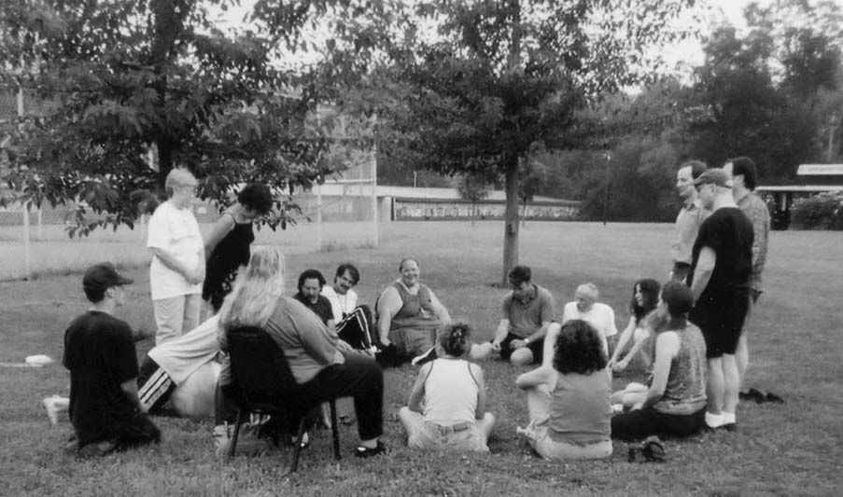
Support Groups for People with Health Concerns
Reasons Why People Join Support Groups
Many feel that they are not being treated supportively socially
Without support, an individual increases their chances of having an inadequate immune system, longer recovery time, disease vulnerability, and higher stress levels
Difficulties communicating about illness within traditional social networks

Slide 36
Communication Processes Within Support Groups
Use of Narrative
A person’s personal story about their life and dealing with their disease
Told in a sequence, giving listeners a perspective of different stages of disease
Being Helped by Helping
Other members help to cope with physical, psychological, and social issues
Sense of self-worth in sharing stories and helping others cope

Slide 37
Chapter Five
Cultural and Diversity Issues in Healthcare

Slide 38
Patient Diversity
Many minority groups lack income needed for healthcare
Language barriers can lead to miscommunication

Slide 39
Cultural Differences in Concepts of Health and Medicine
Cultural differences in attributions of illness/health
Some cultures believe evil spirits are the cause of disease and illness, or take a more fatalistic approach to disease
Many cultures not familiar with normal medical procedures such as surgery or blood transfusions, which causes apprehension

Slide 40
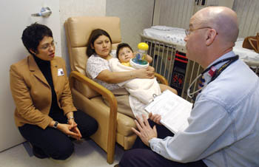
Cultural Differences in Concepts of Health and Medicine
In the U.S., everyone has the legal right to be fully informed about their health condition.
In some cultures, it is customary to inform the patriarch in the family of a patient’s condition and let them decide the course of action to take.
Medical interpreters tell the diagnosis of the patient correctly while respecting their culture simultaneously, which can lead to miscommunication.

Slide 41
Alternative Medicine
Herbal remedies, acupuncture, osteopathy, chiropractics, yoga, massage, guided imagery, and therapeutic are becoming popular
Many dismiss alternate medicine
Someone with a good prognosis will often choose biomedical approaches, while someone who is near death may try alternative medicine

Slide 42
Social Implications of Illness
Stigma and Disease
HIV/AIDS
Media places strong emphasis on sex, many people engage in unprotected sex
First prominent amongst gay men and intravenous drug users, some may view it as unacceptable disease

Slide 43
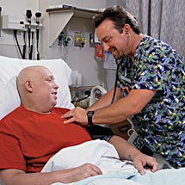
Social Implications of Illness
Stigma and Disease
Cancer
Fear of death produces negative effect on interpersonal relationships
Patients should adopt “agency” approach to achieve self-empowerment

Slide 44
Social Implications of Illness
Stigma and Disease
Alcoholism
“Normal” drinkers look down upon alcoholics because they can’t control their drinking
A person addicted to alcohol cannot control their drinking

Slide 45
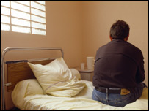
Social Implications of Illness
Stigma and Disease
Mental Illness
Mass media caused mental illness to be perceived as something that only “psychos” would have, and they are thus thought of as dangerous.
The most common mental illnesses do not make an individual dangerous, but because of stereotypes, those with mental illnesses can feel shunned and isolated from others

Slide 46
Changing Social Perceptions of Health Issues through Communication
By changing stereotypical terminology to describe disease patients, some diseases can be changed to be seen in a more positive view.
Narratives told about a particular disease can change how others perceive that disease, depending on how they tell it.
Because many people perceive cancer as a hopeless disease, individuals who get cancer may enact a self-fulfilling prophecy and let cancer win instead of attempting to fight.
Support groups and storytelling can help people to overcome the social stigmas associated with some diseases.

Slide 47
Chapter Six
Communication and Healthcare Services

Slide 48
Healthcare Organizations as Systems
Characteristics of Systems
Different units of a system are interdependent.
Communication between hospitals and other units of health organizations vital in order for hospitals to function effectively.
Systems use homeostasis to balance themselves to fit changing conditions.
Systems must also achieve equifinality, or use different strategies to achieve goals and maintain a sense of equilibrium.

Slide 49
Healthcare Organizations as Systems
Types of Healthcare Organizations
Most are interdependent
Can help manage the cost of healthcare
Investor owned/non-profit can pool resources

Slide 50
Communication within Healthcare Organizations
Organizational information theory and healthcare organizations
Organizational information theory: the ways in which organizations collect, manage, and use information they receive, and that change is a constant that should be confronted regularly.

Slide 51
Communication within Healthcare Organizations
Organizational information theory and healthcare organizations
Cycles include action, response, and adjustment
Downward communication: higher level administrators communicate to lower levels of hierarchy
Upward Communication: lower levels of hierarchy communicate to higher level administrators

Slide 52
Communication within Healthcare Organizations
Organizational information theory and healthcare organizations
Horizontal communication: problems are communicated to administrators who share the same status
Formal communication networks: typically written or oral memos associated with the organization
Informal communication networks: discussed amongst friends in a casual manner

Slide 53
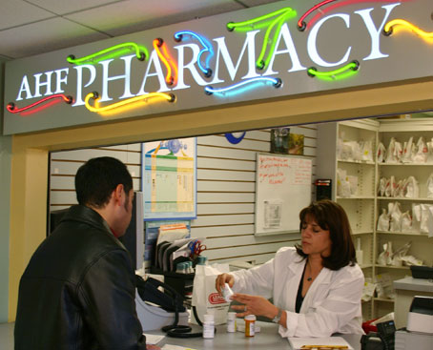
Influences on Healthcare Organization Communication
Pharmaceutical and biotechnology companies
Providers will often prescribe more expensive drugs
Expensive drugs may not be more effective than cheaper drugs

Slide 54
Influences on Healthcare Organization Communication
Healthcare Insurance and Accountability Act
HIPPA passed in 1996
Lower healthcare costs
Safeguard identifiable patient data
Promote e-commerce

Slide 55
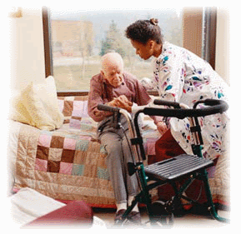
Influences on Healthcare Organization Communication
Medicare and Medicaid
Those on fixed income, with a disability and therefore cannot be employed, or are below the poverty level
Cannot reimburse all expenses for certain medications

Slide 56
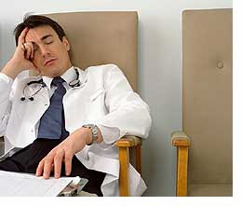
Provider Stress, Conflict, and Support within Healthcare Organizations
Stress and Conflict
Providers work in fast-paced environment
Deal with stress by being argumentative, verbally aggressive, or conflict avoidant
Must engage in unpleasant tasks

Slide 57
Provider Stress, Conflict, and Support within Healthcare Organizations
Effects of Job Stress
Burnout: provider reaches level of emotional exhaustion
More medical errors likely to happen

Slide 58
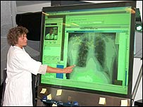
Chapter Seven
New Technologies and Health Communication

Slide 59
Health Information on the Internet
Health Information Access
Use search engines to look up information on illnesses
Credibility
Many choices come up from search engines, often hard to determine which are credible
Literacy Issues/Underserved Populations
Does not benefit those without internet or with low literacy levels

Slide 60
New Technologies and Patient-Provider Communication
Advantages and disadvantages of online support groups
Finding people outside of your area
Many feel inhibited by sex, age, or appearance
Lack of immediate response
Difficulty of expressing emotions

Slide 61
New Technologies and Provider-Provider Communication
Email, wireless/satellite communication, and electronic records
Emailing other providers for medical advice
Satellite technology allows for global communication
Wireless communication eliminates problem of poor handwriting
Electronic records can prompt providers to ask important questions to patients

Slide 62
New Technologies and Provider-Provider Communication
Disadvantages of new communication technologies
Less patient-provider contact
Patients concerned about privacy
Health insurance agencies might use patient’s information to their disadvantage

Slide 63
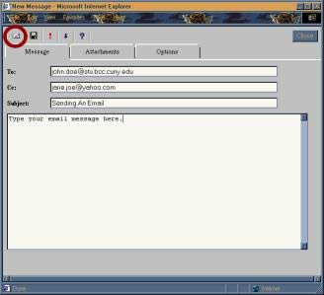
New Technologies and Provider-Patient Communication
Potential for increased provider-patient interaction
Only 9% of people have been found to have emailed their doctors
Many providers feel that giving their email is an invasion of privacy
Patients have more time to compose thoughts with email

Slide 64
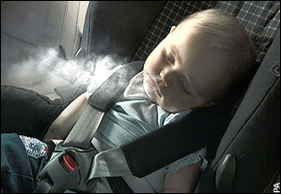
New Technologies and Health Campaigns
Tailoring Health Messages
Increased technology can determine someone’s demographics, psychological characteristics, and communication behaviors
More likely to reach target audience

Slide 65
Chapter Eight
Mass Communication and Health

Slide 66
Two Perspectives of Media Influence
1. Cultivation Theory
First order effects are information that is learned from watching television; second order effects are information that is more generalized and learned from television
2. Uses and Gratifications Theory
The type of media that people concentrate on depends on their various psychological and social needs

Slide 67
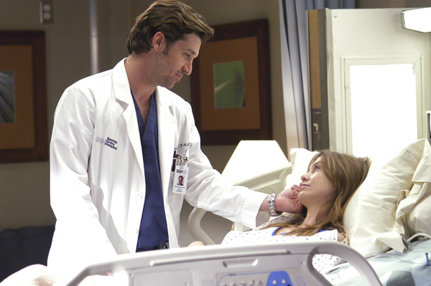
Needs Fulfilled by the Mass Media Concerning Health
Entertainment, diversion, and tension release
TV shows such as ER and Grey’s Anatomy contain relevant information on health
People can mimic good health behaviors as seen on TV

Slide 68
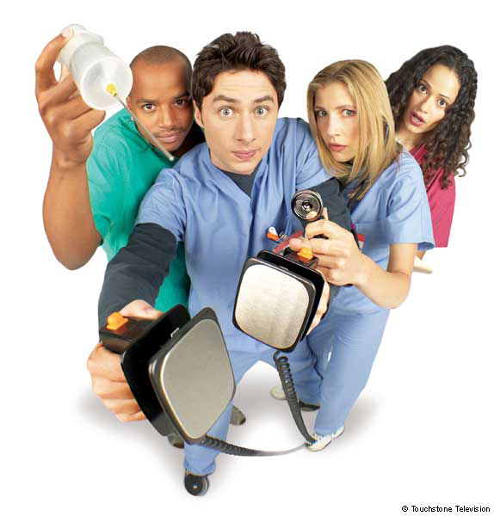
Media Usage, Health Portrayals, and Health Behaviors
Unrealistic portrayals of health situations
Medical procedures more successful than in real life
Provider-patient communication mostly biomedical and not psychosocial
Patients with disabilities treated stereotypically

Slide 69
Media Usage, Health Portrayals, and Health Behaviors
The influence of media on eating habits
Obesity
280,000 U.S. adults die annually from obesity
Food companies use TV to advertise
Eating Disorders
Media places pressure on people to be thin
Most women on TV shows 25% thinner than normal women

Slide 70
Media Usage, Health Portrayals, and Health Behaviors
The relationship between media and substance abuse
Alcohol depicted in an attractive way
Cigar companies claim that smoking cigars is classier and healthier than cigarettes
Cigars are linked to the same health hazards as cigarettes.

Slide 71
Health News Stories in the Media
Problems in the reporting of health news stories
Agenda-setting theory: way of making people perceive a health issue by carefully choosing the selection and display of news story
Underreporting can occur when the media believes that people would not be accepting of learning about a health issue (i.e. STDs)
Overreporting can occur when news stories involve deaths from catastrophic events

Slide 72
Health News Stories in the Media
Media bias and inaccuracies in reporting health issues
Media chooses news stories based on social, cultural, and economic factors
Time limits on stories can exclude valuable health information

Slide 73
Chapter Nine
Risk and Crisis Communication

Slide 74
Defining Risk Communication
Risk Communication: discourse about physical hazards
Income, education, and whether someone is part of a marginalized group decide how to communicate about risk communication

Slide 75
Global and Large-Scale Health Threats
Environmental threats/world hunger
Environment: waste disposal, overpopulation, smog, and pollution
Hunger: stunted growth, susceptibility to disease, cognitive impairment, and early mortality rates

Slide 76
Global and Large-Scale Health Threats
Pandemics
HIV/AIDS
Ways of contracting AIDS vary between regions making it hard to communicate ways of preventing it
SARS/Avian Flu
CDC came up with a crisis management plan to be prepared in the event of another SARS/avian flu outbreak

Slide 77
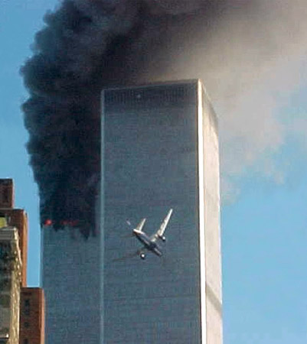
Global and Large-Scale Health Threats
Terrorism
Terrorism’s ultimate goal is to communicate fear in order to achieve their goals
Can lead to many stress related illnesses, post-traumatic stress, and depression

Slide 78
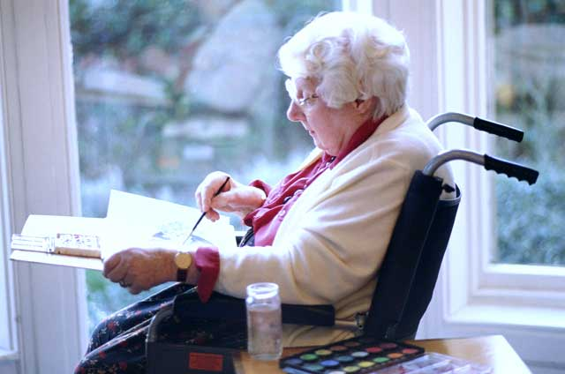
At-Risk Communities within the United States
Risk Factors
Social Status
Infants
Children
Elderly
Single females living alone
Certain racial or ethnic groups
Unemployed
Low incomes

Slide 79
At-Risk Communities within the United States
Risk Factors
Social Capital
Quantity or quality of interpersonal ties among people within a community, and the resources made available to the community
Human Capital
A community’s investments in people’s skills and capabilities that enable them to act in new ways or enhance their ability to be productive members of society

Slide 80
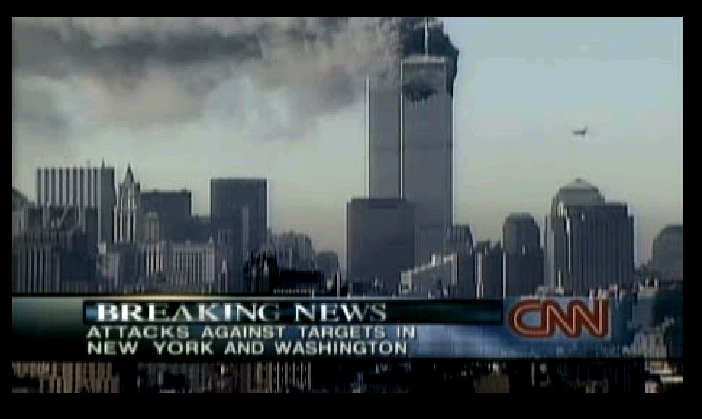
Communication Strategies for Addressing Health Risks
Dealing with the Threat of Terrorism
Coomb’s Four Step Process to Crisis Management:
Prevention
Preparation
Response
Learning
Media should keep public informed about situation

Slide 81
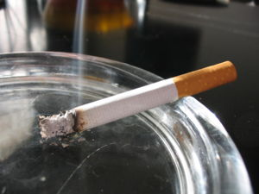
Community-Based Health Initiatives for At-Risk or Marginalized Populations
Health behaviors often linked to group identities, and individuals will most likely act the way their peers act
Community empowerment important
Incorporate community effort

Slide 82
Risk Communication Strategies at the Provider-Patient Level
Physicians can give conflicting messages to patients
Physicians should empathize with patient’s feelings and explain health risks simultaneously

Slide 83
Chapter Ten
Health Campaigns and Community Health Initiatives

Slide 84
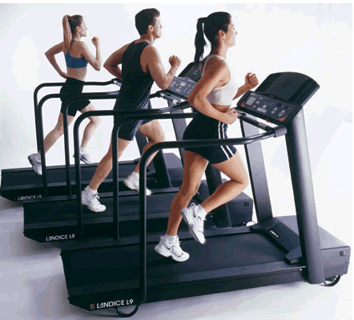
Campaign Goals
Health Awareness and behavioral change campaigns
Behavioral change campaigns: influence individuals to change something they have control over

Slide 85
Theoretical Approaches to Health Campaigns
Social Cognitive Theory
Behavior is the outcome of interaction between cognitive processes and environmental events
An action will lead to a particular outcome
The expectation a person has about his/her ability to perform this action
Environmental influences affect behavior

Slide 86
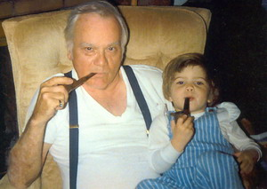
Theoretical Approaches to Health Campaigns
Theory of Reasoned Action
The main predictor of a behavior is an intention to engage in that behavior
Positive or negative attitude towards a health behavior from family/friends can influence how a person feels about a health behavior

Slide 87
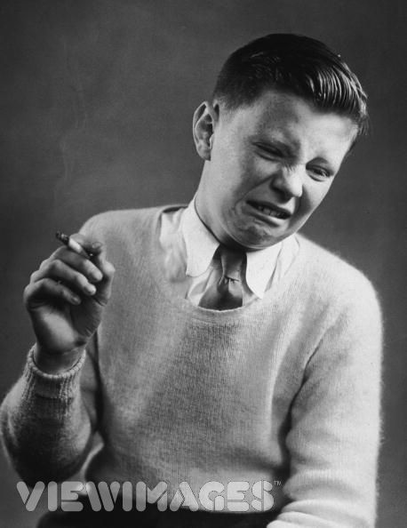
Theoretical Approaches to Health Campaigns
Health belief model
A person’s own assertion of how dangerous and susceptible they are to a health risk
Internal cues: motivations that come from within the individual
External cues: motivations that come from an outside pressure from other individuals

Slide 88
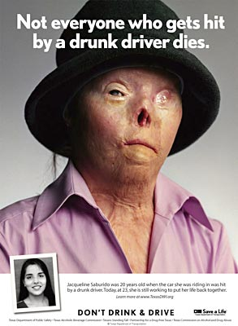
Theoretical Approaches to Health Campaigns
Extended parallel process model
Fear appeals as a motivation for health behavior change
Danger control
Fear control

Slide 89
Theoretical Approaches to Health Campaigns
Stages of change models
Transtheoretical 5 stages of behavioral change:
Precontemplation
Contemplation
Preparation
Action
Maintenance/Relapse

Slide 90
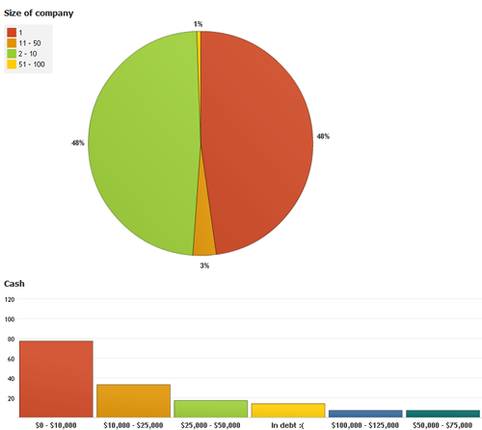
The Process of Conducting a Health Campaign
Audience analysis
Uses available data such as patient records, local and state government’s health related statistics, employee records, etc.
Surveys
Interviews/Focus Groups

Slide 91
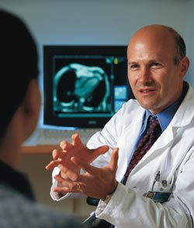
The Process of Conducting a Health Campaign
Creating message content
Getting audience members’ attention through vivid imagery and repetition
Credibility increases when physicians are used
Legal ramifications or repercussions proven more effective

Slide 92
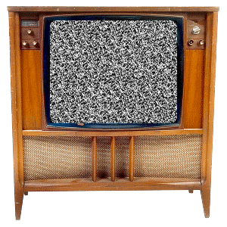
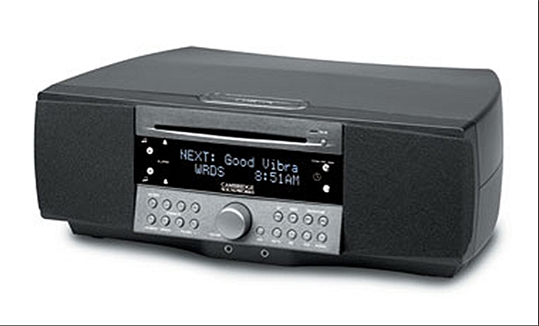
The Process of Conducting a Health Campaign
Channels and message dissemination processes
Radio/Television tend to reach the most people
Interpersonal messages are most effective
Accessibility, depth, economy, and efficiency

Slide 93
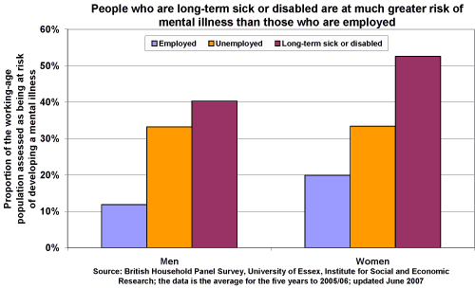
Formative Campaign Evaluation
Pilot Testing
Evaluations can determine how effective campaign was
The Sleeper Effect occurs when a campaign takes a long time to take an effect

Slide 94
Chapter Eleven
Interdisciplinary Healthcare Teams

Slide 95
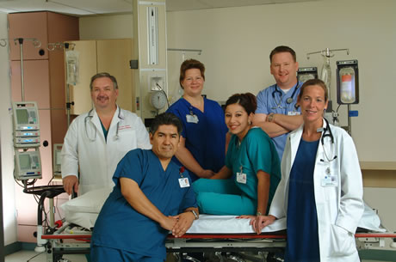
Importance of Interdisciplinary Teams
No one is an expert in all areas of healthcare
Can help evaluate the range of physical, psychosocial, or spiritual health problems
Equal involvement with patient important

Slide 96
Continuum of Healthcare Teams
Unidimensional models allow the physician to make all decisions and other team members are employees of the physician
Multidisciplinary models: use multiple viewpoints depending on healthcare provider’s area of expertise; physician usually makes all decisions
Interdisciplinary models: more equal share of responsibilities on a healthcare team, learn to make compromises, and avoid competition
Transdisciplinary models: identify problems of patients in a consultative and problem-solving way
Synergistic models: healthiest for patients in that they emphasize participation of all members of the team and are patient-centered

Slide 97
Model of Synergistic Healthcare Teams
Instilling a sense of ownership
Building and maintaining trust
Communicating importance of mission keeps commitment of team
Helping others gives sense of accomplishment

Slide 98
Model of Synergistic Healthcare Teams
Becoming performance based
Setting goals that are tangible, meaningful, and performance-based
Rate of accomplishment from goals should be measured
Decision-making should be made after problem identification, clarifying parameters and criteria, generating alternatives, evaluating alternatives, selecting the best option, implementing the option, and, evaluating the results

Slide 99
Developing Team Synergy
Role Congruence
Each team member should know their role
Competent Listening
Indicate listening through non-verbal cues

Slide 100
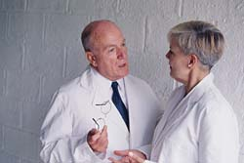
Developing Team Synergy
Participation and Empowerment
“Who,” “What,” “Where,” “When,” and “How,” questions
Conflict Management
Team members can disagree about nature of a health problem

Slide 101
Developing Team Synergy
Consensus building
Set an agenda, employ a time monitor, limit the time it takes to say a comment, make a reward system to having good efficiency
Patient-centered focus
Patient should be more involved in decision making

Slide 102
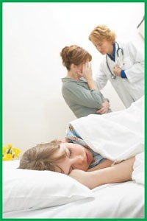
Chapter Twelve
Emerging Health Communication Contexts and Challenges

Slide 103
Health Literacy
The capacity to obtain, process, and understand basic health information and services needed to make appropriate health decisions
Four Components
Cultural and Conceptual Knowledge
Listening and Speaking
Writing and Reading
Numeracy

Slide 104
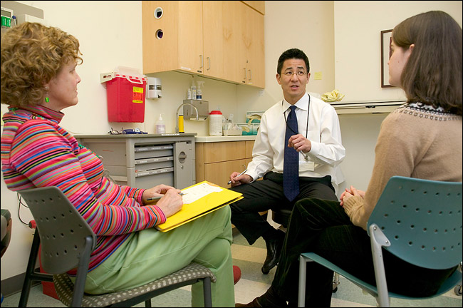
Breaking Bad News
Demographic effects on bad news delivery
Patient’s and provider’s sex, age, ethnicity, and education level can effect how bad news is delivered
Way that a person reacts to bad news depends on their age, familial obligations, and culture

Slide 105
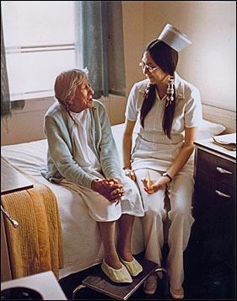
Health Communication and Older Adults
Getting older and experiencing health problems
Elderly more prone to sickness because of lifestyle choices
Some illnesses related to age, but mostly a stereotype

Slide 106
Health Communication and Older Adults
Age-related issues affecting older adult health and healthcare
Presbycusis: age related hearing loss
Alzheimer’s Disease: gradual memory loss that progresses into severity
Physical Activity/Mobility: important to reduce risk of obesity, cardiovascular disease, osteoporosis, hypertension, and certain types of cancer
Polypharmacy: problems that arise from the prescription of an excessive number of medications

Slide 107
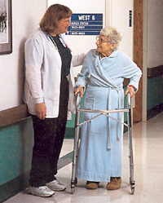
Health Communication and Older Adults
Provider-older patient interaction
Physicians more condescending
Avoid psychosocial concerns
Providers use overaccommodation
Providers should use discourse management
Patient should bring companion

Slide 108
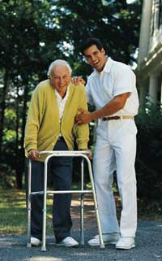
Health Communication and Older Adults
Institutionalized older adults
Nursing staff may lack knowledge to care for severe health issues
Residents lack communication that isn’t task-oriented
Baby talk can lead patients to dependency

